Slide 1
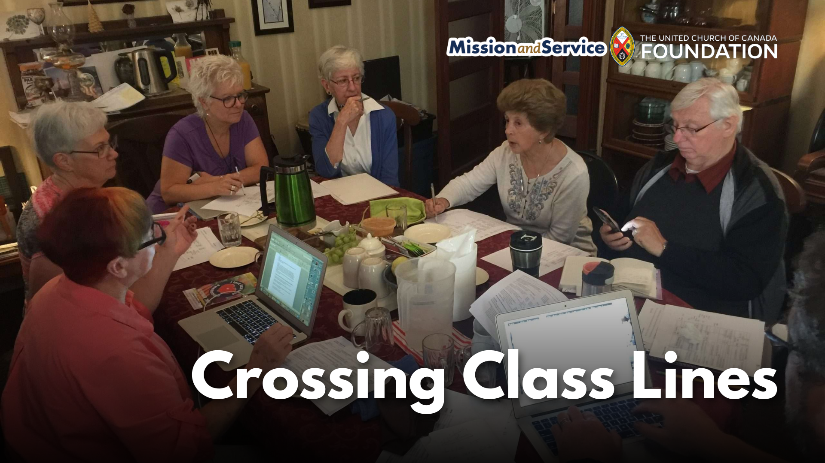

Slide 2
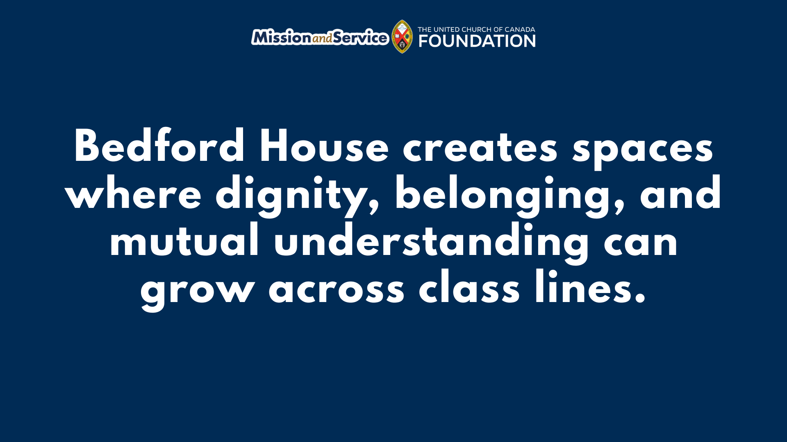
Notes:
The following was written by Jes Smith, Executive Director at Bedford House in Peterborough, ON.
One of the most meaningful parts of our small group Crossing Class Lines: 12-Week Bridging Team program, which ran from February to April this year in Peterborough, Ontario, was something very simple: we shared a meal together before we did anything else.
Each week began around the table with a hearty, home-cooked meal prepared by one of our co-facilitators. Our facilitation team included four facilitators—three with lived experience of poverty and one middle-class staff member—and the meals reflected the care and hospitality they brought to the program. We planned menus that accommodated dietary needs so everyone could feel welcome. Some weeks we shared homemade beef stew with fresh buns; other weeks it was baked macaroni and cheese with vegetarian lentil soup. A few participants also chose to bring food to share, offering what they could as a way of contributing to the community we were building together.
The meal did far more than fill empty stomachs. It created a level playing field. Before conversations about poverty, privilege, and social class began, everyone gathered around the same table, eating the same food. It reminded us that we all have basic human needs, and that sharing food has a remarkable way of breaking down barriers and helping strangers become neighbours. The meal was never about serving one group and helping another. It wasn’t an act of charity – it was mutual hospitality. It was about creating a space where everyone could both give and receive, and where relationships could grow across economic differences with dignity and mutual respect.
More than half of the participants in this program were living in poverty. Many spoke openly about the rising cost of groceries and how difficult it had become to afford healthy food. One participant, who rents a room in a shared house, quietly shared that our weekly meal was the most vegetables she ate all week. She looked forward to coming each Wednesday, not only for the learning and relationships, but because she knew she would receive a nourishing, home-cooked meal prepared with care.
Once we had eaten together, we spent the afternoon learning from one another about the realities of poverty and privilege – the importance of stable housing, access to education, meaningful relationships, and mental health support. The conversations were richer because trust had already begun to grow around the table.
At the end of each week, participants living on low incomes received a $50 grocery gift card in recognition of the invaluable expertise they brought through their lived experience. Their stories and insights were not simply welcomed—they were essential to the learning of the entire group.
In a time when many people feel increasingly isolated and divided, we have witnessed how something as ordinary as sharing a meal can become an extraordinary act of community building. Around a table, people from very different economic backgrounds discover one another's humanity. They listen more deeply, build relationships across differences, and begin imagining what a more connected and compassionate community could look like, together.
The views contained within these blogs are personal and do not necessarily reflect those of The United Church of Canada or United Church of Canada Foundation.

