Slide 1
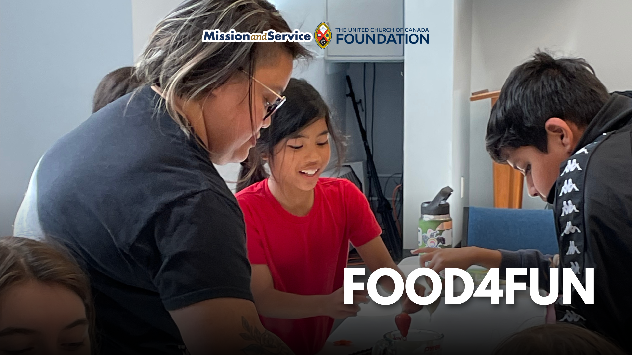

Slide 2
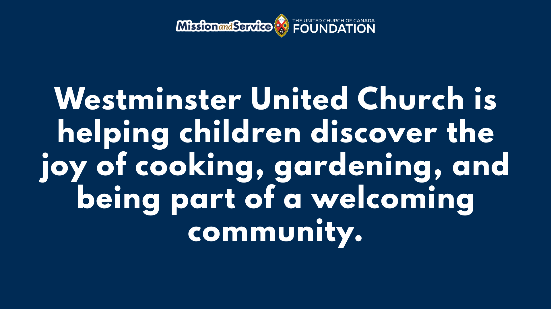
Notes:
Westminster United Church in Orangeville, ON is helping children discover the joy of cooking, gardening, and being part of a welcoming community. Here is the Mission and Service Story for September 13, 2026.
PA Days can be difficult for working parents who are looking for affordable, safe, and engaging activities for their children. For families of children on the autism spectrum, finding programs that are welcoming with appropriate support can be an even greater challenge.
Westminster United Church saw the need, and responded by offering FOOD4FUN, a series of gardening and cooking camps for children ages four to twelve. The program gave children a place to spend their PA Days while learning about food, gardening, and community.
FOOD4FUN brought children into Westminster’s garden, where they could experience food growing at its source. They planted, harvested, explored the garden, and took part in mindful walks. In the kitchen, they prepared food, learned new skills, and shared meals together. Lunch and snacks were provided, and sometimes food was sent home with campers.
The program welcomed children with a wide range of interests, abilities, and needs. Volunteers provided additional support as required, helping create a barrier-free environment where everyone could participate. Some children who didn't regularly spend time outdoors became especially enthusiastic about the garden.
Impact could be seen in things campers said. When a camper, referred to as "M," returned for a second camping session, their first question was: “When are we going outside? I need to visit my special tree.” Other campers were already asking when the next PA Day camp would be held. Campers "S" and "B" were eager to know if they would be growing potatoes again and if they could help with the harvest.
These experiences build more than gardening and cooking skills. Children develop confidence in the kitchen, become more comfortable in groups, build relationships with other campers, and develop a healthy relationship with food. They also have opportunities to build a lasting connection with the land.
FOOD4FUN has also helped Westminster learn more about what is needed to provide accessible and welcoming programming. The congregation is exploring relationships with autism services in Orangeville and is developing plans for a weeklong summer camp for food-insecure families in 2027.
Our gifts through Mission and Service make this work possible. Our support helps congregations respond to needs in their communities and create opportunities for people, especially children, to learn, connect, and thrive.
Let’s give generously so children can continue discovering confidence, skills, and connections that grow.

