Slide 1
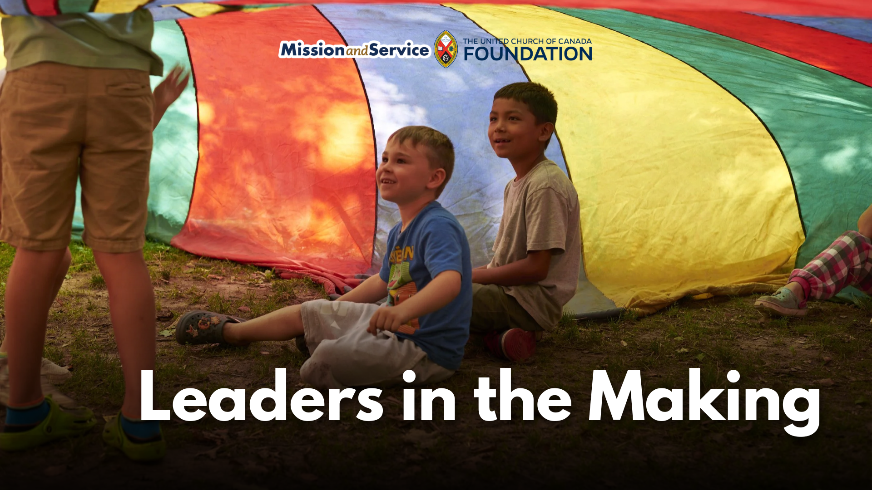

Slide 2
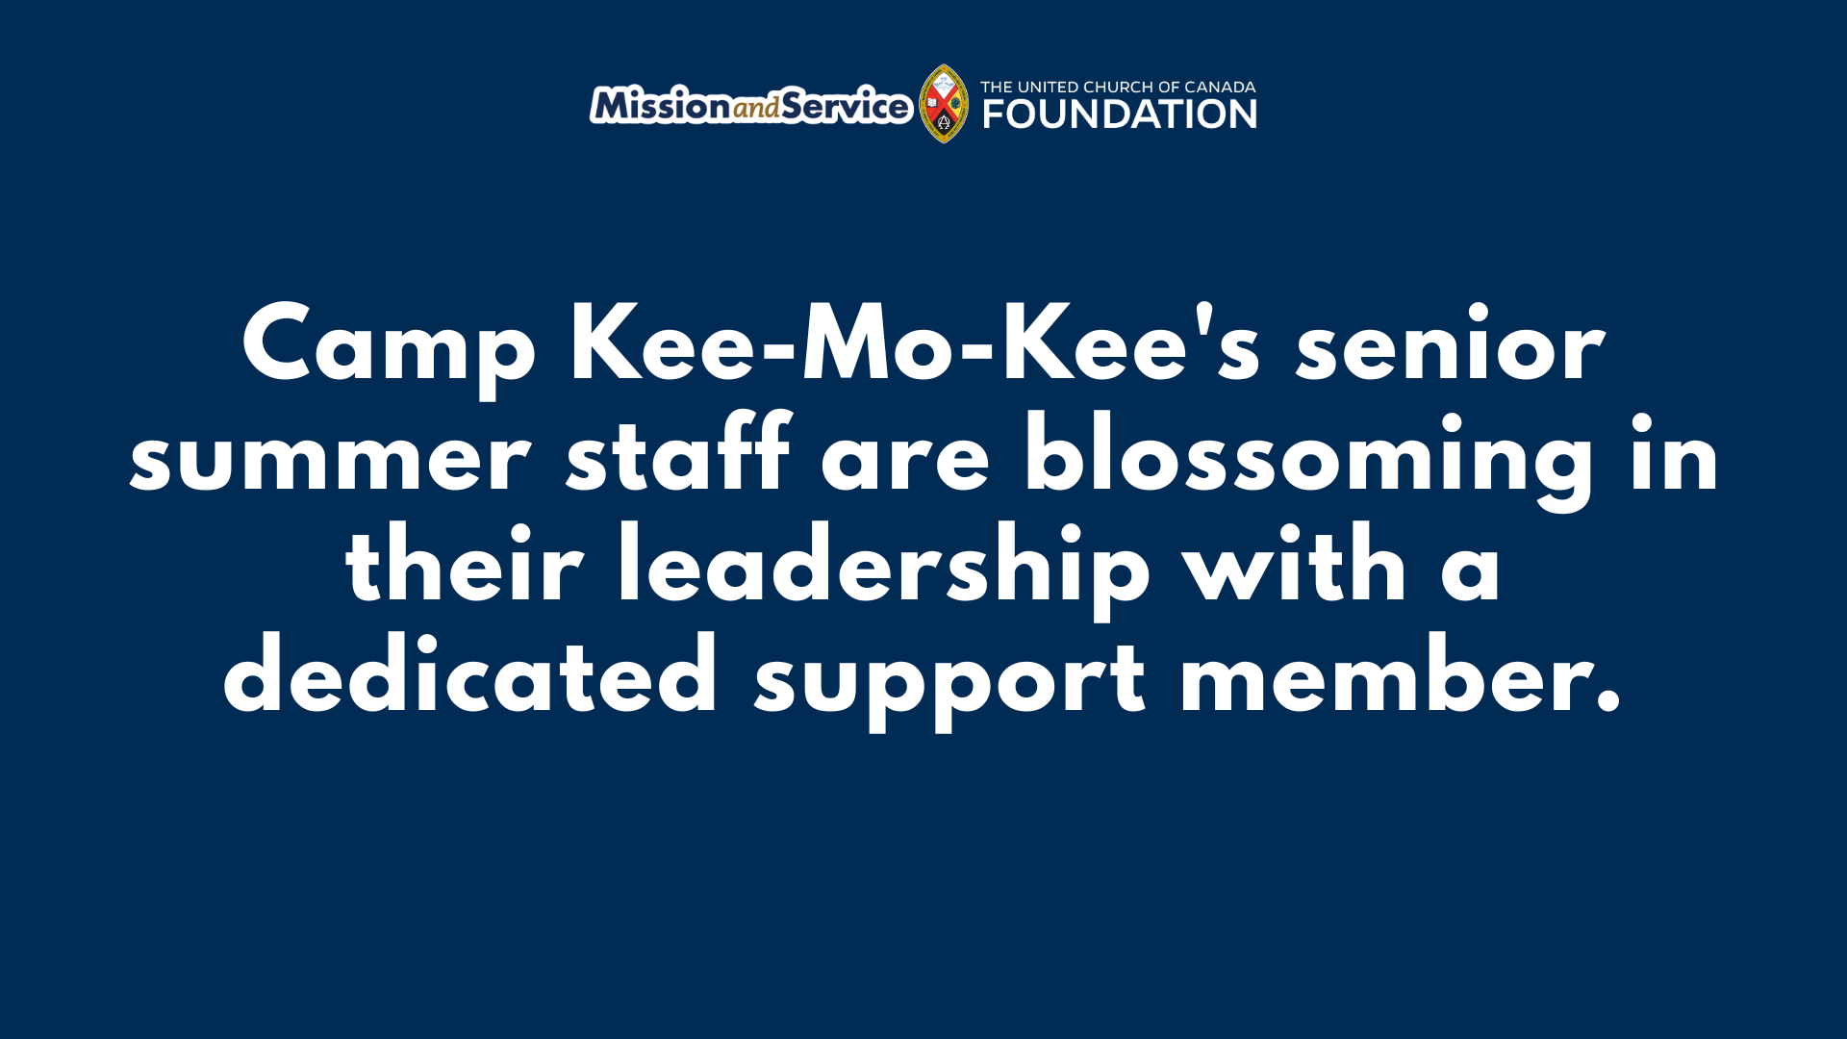
Notes:
Camp Kee-Mo-Kee's senior summer staff are blossoming in their leadership with a dedicated support member. Here is the Mission and Service Story for September 6, 2026.
At Camp Kee-Mo-Kee in Komoka, ON, our Mission and Service gifts help to strengthen something at the heart of every summer camp experience: the people who make camp possible. By supporting an experienced senior staff role, our gifts help equip emerging leaders, support campers, and strengthen the entire camp community.
Many of Camp Kee-Mo-Kee’s senior summer staff are still growing into leadership. They are capable and committed, but leadership takes experience, and that experience grows through mentorship and support. This summer, our gifts through Mission and Service helped fill the gap by funding a senior staff position dedicated to supporting the summer team.
The person who stepped into the role brought years of experience as a former Camp Director, along with strong relationships throughout the Camp Kee-Mo-Kee community. Her role was intentionally flexible. She mentored and coached newer senior staff, provided hands-on training, and stepped in wherever she was needed.
Whether that meant covering a staff break, helping in the kitchen so another staff member could remain focused on camper care, or supporting a camper through a difficult moment she was ready to step in. Her presence created a steady source of encouragement, experience, and connection across camp.
“I've been able to support all over camp and take on the other small or behind-the-scenes tasks to support staff success, which then carries on to support camper success,” she shared. “Being able to be out and around, building connections across camp, and always on the move to jump in where needed has made for a tremendous summer experience.”
The impact reached beyond funding that single position. Senior staff had an experienced mentor to turn to, which strengthened staff preparedness and helped build a stronger leadership team. The campers benefited from having confident, supported leaders who could be fully present for them.
This is the ripple effect of our Mission and Service gifts. When we invest in people, that investment reaches entire communities.
At Camp Kee-Mo-Kee, this has not only supported staff and campers for one summer. It's created a model of mentorship that can continue developing strong camp leaders for years to come.
Our gifts through Mission and Service help strengthen communities by creating places where children and youth can belong, grow, build meaningful relationships, and experience God’s love. Let’s give generously so camps like Camp Kee-Mo-Kee can continue nurturing leaders, supporting campers, and creating meaningful experiences for generations to come.

