Slide 1


Slide 2
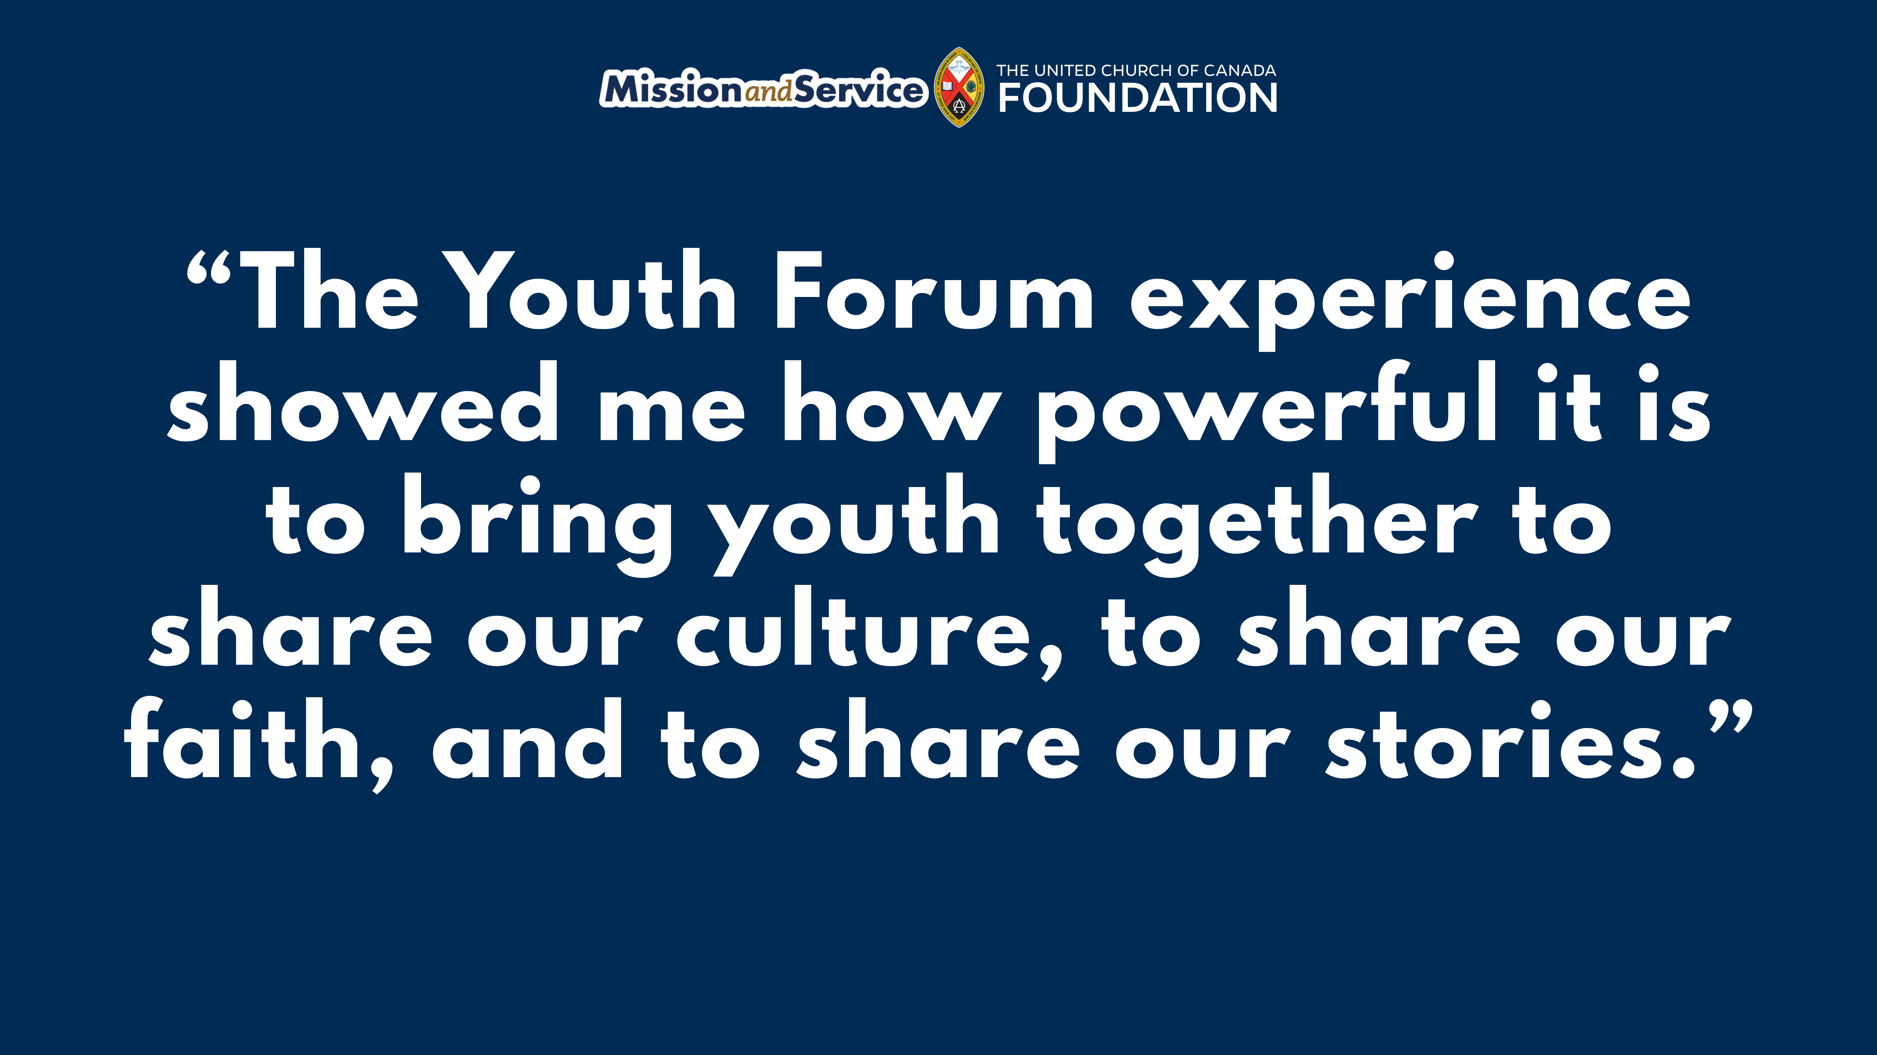
Notes:
The following was written by Ashley Keeping, one of two United Church young adults selected to attend the 2024 Minority Youth Forum in Miyakojima, Japan, hosted by the Center for Minority Issues and Mission. The Youth Forum is an ecumenical initiative of churches in Japan, supported by The United Church of Canada and Mission and Service. Our generosity through Mission and Service helps programs that inspire peace and learning.
Just like Miyako residents, I live on an island and can relate to their everyday lives on their island, as it was small and humble just like here in Newfoundland. There was one prominent difference. The majority of the residents are seeking peace from their own government, something we don’t have to worry about here in Canada. God called upon me to see how the people of Miyako Island are living, and to share with everyone their struggle for peace.
The Minority Youth Forum program brought together young adults from Canada, Japan, and Taiwan. The Youth Forum experience showed me how powerful it is to bring youth together to share our culture, to share our faith, and to share our stories. To be able to have discussions with youth from other cultures about how we can change the world gives me so much hope for our future.
This trip filled my heart with joy, hope, and love for the wonderful people that I can now forever call friends. It also taught me that you need to find, keep, and treasure peace, as well as pursue it for the rest of your time, and that I will do. Thank you, Miyako, for everything you taught me.
Read Ashley’s full blog: Pursuing Peace from the Atlantic to the Pacific.
The views contained within these blogs are personal and do not necessarily reflect those of The United Church of Canada or The United Church of Canada Foundation.

