Slide 1
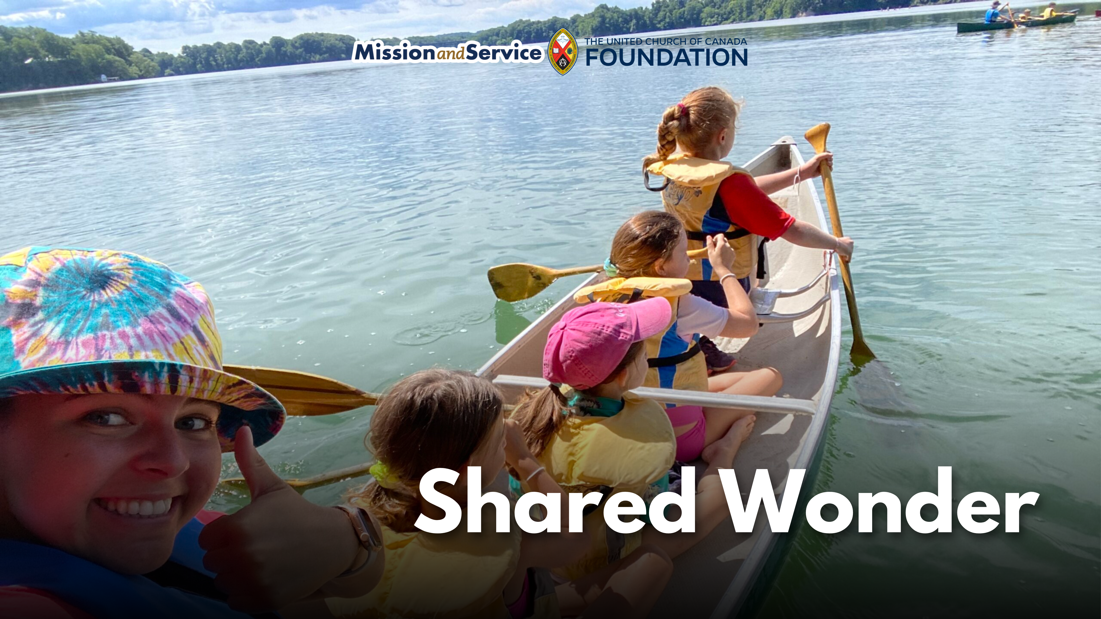

Slide 2
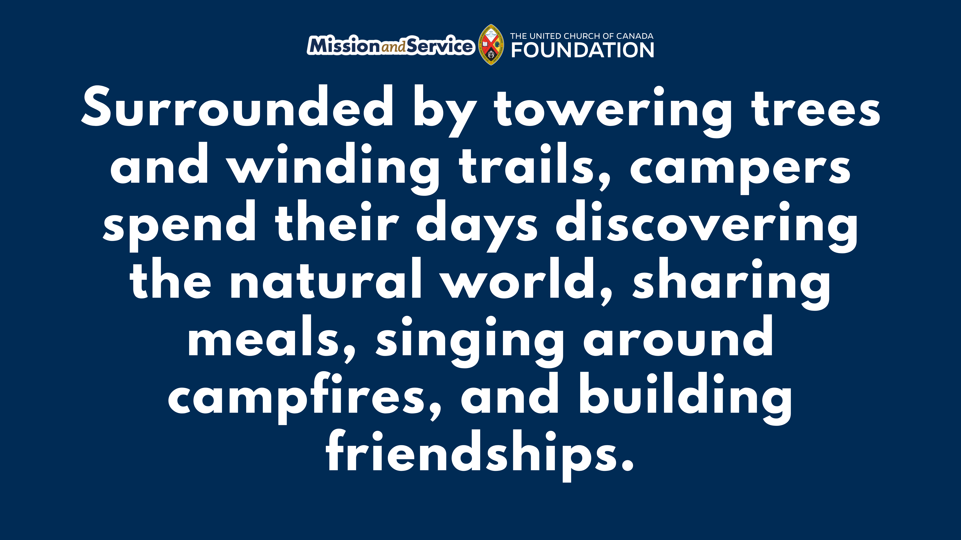
Notes:
Nestled along the Niagara Escarpment, Cave Springs Camp offers children and youth something that can be hard to find in today's world: space to slow down, explore, and to connect with creation, one another, and God.
A child crouching down beside a forest trail suddenly shouts, “I found a salamander!”
Within moments, a group gathers around, curious and excited. For a few minutes, nothing else matters. Not phones, schedules, or other distractions that fill our days. Just a small creature, a shared discovery, and a sense of wonder.
Moments like these happen every day at United Church camps.
Surrounded by towering trees and winding trails, campers spend their days discovering the natural world, sharing meals, singing around campfires, and building friendships. Amidst all the activity, something deeper takes root: camp becomes a place of belonging.
For some children, it may be the first time they feel fully accepted for who they are. For others, it may be the first time they experience the quiet beauty of creation or feel comfortable asking questions about faith. Away from the pressures and distractions of everyday life, campers can be fully present. They get to be themselves in a supportive community, with God's presence all around them.
The lessons learned at camp often stay with them long after summer ends. A love of creation. A sense of confidence. New friendships. A growing faith. These gifts are carried home, and woven into the lives of young people as they continue to grow.
Through Mission and Service, we help make these experiences possible. Together, we support United Church camps that nurture faith, foster community, and invite young people to encounter God's love in meaningful ways.
Let’s give generously to continue helping create spaces where children and youth can discover wonder, belonging, and the joy of being part of God's creation.

