Slide 1
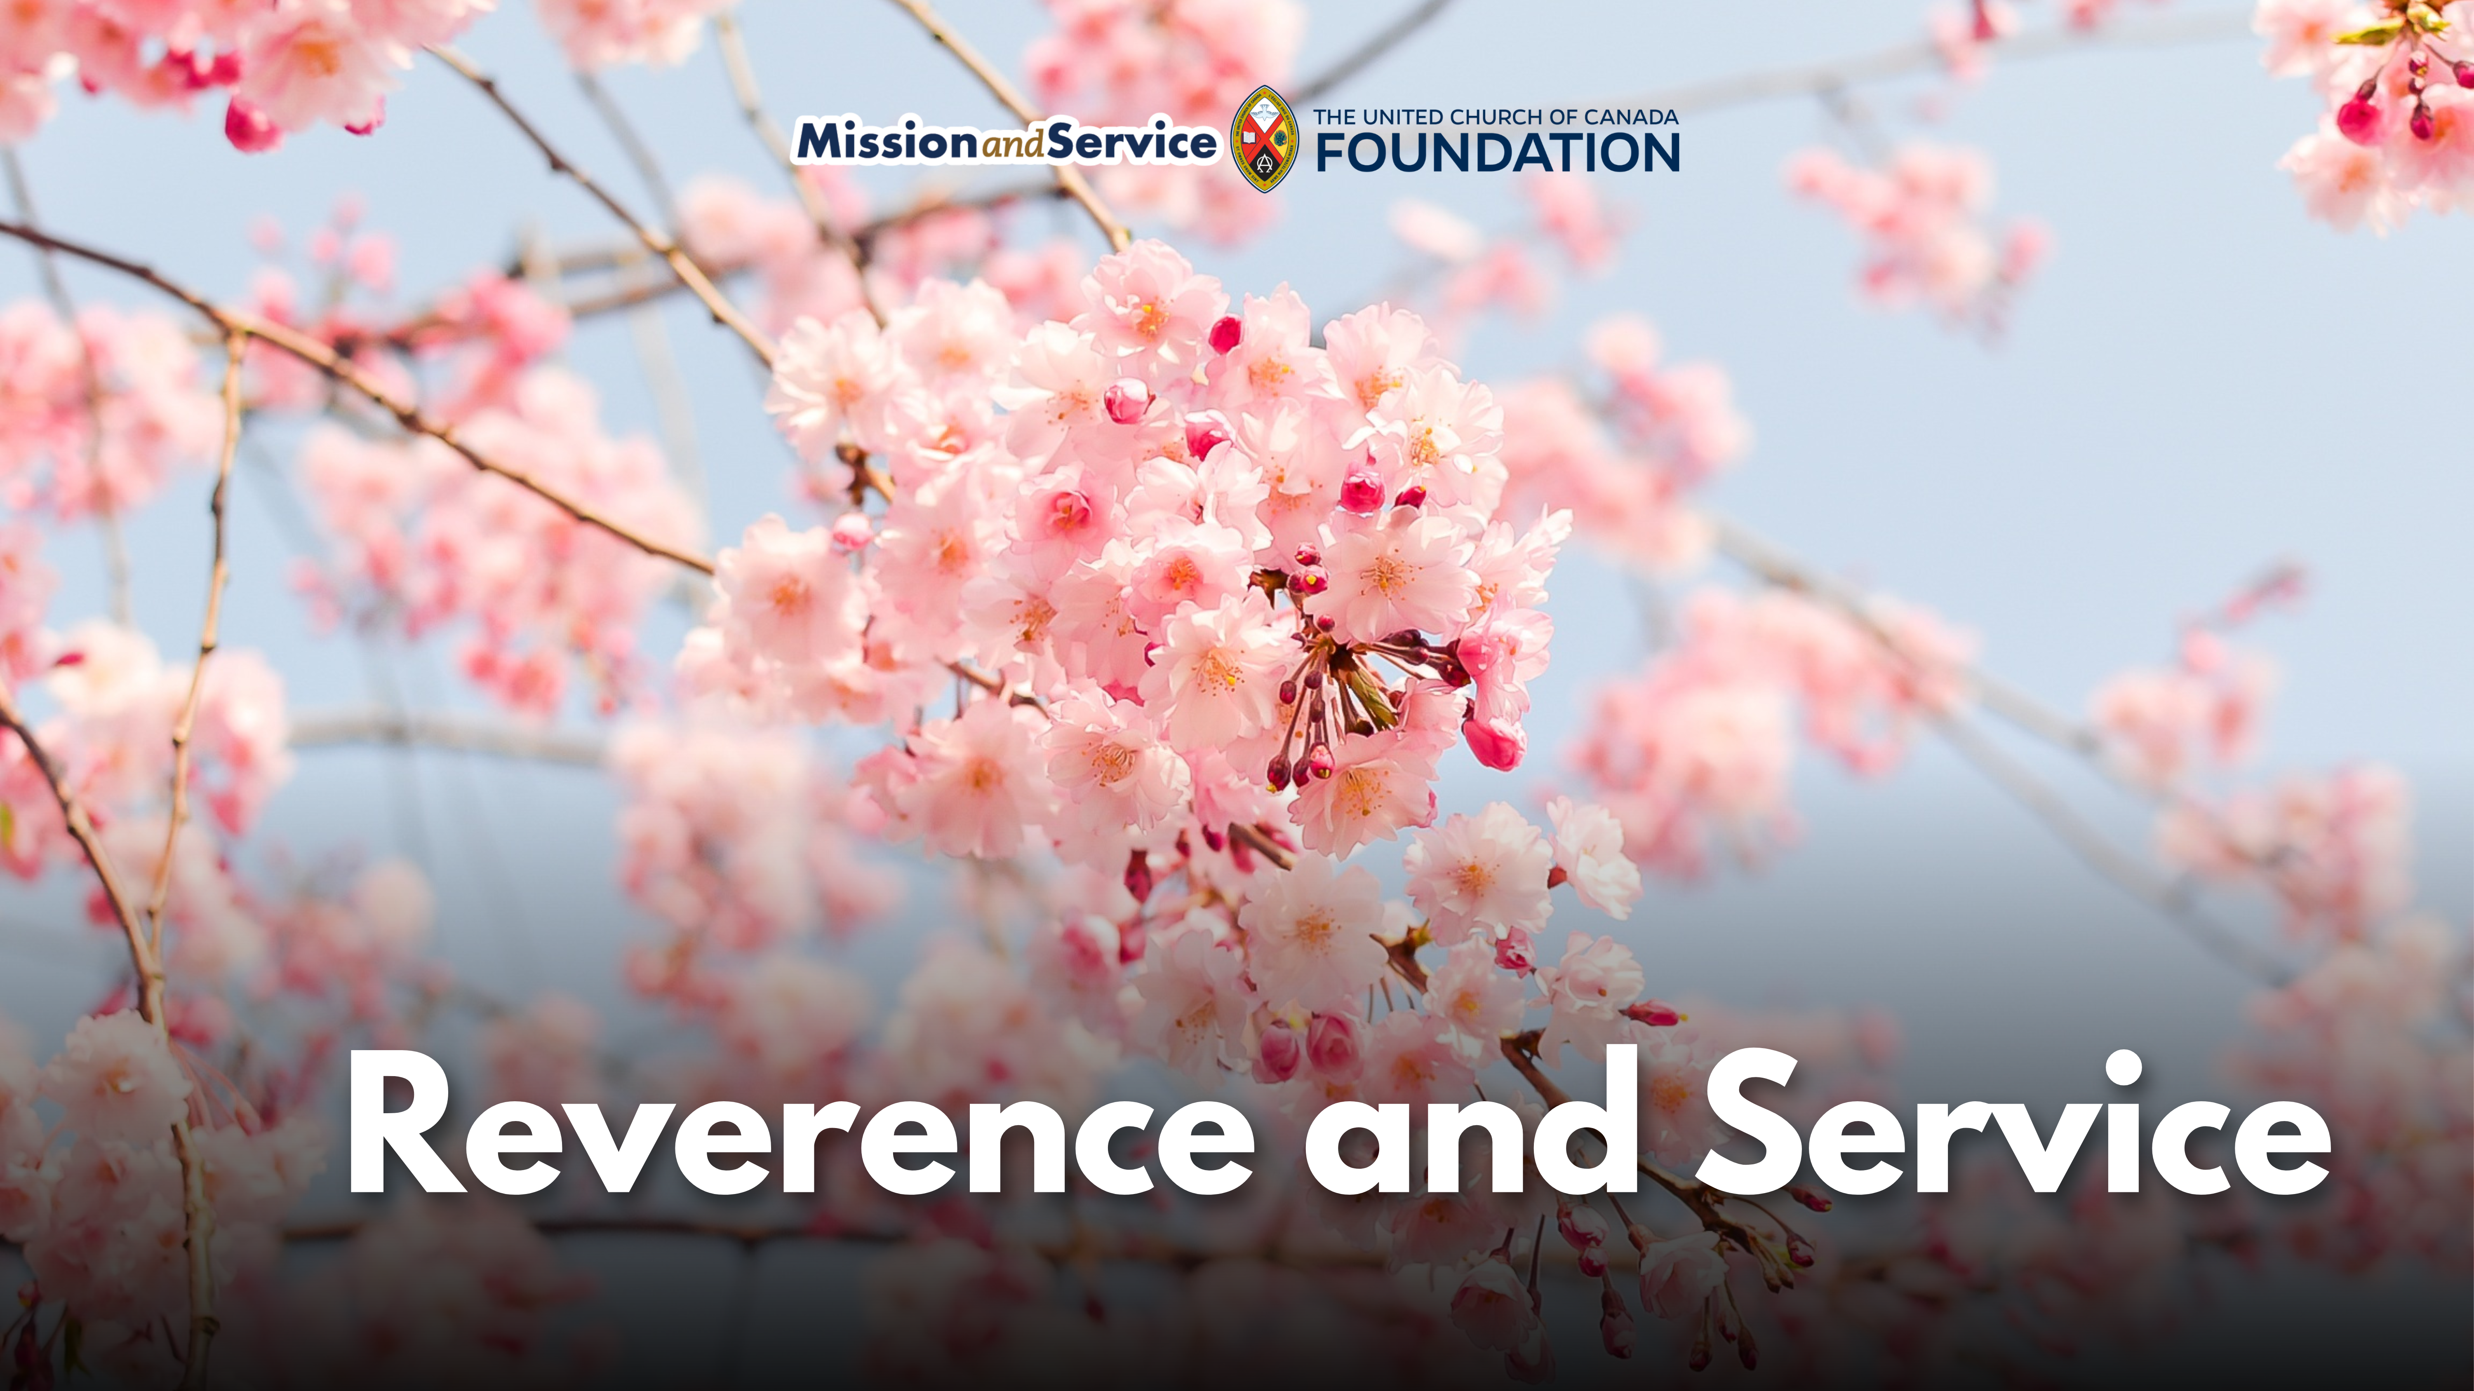

Slide 2
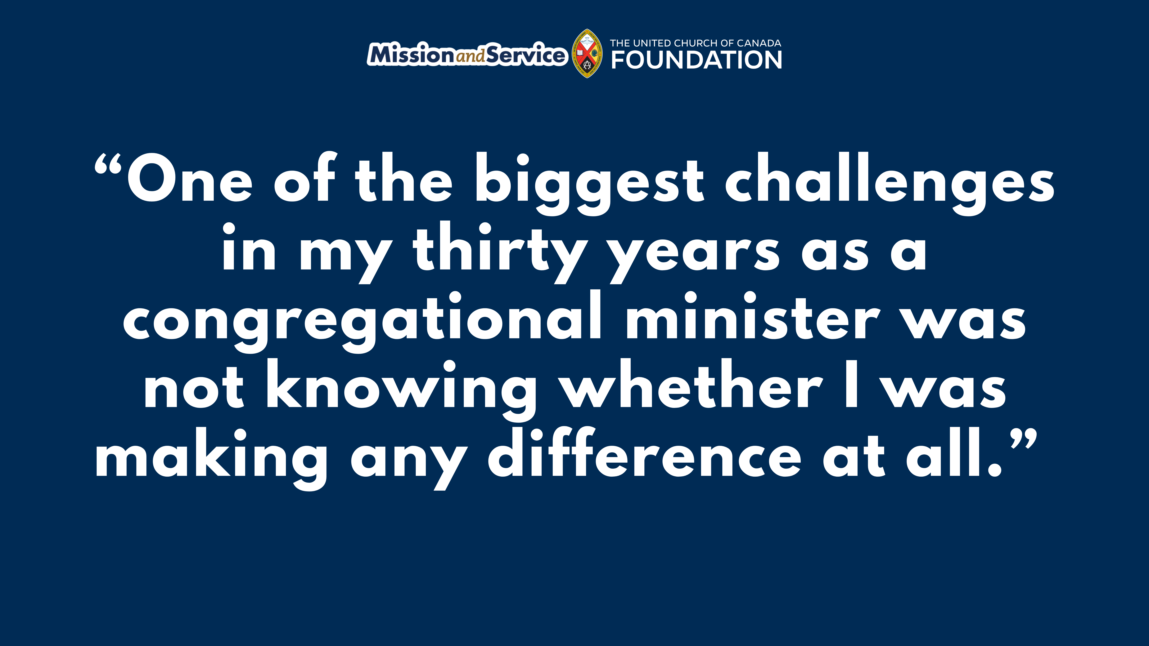
Notes:
We would like to share a blog written by Rev. Won Hur, who works as the Global Partnership Program Coordinator for Asia in the General Council’s Church in Mission Unit:
One of the biggest challenges in my thirty years as a congregational minister was not knowing whether I was making any difference at all. Unlike bricklayers, butchers, or teachers, there were no concrete indicators to measure the impact of my ministry. This also holds true when we give, practice generosity, and support Mission and Service. We often want to know what difference it makes.
In reality, our offerings do make a difference in ways we cannot even imagine, and often in very concrete ways.
There are many partners of The United Church of Canada who do incredible work in Canada and around the world. One of them is Toyo Eiwa Jogakuin, a private Christian girls’ school in Tokyo, Japan. The school was founded in 1884 by Ms. Martha Cartmell (1845–1945), the first woman missionary of the Canadian Methodist Church, a predecessor of The United Church of Canada.
At a time when girls were often denied education, she started a school for them, beginning with just two students. Today, the school has grown to an enrollment of over 4,200, with students from kindergarten through high school and into graduate school. It has retained its core Christian identity—the school day begins with worship, and students take classes on Christianity while living into the school’s motto, “Reverence and Service.” Over its history, more than 140 members of the United Church have answered the call to serve this school.
One of the more famous graduates of Toyo Eiwa is Hanako Muraoka, who graduated in 1913. During her time at the school, she enjoyed the library and read many books in English; she became a writer and translator. Later in life a Canadian friend, Loretta Leonard Shaw, gave her a copy of Anne of Green Gables, by Lucy Maud Montgomery. Hanako fell in love with the book and its main character, Anne, and went on to translate it into Japanese. The translation became a bestseller and has since become a cultural phenomenon—Japanese tourists regularly visit Prince Edward Island to see the Anne of Green Gables Museum, as Toyo Eiwa students each year do.
Another notable graduate is Rev. Shoko Aminaka, General Secretary of the United Church of Christ in Japan (UCCJ), who attended the school from grade one through grade 12. Having grown up in this environment and been immersed in Christian faith, she began to think deeply about life and she found freedom in entrusting herself to God. After being baptized in grade nine, she discerned her call, was ordained, and eventually rose to the highest office in the UCCJ. Currently, four ordained women clergy in the United Church of Christ in Japan are graduates of Toyo Eiwa.
It is often difficult to see or fully understand the impacts of our faith at work in the world. Like fruit trees in an orchard, they take time to grow, blossom, and bear fruit for all to enjoy. Such is the work of ministry and service—it is often hidden from our eyes, yet it is growing and flourishing.
Among Toyo Eiwa students and alumni, there is immense gratitude toward Ms. Martha Cartmell and The United Church of Canada. They raised funds to plant about 100 cherry blossom trees in Centennial Park in Dundas, near Hamilton, Ontario, and in Lakeview Cemetery in Thorold, Ontario—Ms. Cartmell’s hometown. In 2014, for the school’s 130th anniversary, they visited Dundas to celebrate the tree-planting ceremony.
Thanks to your contributions to Mission and Service, The United Church of Canada continues to support partners around the world in ways that are not always visible. Yet those partners—and God—appreciate our generosity and our shared commitment to a more just and peaceful world.
The views contained within these blogs are personal and do not necessarily reflect those of The United Church of Canada or The United Church of Canada Foundation.

