Slide 1
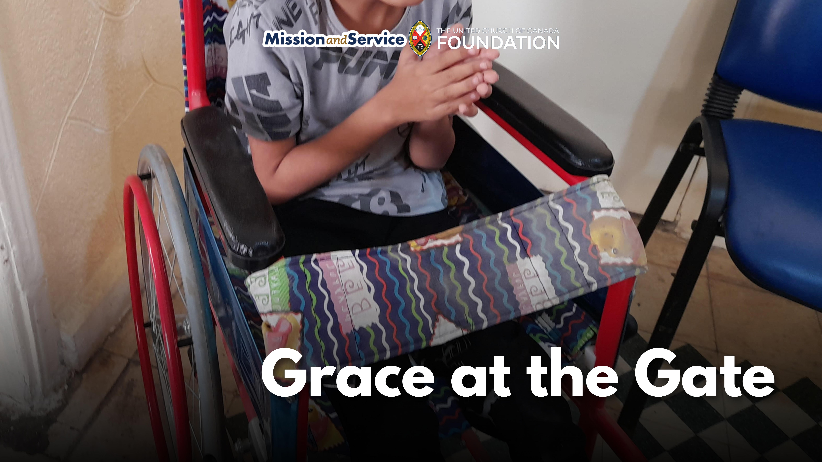

Slide 2
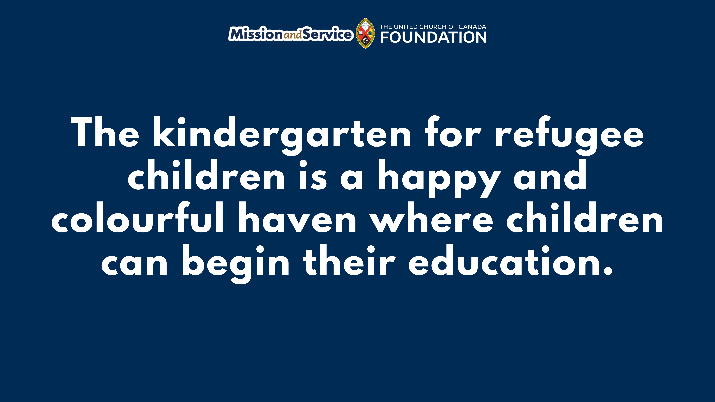
Notes:
Every morning in the Sabra/Shatila refugee camp in Beirut, five-year-old Mohammad was lifted into his wheelchair and placed at the gate of his home by his father.
It was the only way he could be part of the world beyond his doorstep. Unable to afford a special school or professional care, his father would set him in his wheelchair at the doorway just so he could watch the crowded street.
From there, Mohammad would see other children on their way to kindergarten, while he was left behind.
Mohammad was born with partial paralysis affecting one side of his body, including his left arm, left leg, and vision in one eye. During pregnancy, his mother became seriously ill with cancer and was unable to receive the care she needed. She died shortly after Mohammad was born.
Even with the deep love and care from his father and sisters, life in the refugee camp left little room for specialized care or schooling.
Then something changed.
A Mission and Service partner, the Joint Christian Committee for Social Service in Lebanon (JCC), had recently relocated its kindergarten nearby. There are few bright spots for children in the refugee camp, and since 1950, JCC has been one of them. JCC’s kindergarten for refugee children aged 3 to 6 is a happy and colourful haven where children can begin their education. The centre’s director noticed Mohammad sitting outside, and decided to speak with his father.
He was invited in, and with his father’s permission, Mohammad joined the kindergarten program.
A partner organization with a focus on supporting children with disabilities began working alongside him, and teachers and classmates welcomed him wholeheartedly. As time passed, Mohammad began to grow in confidence, joy, and connection.
In this simple act of welcome, we see God’s love made visible. We see children being embraced, barriers softened, and growth encouraged.
Today, Mohammad is a happy young boy who learns and plays alongside his peers. He no longer has to watch from the sidelines—he has a place of belonging.
His father’s gratitude is consistent and unmistakable.
In places like Sabra/Shatila, even simple things like books, paper, art supplies, and safe spaces are not guaranteed. The JCC kindergarten itself is facing rising costs after relocating, along with inflation and the need for renovations.
Still, this kindergarten in a refugee camp remains a place where all children are seen, included, and given the chance to thrive.
Through Mission and Service, our gifts help make this possible—places where God’s love is lived out through communities that open their doors, and a child at the gate becomes a child in the classroom. Let’s give generously.

