Slide 1
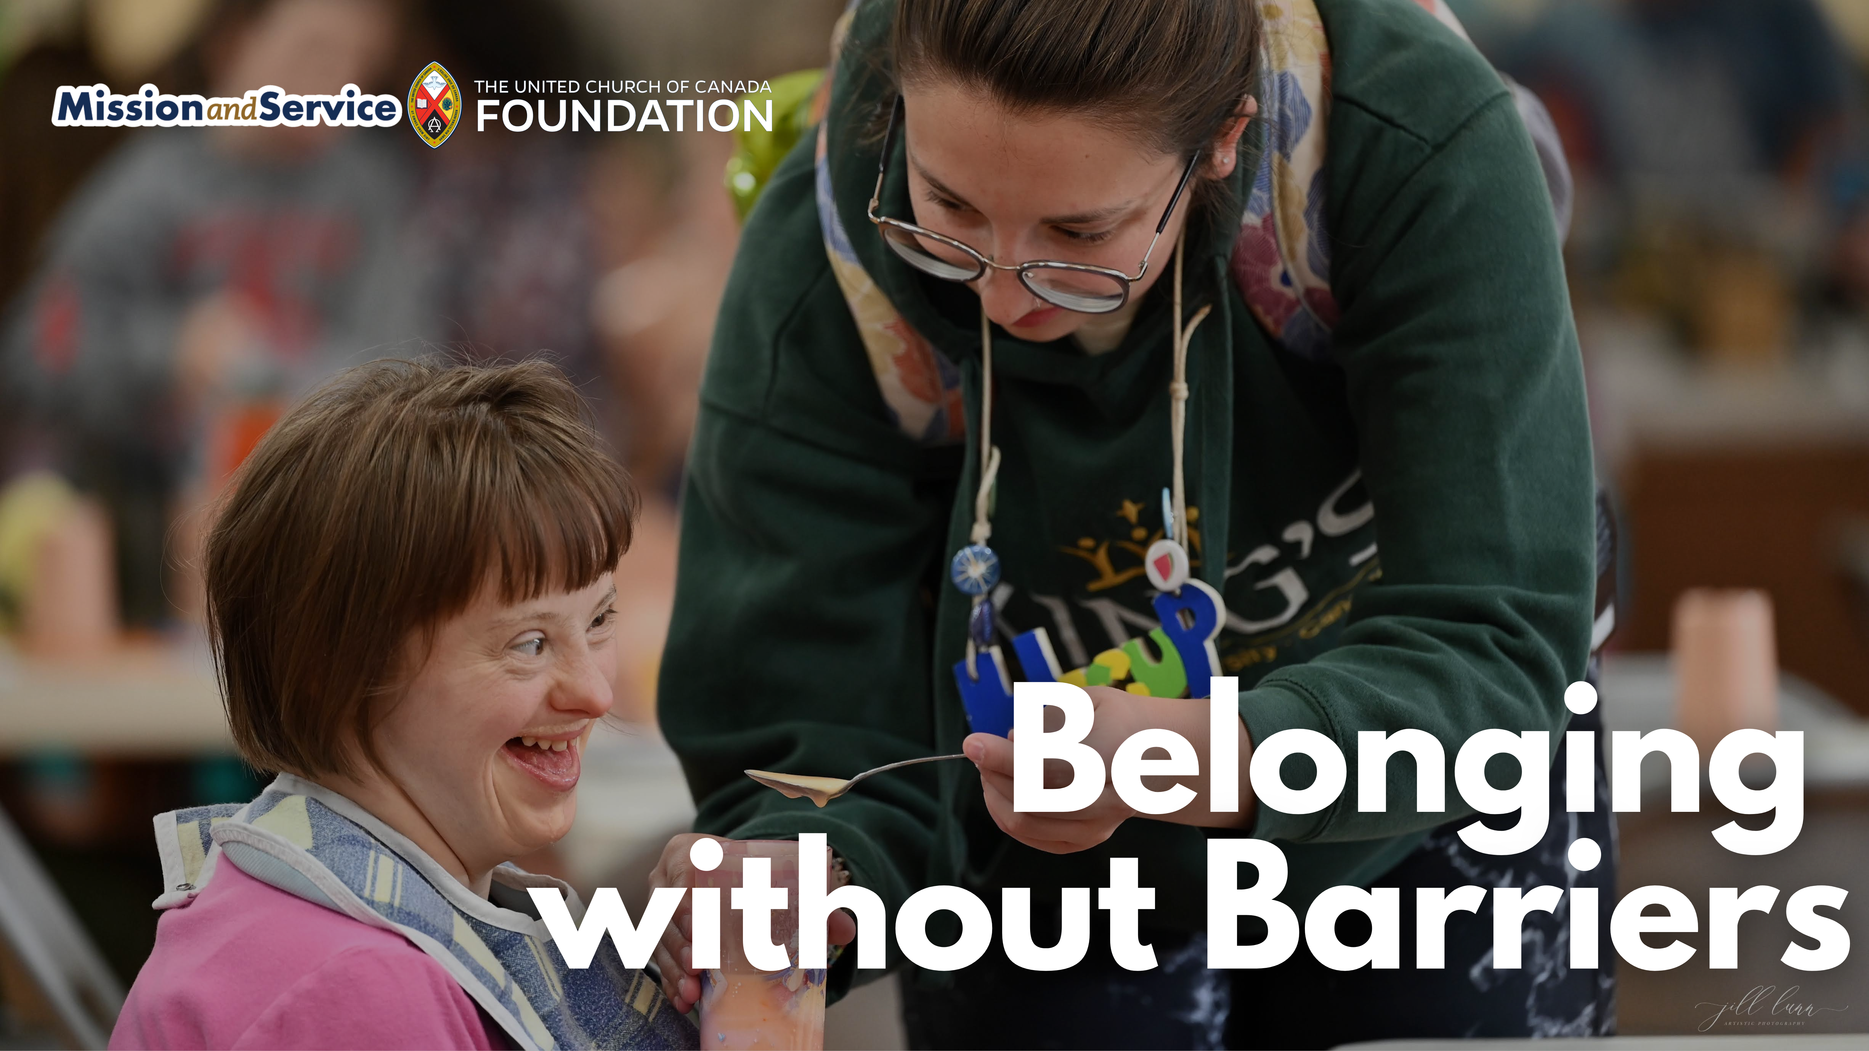

Slide 2
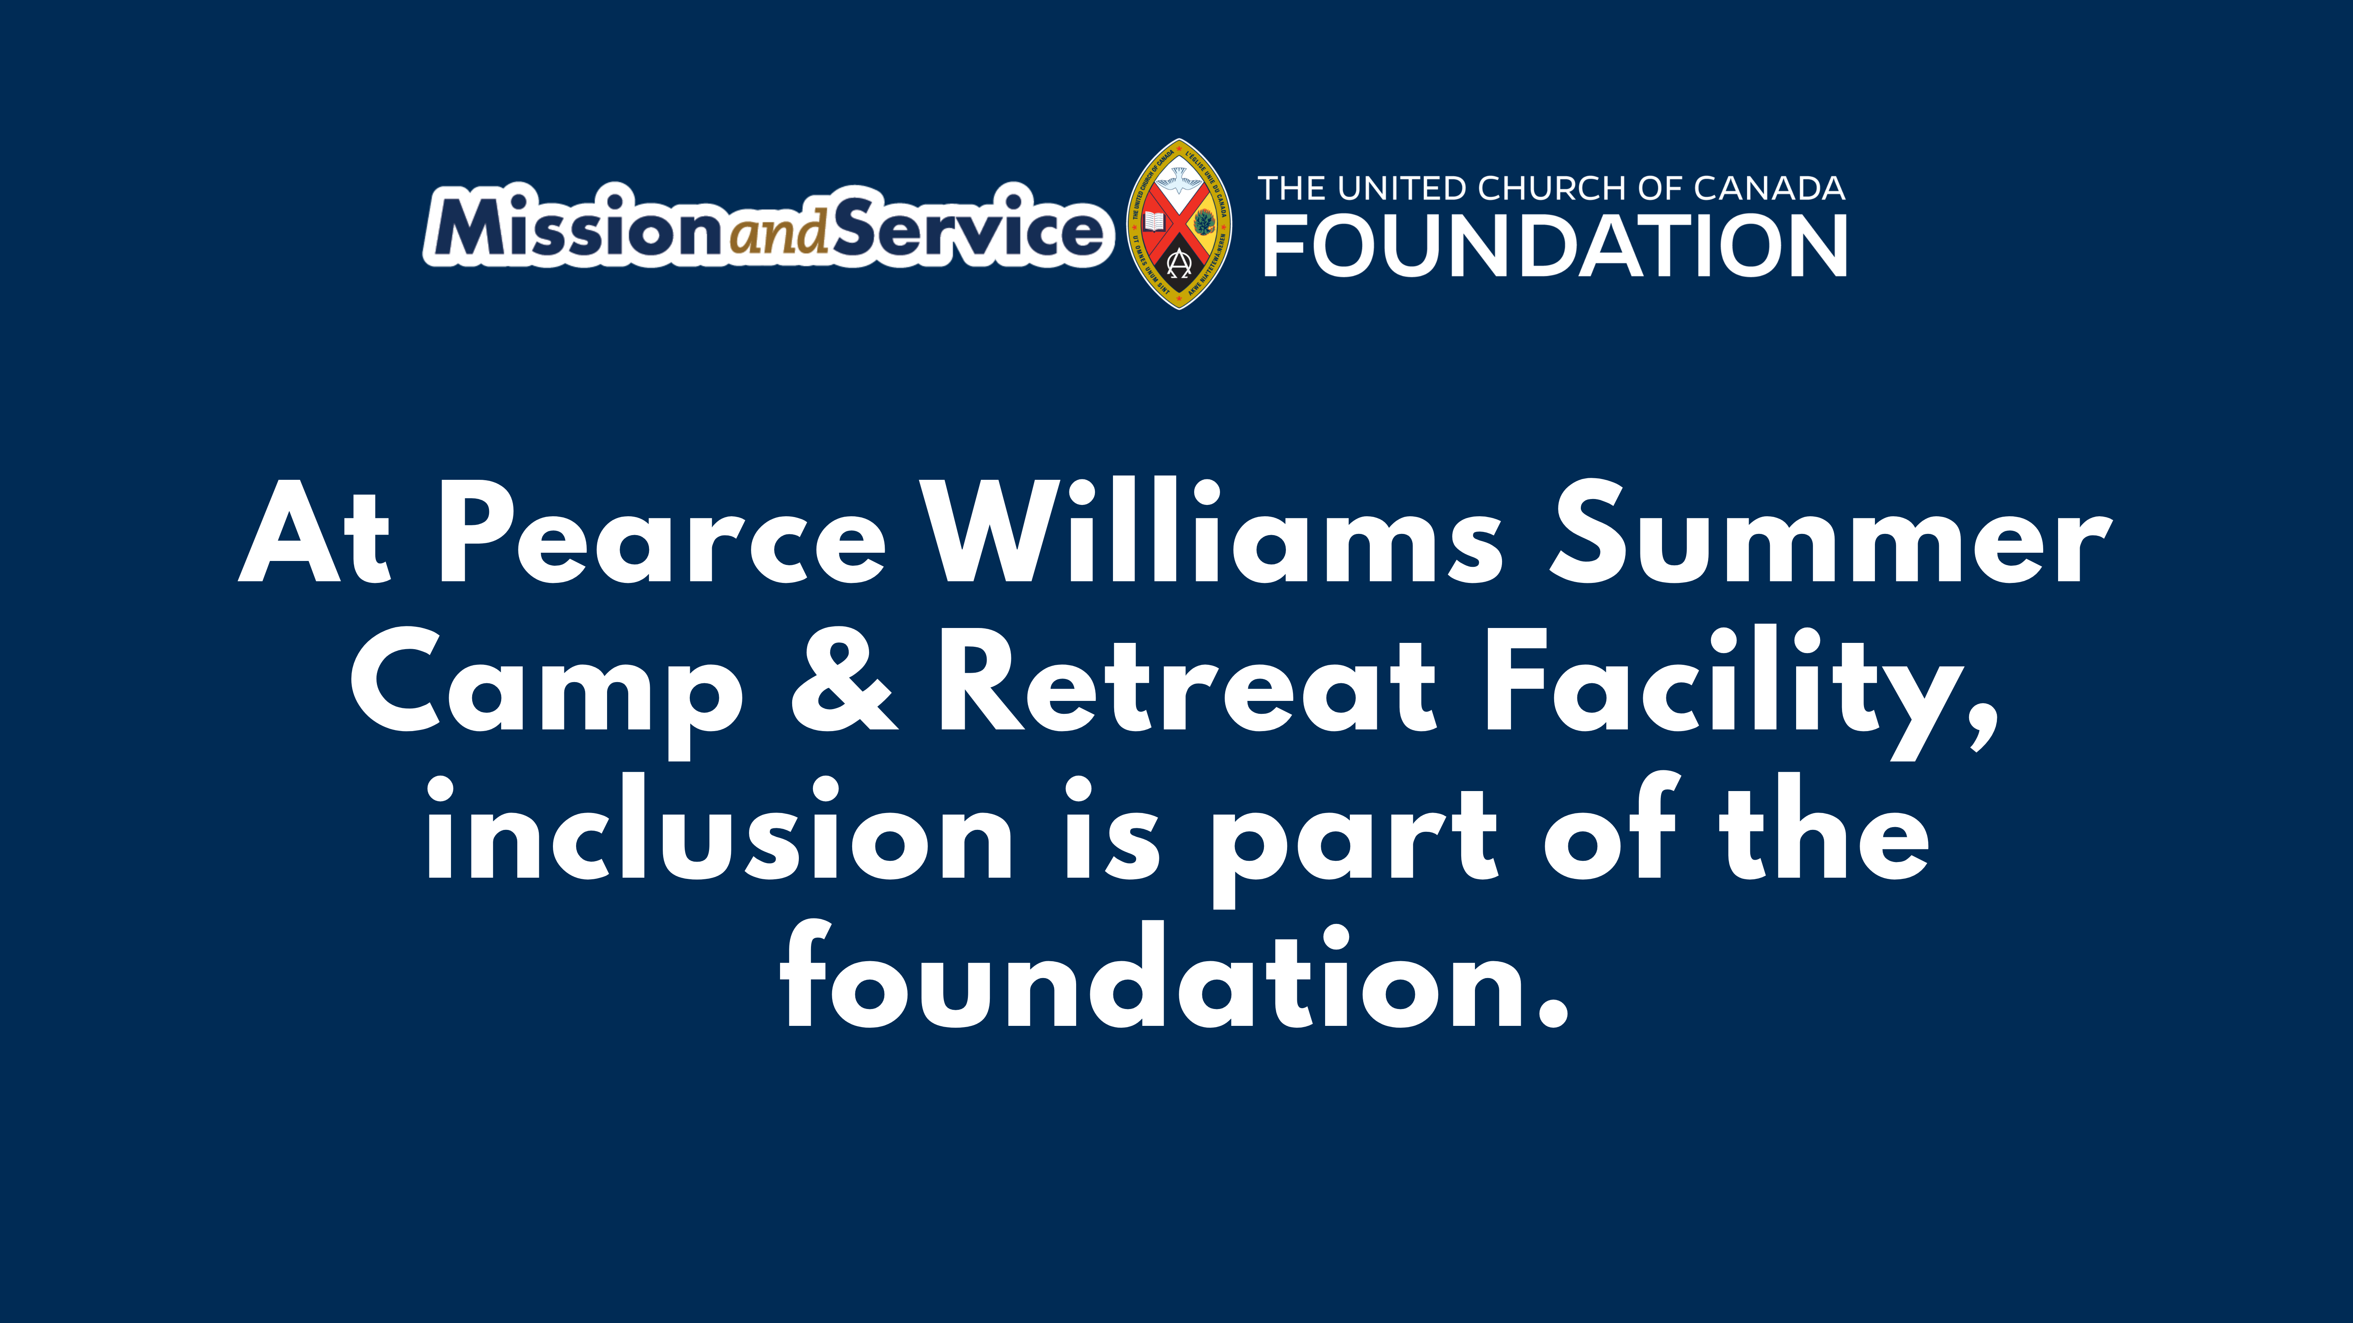
Notes:
Every child should be able to experience the joys of camp: laughing around a fire, trying something new, and feeling the joy of community.
But for some children, camp is not always accessible. When needs are more complex, when extra care, training, or equipment is required, families can be left wondering if there is a place where their child will be able to participate and truly belong.
Through Mission and Service partners, that answer is yes.
At Pearce Williams Summer Camp & Retreat Facility, inclusion is part of the foundation. Staff are specially trained. Adaptive and sensory supports are built into the experience. Care is taken to ensure that every camper can participate fully and safely.
At Pearce Williams, inclusion is more than access. It is about belonging without barriers. Children are not sitting on the sidelines, but fully part of camp life, joining in the singing, swimming, creating, and connecting alongside others. It means families can trust that their children are not just welcomed, but fully supported.
Our gifts to Mission and Service help make this possible. They provide the tools, training, and care needed to ensure no child is turned away because their needs complex.
Every child deserves a place at camp, and every child deserves to know they belong. Make your gift(opens in a new tab) to Mission and Service today.

