Slide 1
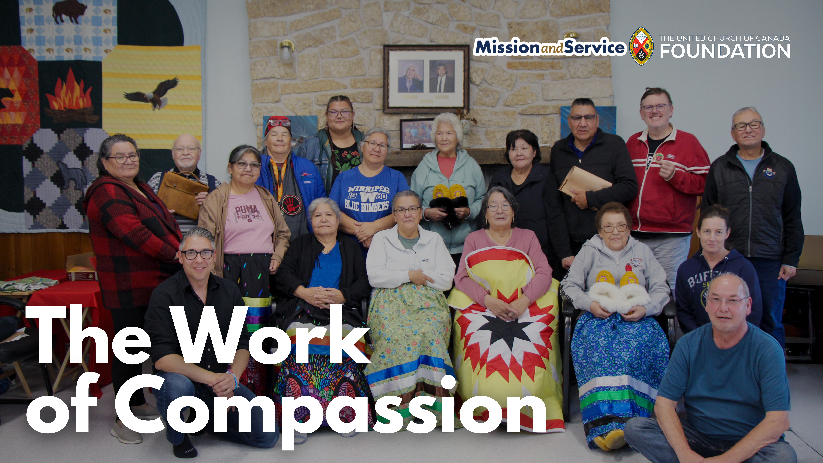

Slide 2
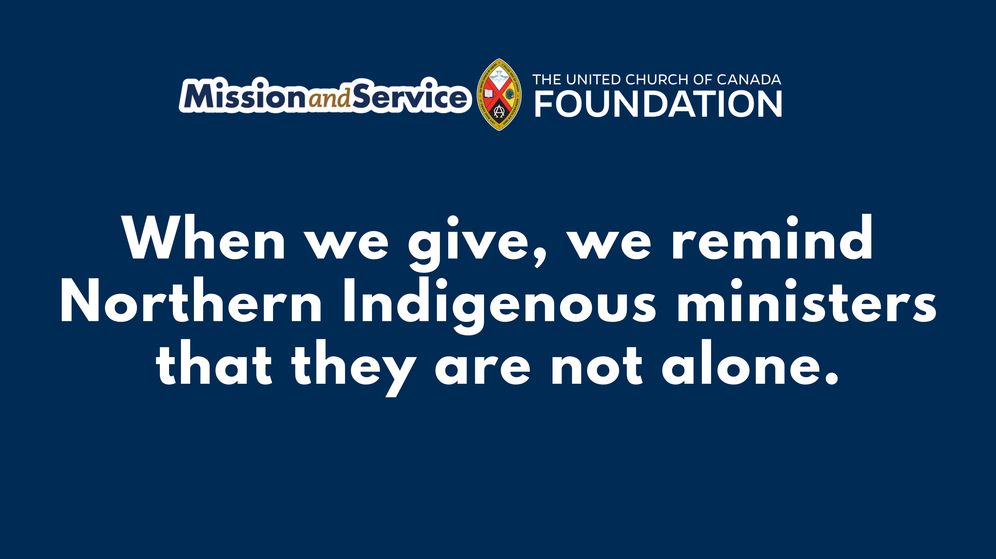
Notes:
Across Northern Canada, Indigenous ministers are serving communities where grief is a constant presence. They walk with families through loss, often leading funerals for young people, holding space for pain that has no easy words. It is sacred work, but it is also heavy work. And too often, it is carried alone.
In many of these communities, distance and isolation make support hard to find. Ministers are expected to be present for others in moments of deep crisis, while having few places for themselves to turn for rest, understanding, or care.
For the past two years, through Mission and Service, something small but powerful has taken place. Northern Indigenous ministers have gathered for a retreat. The retreat is a space for Northern Indigenous ministers to step back from having to lead and give, and step into receiving care and connection.
In Fall 2025, 16 ministers came together with facilitators for five days of rest and renewal. They shared meals and stories, sewed and beaded, and participated in ceremony. These moments provide space to breathe, grieve, and to be among others who deeply understand the weight of this work.
One minister reflected on how meaningful it can be to simply sit in a room with others who know that reality. What it means to not carry everything alone.
That is what the Northern Indigenous Ministers Retreat offers. Not a simple resolution, but something just as important: space. Space where burdens can be shared, even for a little while. Space where healing can begin.
Scripture reminds us to “bear one another’s burdens.” At this retreat, that call becomes real, through presence, community, and care.
This year, a third retreat is being planned at Fisher River Cree Nation, and retreat facilitators hope to welcome even more ministers into healing. The need continues, as does the opportunity to respond.
Through Mission and Service, our gifts help make this possible. They help cover travel, support facilitators, and create space for rest and healing.
When we give, we remind Northern Indigenous ministers that they are not alone. Make your gift(opens in a new tab) to Mission and Service today.

