Slide 1
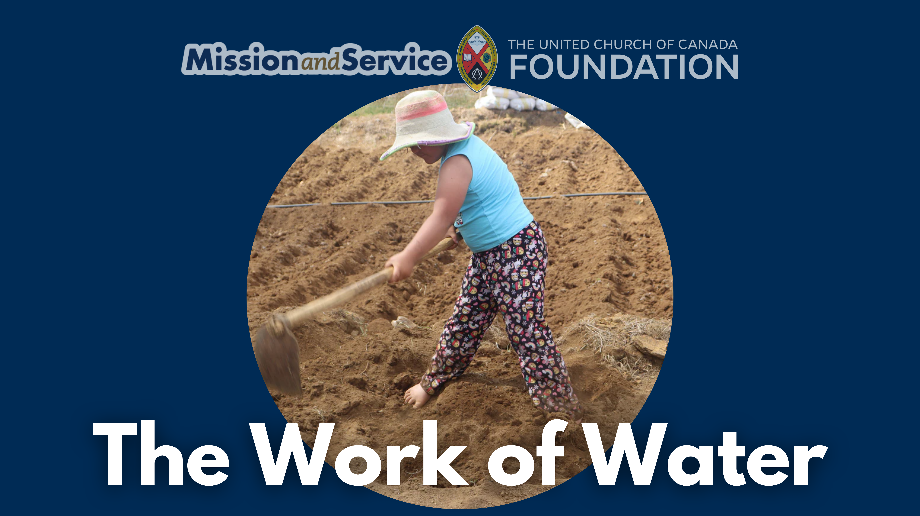

Slide 2
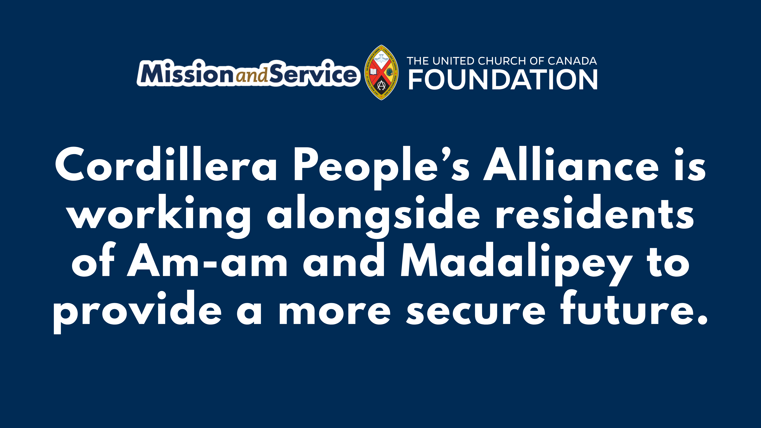
Notes:
In the villages of Am-am and Madalipey in the Philippines, Indigenous families depend on small-scale vegetable farming to support their households. The gardens they tend provide food and a modest income for daily needs.
But over time, the land has changed. As agriculture has expanded, parts of the surrounding forest have been cleared, reducing the land’s ability to hold water. The impacts of climate change have made rainfall patterns less predictable, and dry reasons run longer. For much of the year, local creeks are dry, and water must be brought in from elsewhere. It’s a constant challenge that affects both daily life and the ability to grow crops.
In response, the Cordillera People’s Alliance is working alongside residents to install a solar-powered water pump and storage tank. The system will be maintained locally, ensuring that the community has access to water and ownership of the solution.
With a more stable source of water for both household use and gardens, families can strengthen their livelihoods. Gardens can grow more reliably, daily needs become easier to meet, and pressure on households eases.
When we give through Mission and Service, our gifts are powering long-term support.
Our gifts to Mission and Service help provide stable access to water for Indigenous communities like Am-am and Madalipey. They help sustain life, strengthen food security, and support families as they work toward a more secure future.
Make your gift to Mission and Service today.

