Slide 1
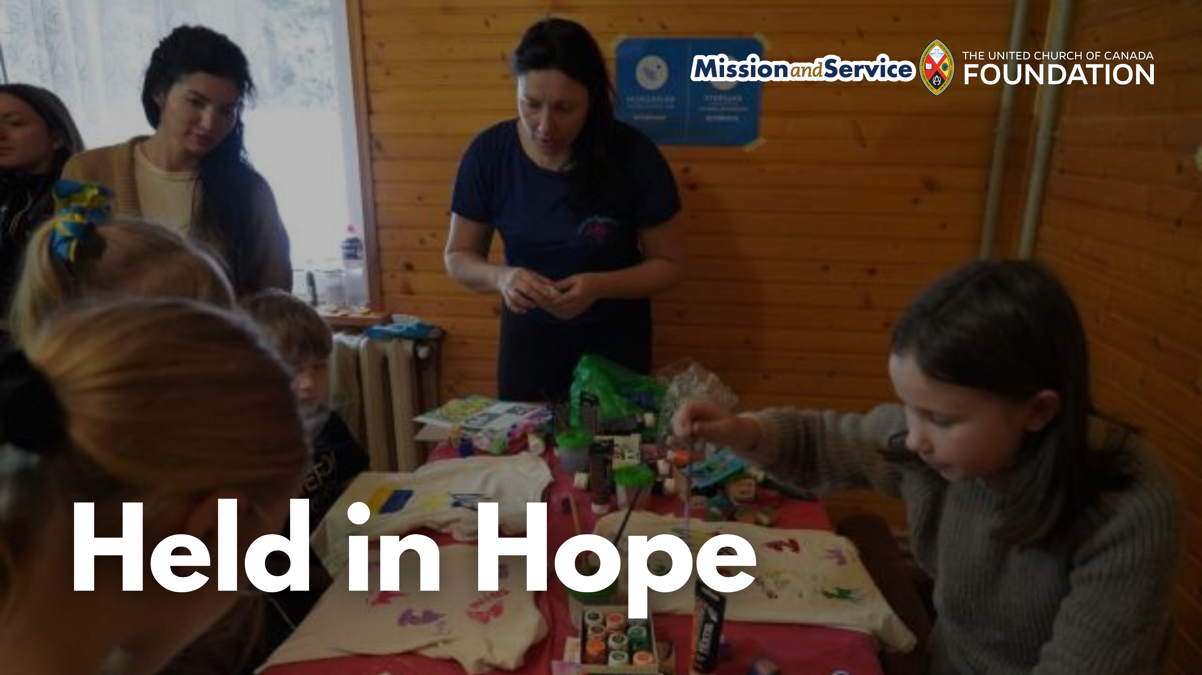

Slide 2
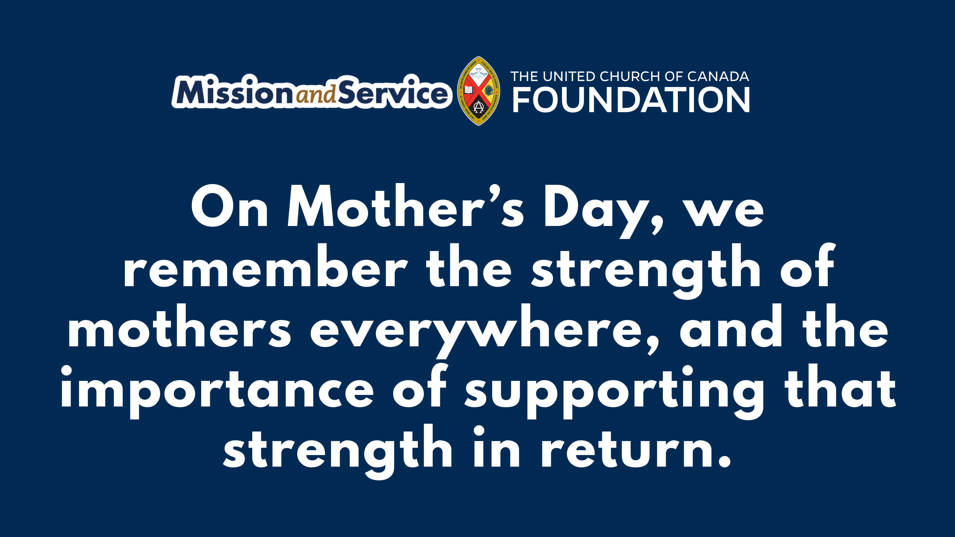
Notes:
On Mother’s Day, we give thanks for mothers and for all those who carry a mother’s love. Those who nurture, protect, and keep going through great responsibility, often while carrying more than they can easily name.
In January 2025, in the Eastern Carpathian Mountains of Ukraine, a retreat in Tukhlya offered mothers and children a chance to step away from the pressures of daily survival and receive care. Through ACT Alliance, ACT member Hungarian Interchurch Aid welcomed families who had been displaced by war or were living near the frontlines into a space of rest and support.
Many of the mothers arrived exhausted, carrying grief, uncertainty, and the constant demands of caring for their children in difficult circumstances. At the retreat, they were offered psychological support, time in nature, and creative activities, while their children were cared for through play and art. For many, it was the first time they had been able to focus on their own wellbeing.
One mother shared that she had spent so long focused on her children’s needs that she had forgotten her own. In this space, she was able to rest, reflect, and begin to regain strength for the journey ahead.
Through Mission and Service, initiatives like this become possible. Our gifts help create spaces where caregivers can receive care, where resilience can be renewed, and where hope can be strengthened even during ongoing hardship.
On this Mother’s Day, we remember the strength of mothers everywhere, and the importance of supporting that strength in return.
Our gifts to Mission and Service help make this care possible, make your gift today.

