Slide 1
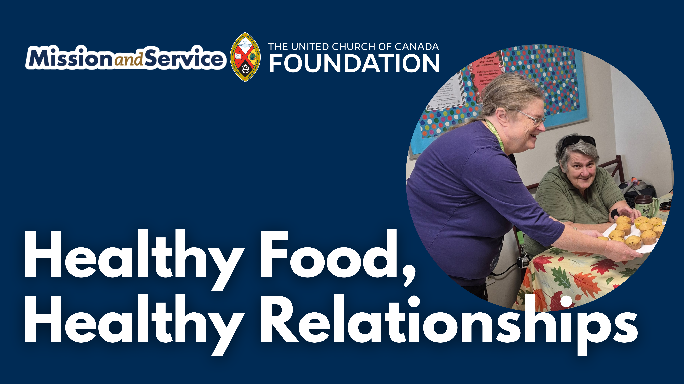

Slide 2
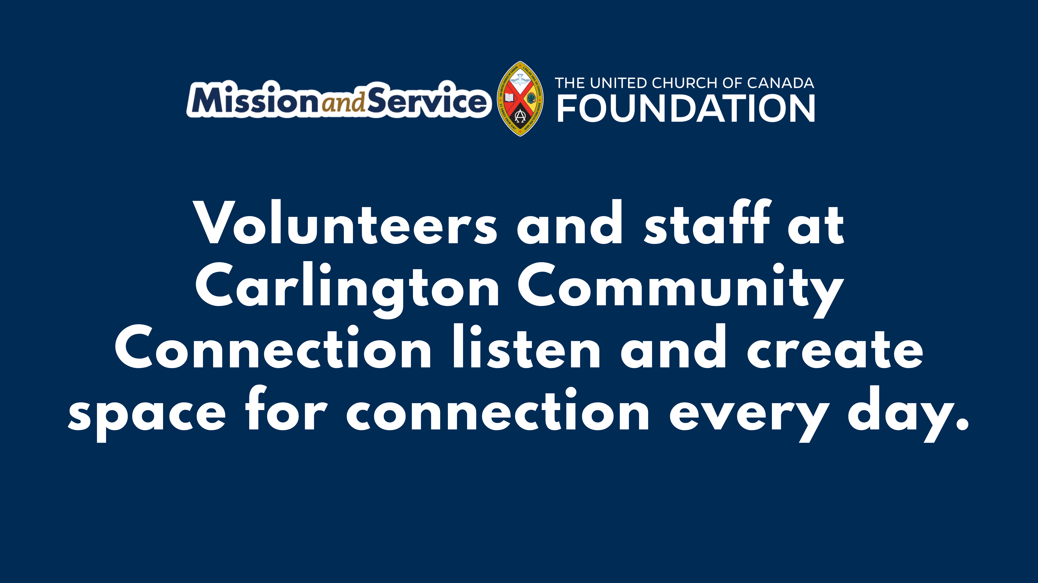
Notes:
Many communities are feeling the weight of isolation. Poverty, violence, and the pressures of daily life can make it harder for people to stay connected, even when living side by side.
At Carlington Community Connection, a chaplaincy in Ottawa, Ontario, people who saw this need chose to respond. They noticed the growing isolation around them and decided to create a place where people could be welcomed and treated with dignity.
That response sounds simple, but it matters deeply. Volunteers and staff greet people with coffee or tea, and a home-baked muffin. They sit together, listening and creating space for everyday connection. In these moments, people are not defined by what they are facing, but by their shared humanity.
That care is also growing in practical ways. The program now offers healthier food options, providing more nourishment during each visit. Volunteers and staff also make it possible for people to take home items like fruit, yogurt, and cheese for their children—supporting families in ways that make a real difference in daily life.
Through Mission and Service, this kind of response is possible. Our gifts to Mission and Service support the people who see a need and choose to act with compassion and care.
When we respond to isolation with kindness, something begins to change. Make your gift to Mission and Service today.

