Slide 1
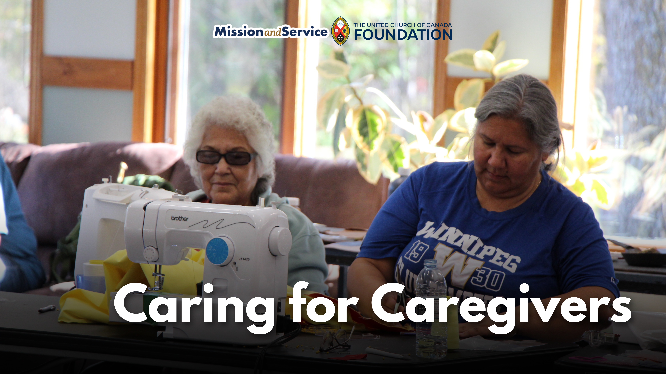

Slide 2
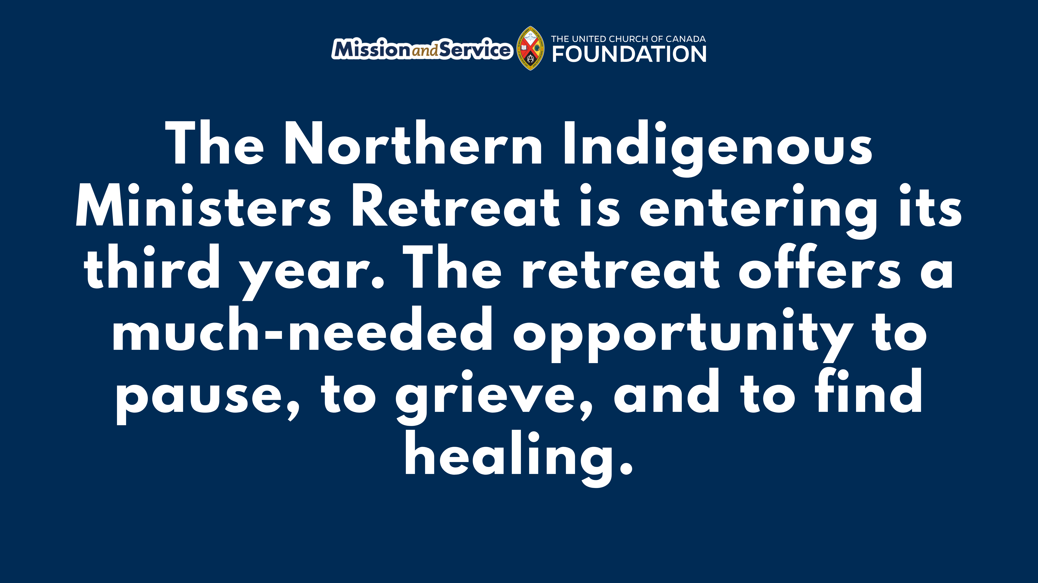
Notes:
Across Northern communities, Indigenous ministers are carrying extraordinary burdens. They walk alongside families through heartbreaking loss and hold space for grief that often has no easy words. It is sacred work. But it is also exhausting work. And too often, it is carried alone.
“When I started in the United Church, we buried a lot of elderly people,” says Rev. Grant Queskekapow. “But now we bury a lot of youth who die as a result of suicide.”
Rev. Queskekapow was a participant in the first Northern Indigenous Ministers Retreat, held in 2024 at Sandy-Saulteaux Spiritual Centre in Manitoba. For many, including Rev. Queskekapow, it was the first time they had gathered in this way with fellow ministers.
With support from our gifts(opens in a new tab) to Mission and Service, the Northern Indigenous Ministers Retreat is entering its third year. The retreat offers a much-needed opportunity to pause, to grieve, and to find healing. Ministers receive trauma-informed support and opportunities for rest, and have spoken about how important it is to experience a space where they do not need to carry everything on their own.
The retreat includes sharing circles, a sweat lodge, and opportunities for rest and relaxation. Participants also spend time making star blankets, moccasins, ribbon skirts, and beadwork together. These activities create space for conversation, reflection, and connection, while also supporting cultural and spiritual healing.
The need continues to grow. Wildfires and ongoing crises in Northern communities have only deepened the strain many ministers are carrying. Plans are now underway for the 2026 Northern Indigenous Ministers Retreat, where even more ministers will be welcomed into a circle of healing and renewal.
"Bear one another’s burdens, and in this way you will fulfill the law of Christ.” —Galatians 6:2
Through Mission and Service, our gifts help cover travel costs, support facilitators, and create space for ministers to receive care themselves. Let’s give generously.
In a video, Rey Anderson, the Community Capacity Development Coordinator for Northern Manitoba and Northwestern Ontario, speaks about the retreat.

