Slide 1
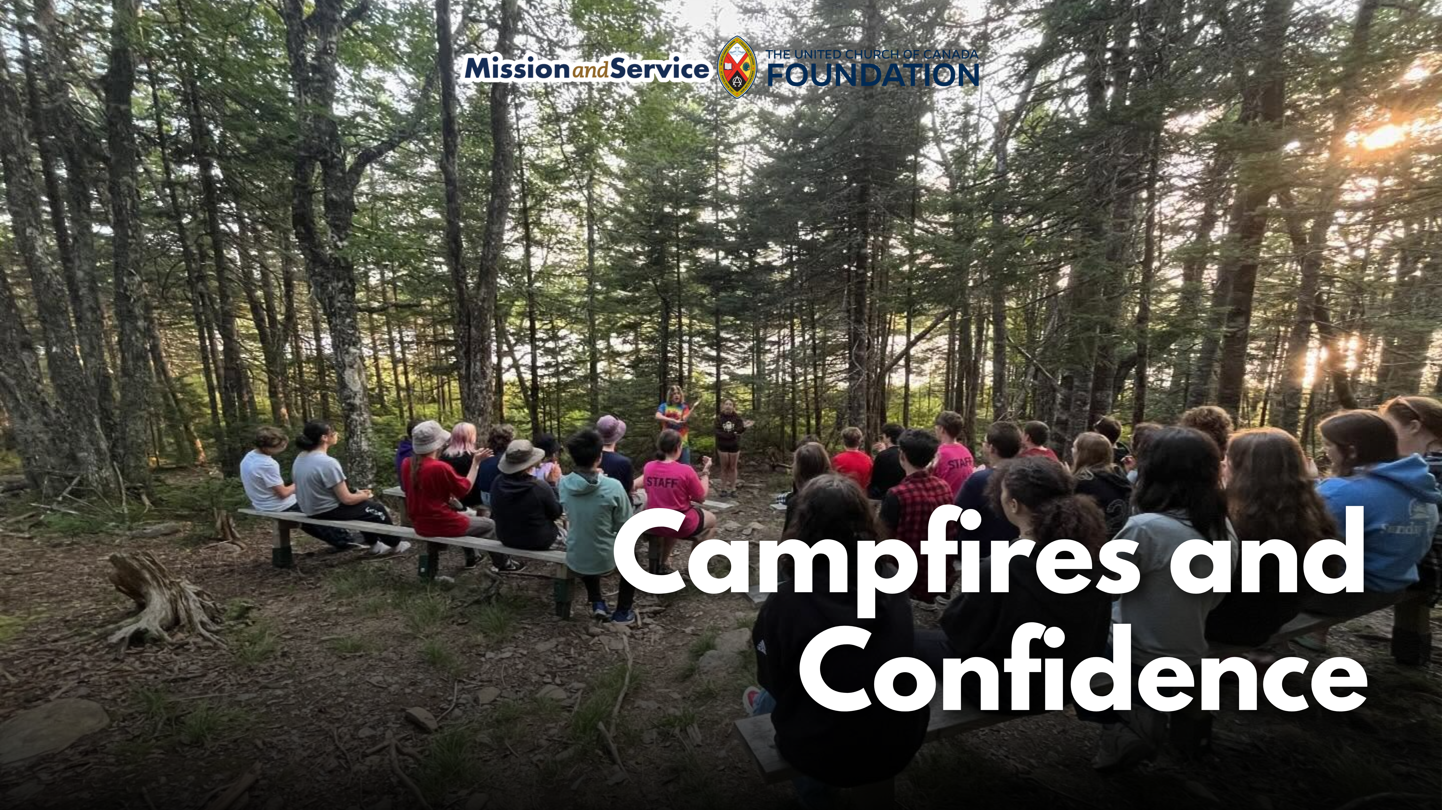

Slide 2
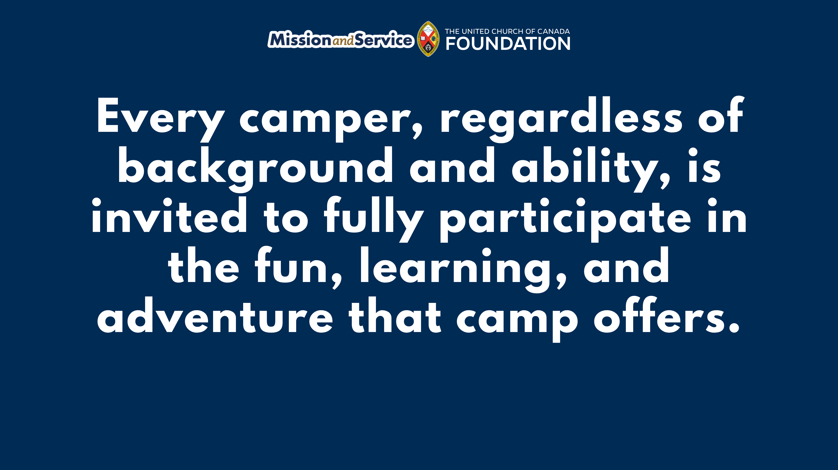
Notes:
For 60 years, Arthur Kidston Memorial Camp has been a place where children and youth can unplug from screens, connect with nature, and discover new strengths in themselves. In 2026, the camp is celebrating six decades of outdoor adventure, friendship, and belonging on the shores of Long Lake in Nova Scotia.
At Camp Kidston, children and youth spend their days canoeing and kayaking, trying slack lines and bog-walking, exploring the outdoors, making crafts, and building confidence through games and leadership opportunities. Campers are encouraged to try new things, build friendships, and simply enjoy being kids.
Our gifts through Mission and Service help make these experiences possible by providing specialized recreational equipment and supplies that go beyond the basics. New life vests for paddling programs, updated sports equipment, and nature exploration kits help make camp safer, more engaging, and more accessible for every child.
These gifts are about more than equipment. They help children build confidence as they learn new skills and discover what they are capable of. They help ensure that every camper, regardless of background, can fully participate in the fun, learning, and adventure that camp offers. And they help create memories that young people carry with them long after summer ends.
Even during the challenges of the summer of 2025, including extreme heat and a region-wide fire ban, Camp Kidston was filled with joy and creativity. Campers enjoyed waterfront adventures, theme days, team-building activities, and imaginative campfire alternatives created by staff. Leadership programs for teens continued to grow, and families spoke about the sense of belonging their children experienced at camp.
As Camp Kidston celebrates its 60th anniversary, our gifts through Mission and Service are helping ensure that children and youth can continue to experience the wonder, friendship, and confidence-building that camp makes possible for years to come.

