Slide 1
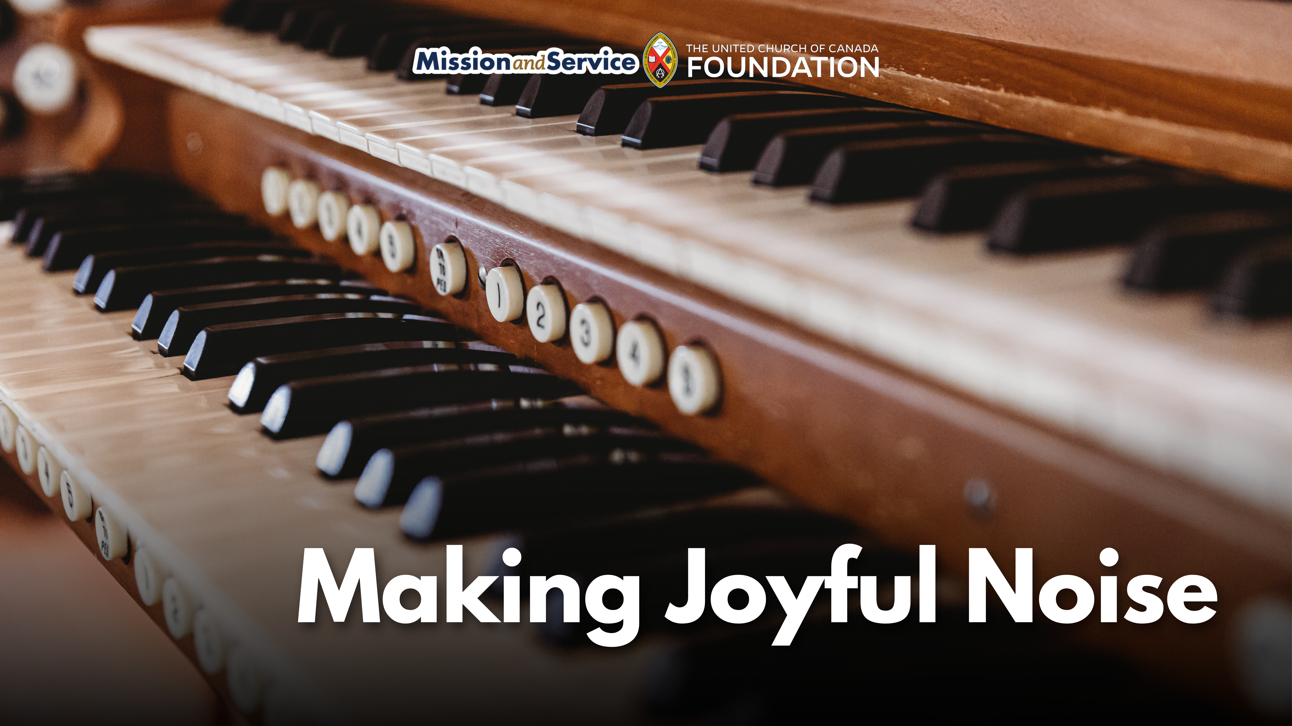
Notes:
Throughout scripture, music is part of how people express joy, hope, grief, and praise. From the Psalms to songs of celebration and courage, music has long helped people connect with God, one another, and themselves.
At First-St. Andrew’s United Church in London, Ontario, two music programs, the “Treblemakers” and “Reverberations” programs, help children and youth discover that same gift today.
For many young people, music is more than something to listen to. It can build confidence, reduce stress, strengthen learning skills, and create a sense of belonging. But as the cost of living continues to rise, many families are finding it harder to afford opportunities like music lessons, instruments, or arts programs for their children.
First-St. Andrew’s music programs help to ensure young people do not miss out.
Open to children and youth aged 3 to 17, the weekly programs offer a welcoming space where participants can explore music, creativity, and community together for a low fee. Each gathering begins with a shared meal, providing nourishment before children move into activities like singing, handbells, chimes, and drama.
The impact goes far beyond learning notes or rhythms.
Programs like Treblemakers and Reverberations help young people develop confidence by trying new things and performing together. They encourage teamwork, creativity, and self-expression while offering a safe place and a reliable meal. Music also supports cognitive development, memory, focus, and emotional well-being—benefits that can shape a child’s growth.
For some families, programs like this may be among the few accessible extracurricular opportunities available to their children. By lowering financial barriers and creating an inclusive environment, First-St. Andrew’s aims to ensure every child has the chance to grow and shine.
In a world where many young people are carrying stress, isolation, or uncertainty, spaces of creativity and belonging matter deeply. Through music, meals, laughter, and shared experiences, children and youth are discovering not only new skills, but also confidence, friendship, and joy.
Through Mission and Service, we support communities and ministries that nurture young people in body, mind, and spirit. Together, we are helping create spaces where children and youth can discover their gifts, build confidence, and know they belong. Make your gift to Mission and Service today.

Slide 2
