Slide 1
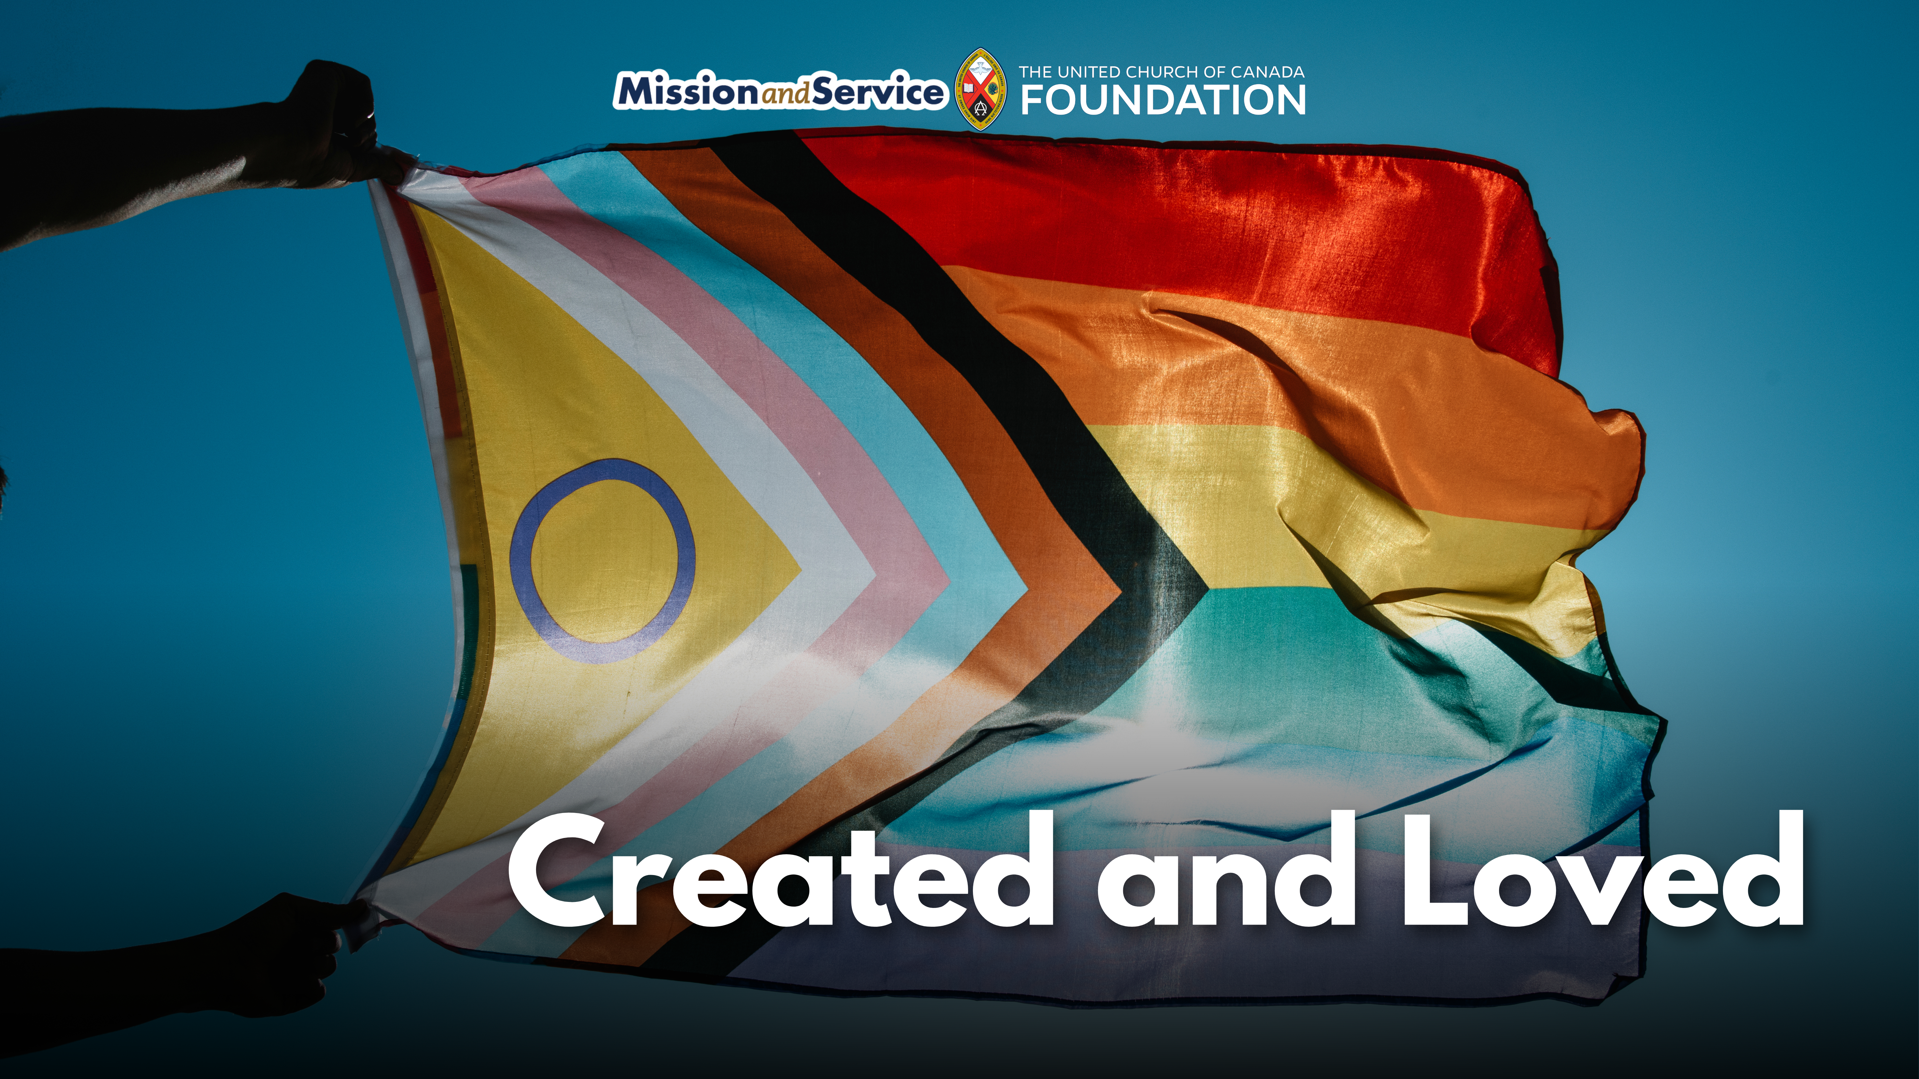

Slide 2
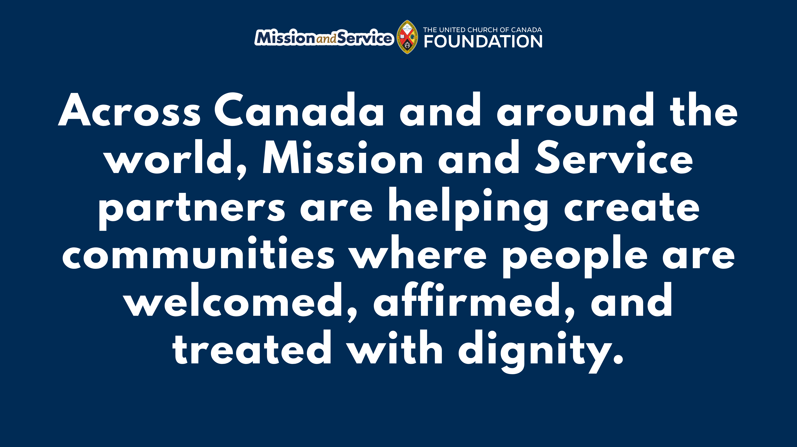
Notes:
Across Canada and around the world, Mission and Service partners are helping create communities where people are welcomed, affirmed, and treated with dignity. Sometimes that work is visible through advocacy, public education, or community programming. Other times, especially in places where speaking openly about 2S and LGBTQIA+ inclusion can put people at risk, it happens more quietly—through safe spaces, trusted relationships, and acts of accompaniment.
At the heart of this work is a simple but powerful truth: every person is created in God’s image and loved fully by God. That love is not conditional. It is not limited by identity, orientation, or circumstance. Through acts of compassion, protection, and welcome, Mission and Service partners reflect that love in tangible ways.
This work can take many forms. It may look like creating a community meal where everyone is welcomed without question. It may mean ensuring a young person has supportive adults around them. It may mean offering spaces where people can gather safely, share their stories, or simply exist without fear.
Sometimes it means walking alongside someone who has fled their home country because their safety was threatened due to their sexual orientation or gender identity. In a new community, through the care and support of others, they may begin to experience something many of us take for granted: the freedom to live openly, safely, and fully as themselves. That kind of welcome is life-changing.
“One of our partners in Kenya has advocated strongly for the human rights of sexual minorities, and that has caused him to be in jail, caused him to risk his life to be able to do that,” says Rev. Michael Blair. The United Church’s first openly gay General Secretary is now helping to advocate for sexual and gender minorities in other countries.
“When we hear these stories, we can see that this is a life and death matter,” he says.
We know the journey toward safety, affirmation, and justice is not complete, in Canada or around the world. Many 2S and LGBTQIA+ people still face discrimination, isolation, and violence. The work of building truly welcoming communities is ongoing.
In the face of these realities, acts of care create room for healing and hope. They witness to a faith rooted in justice, compassion, and God’s expansive love for all people. They remind people they are not alone and that they are worthy of safety, belonging, and joy.
Through Mission and Service, our gifts help support the ongoing work in Canada and around the world. Together, we are helping nurture communities where people can experience belonging and the reminder that they are cherished by God exactly as they are.
We give thanks for the many communities and partners who continue this work of affirmation, compassion, and inclusion every day of the year. Make a gift to Mission and Service today. Together, let’s help share a message the world deeply needs: there is room for everyone in God’s beloved community.

