Slide 1
2025 Strategic Plan Report

Slide 2






The General Council Office’s Strategic Plan is helping the church realize our Vision, working closely with regional councils across the country. This is the third and final year for our annual Strategic Plan Report, which aligns with the budget. We are continuously refining our efforts to meet our strategic objectives.
Embolden Justice
Collaborating to Mend Church and World
Deepen Climate Integrity
Living Climate Commitments
Invigorate Leadership
Adapting and Innovating for Bold Discipleship
Strengthen Invitation (Growth)
Humility and Confidence in Sharing Faith
Nurture the Common Good
Equity and Sustainability in Resources
Journeying Indigenous Pathways
Forging Right Relations

Slide 3
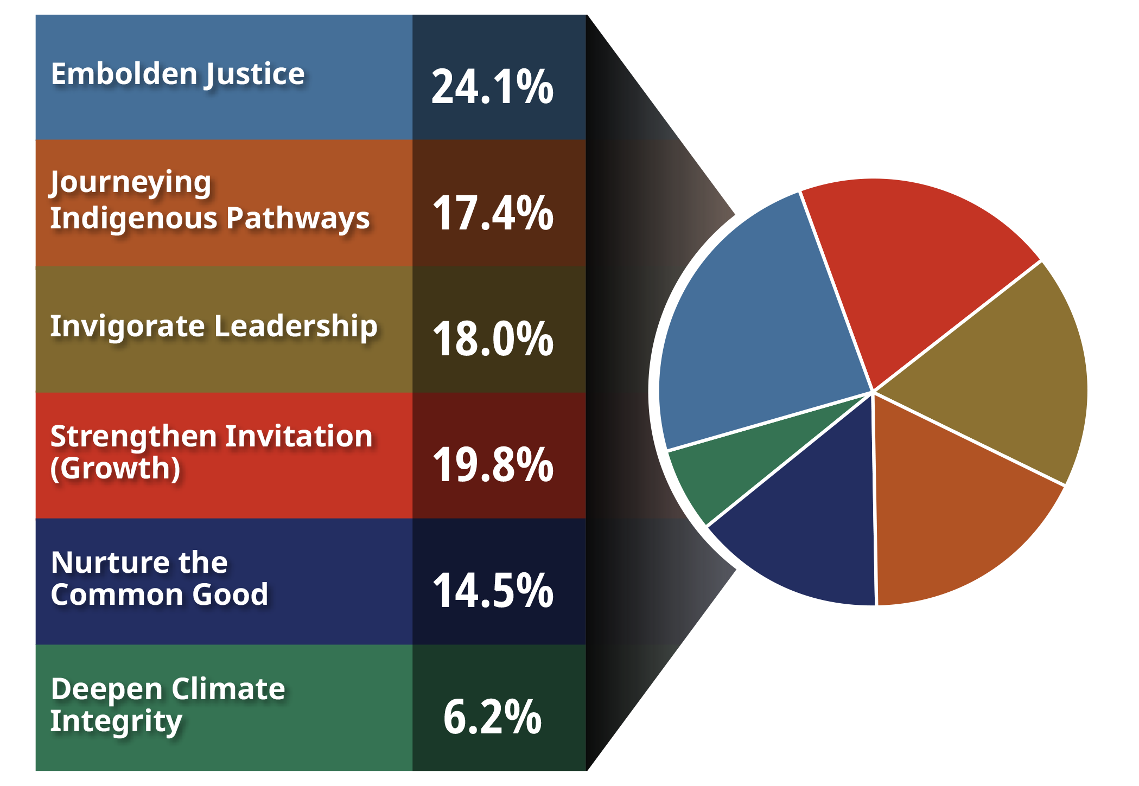
Financials Operating Budget PLUS Fund Centre Activities
In 2025, the General Council of the United Church dedicated resources (salaries, grants, programs, etc.) from the operating budget to the six areas of the Strategic Plan.
In addition, particular areas were supplemented by specialized reserve funds, or fund centres.

Slide 4
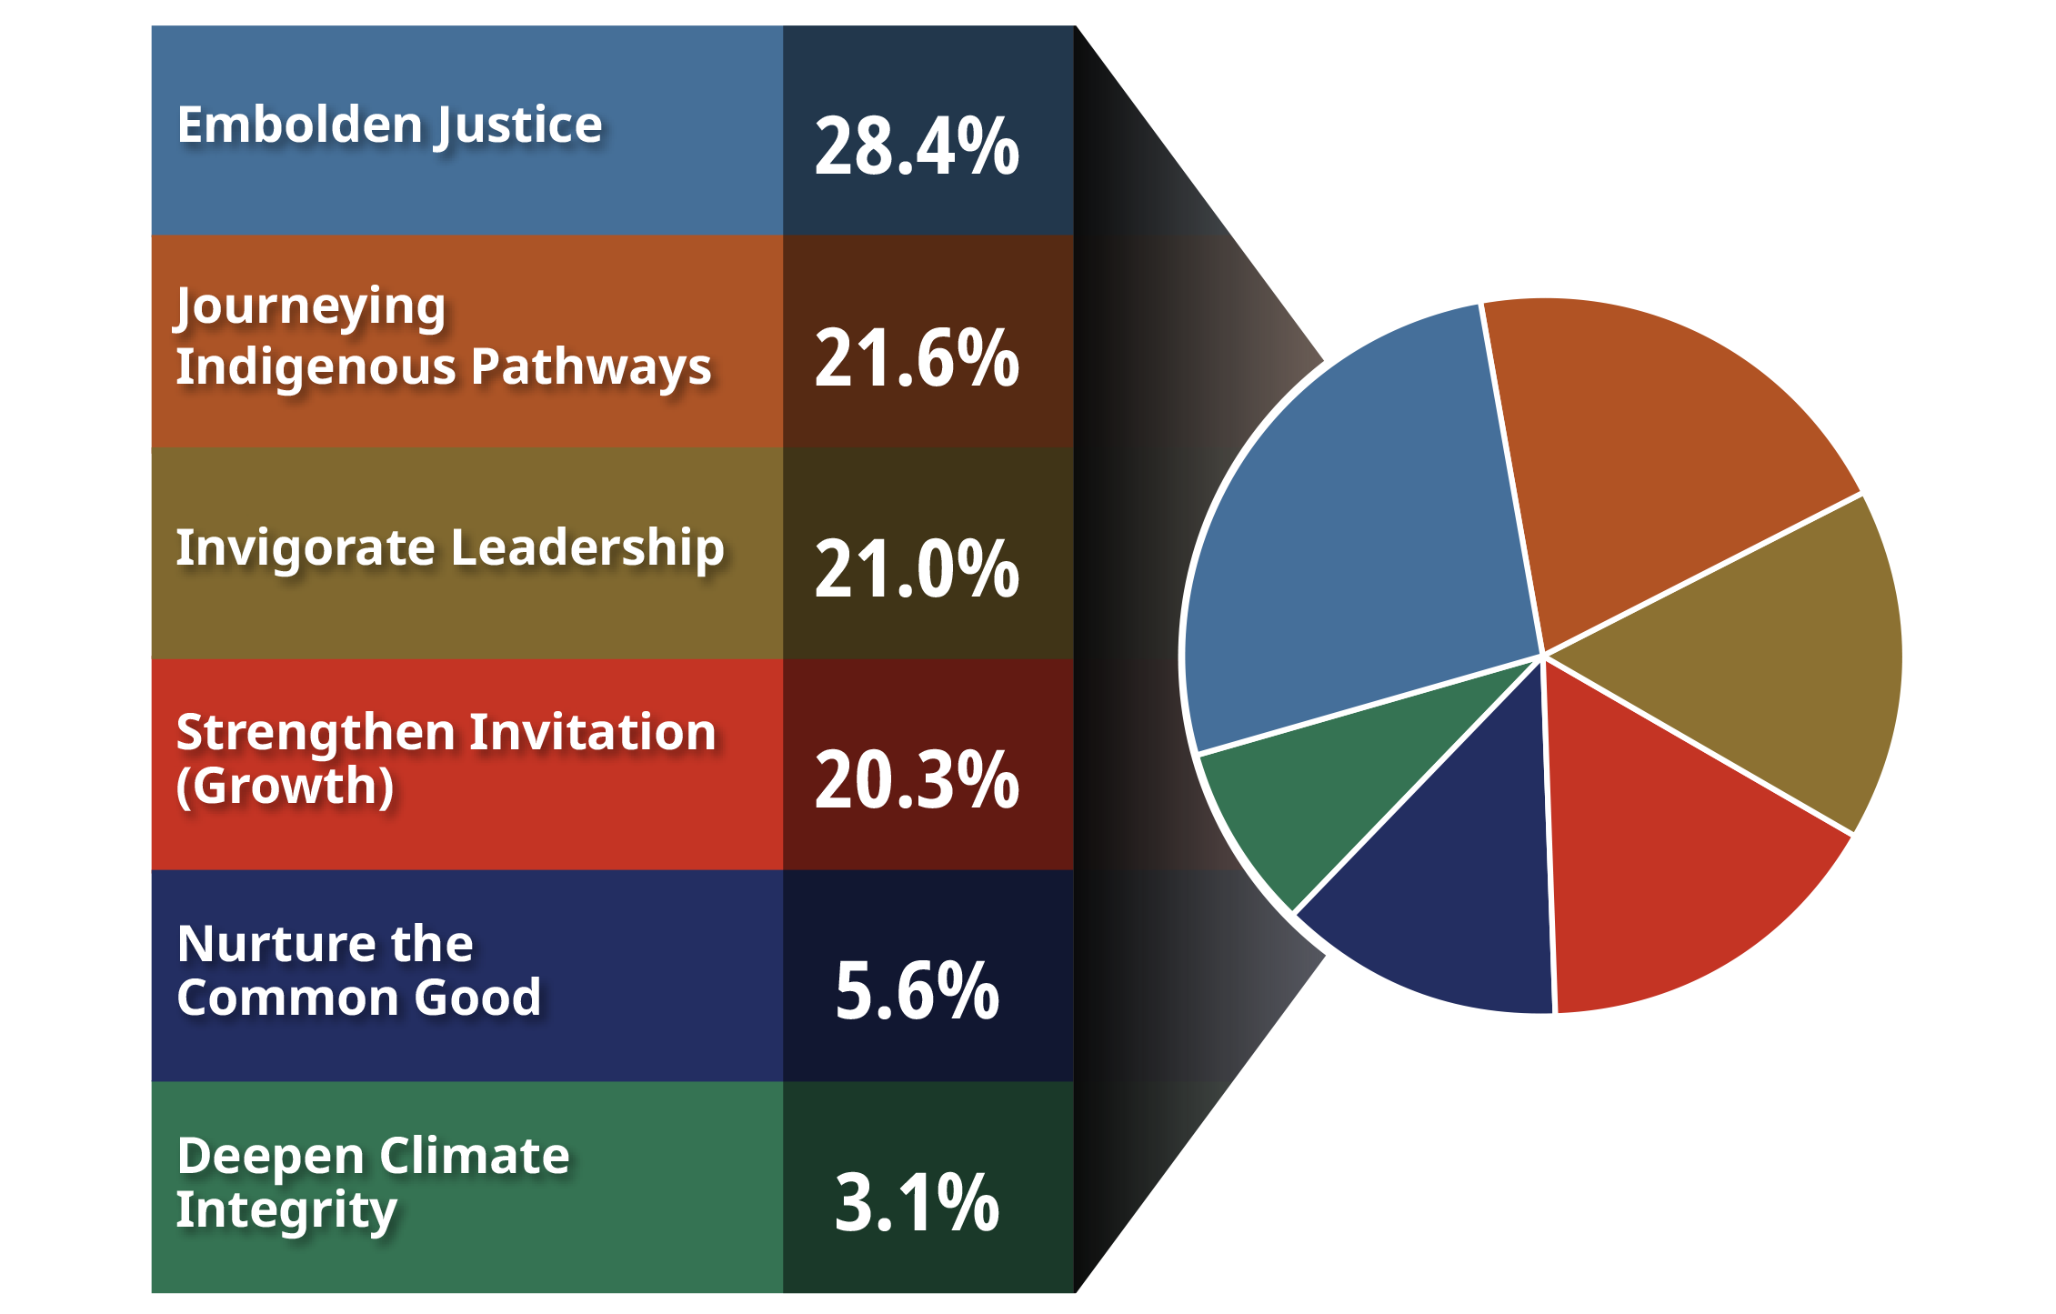
Financials Operating Budget only
In 2025, the General Council of the United Church dedicated resources (salaries, grants, programs, etc.) from the operating budget to the six areas of the Strategic Plan.

Slide 5
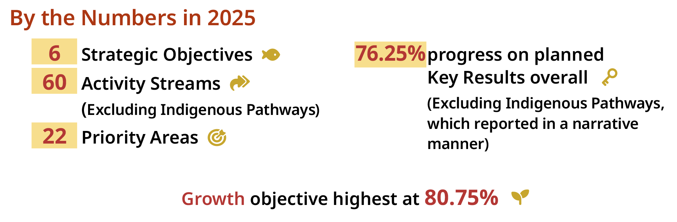
By the Numbers in 2025

Slide 6
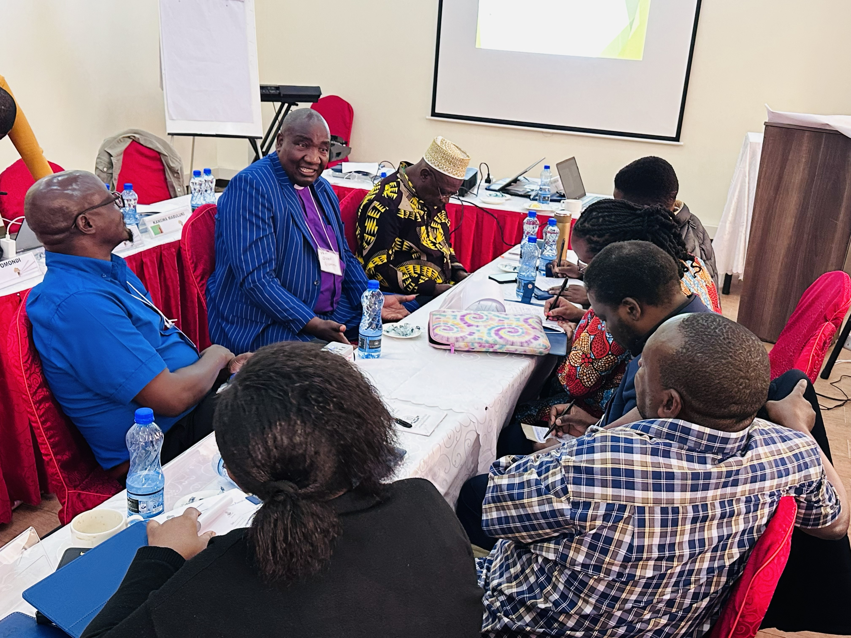
Embolden Justice Collaborating to Mend Church and World
East African “Faith Beyond Borders” interfaith workshop participants in Nairobi, Kenya
Credit: Jane Thirikwa

Slide 7
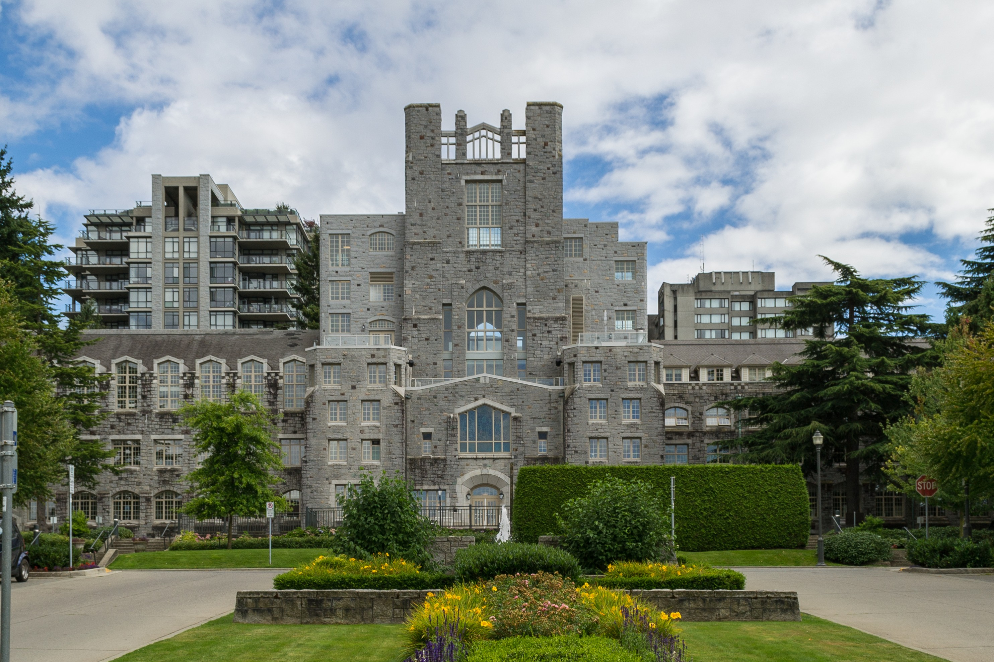
Invigorate Leadership Adapting and Innovating for Bold Discipleship
Vancouver School of Theology
Credit: Wikimedia/Xicotencatl

Slide 8
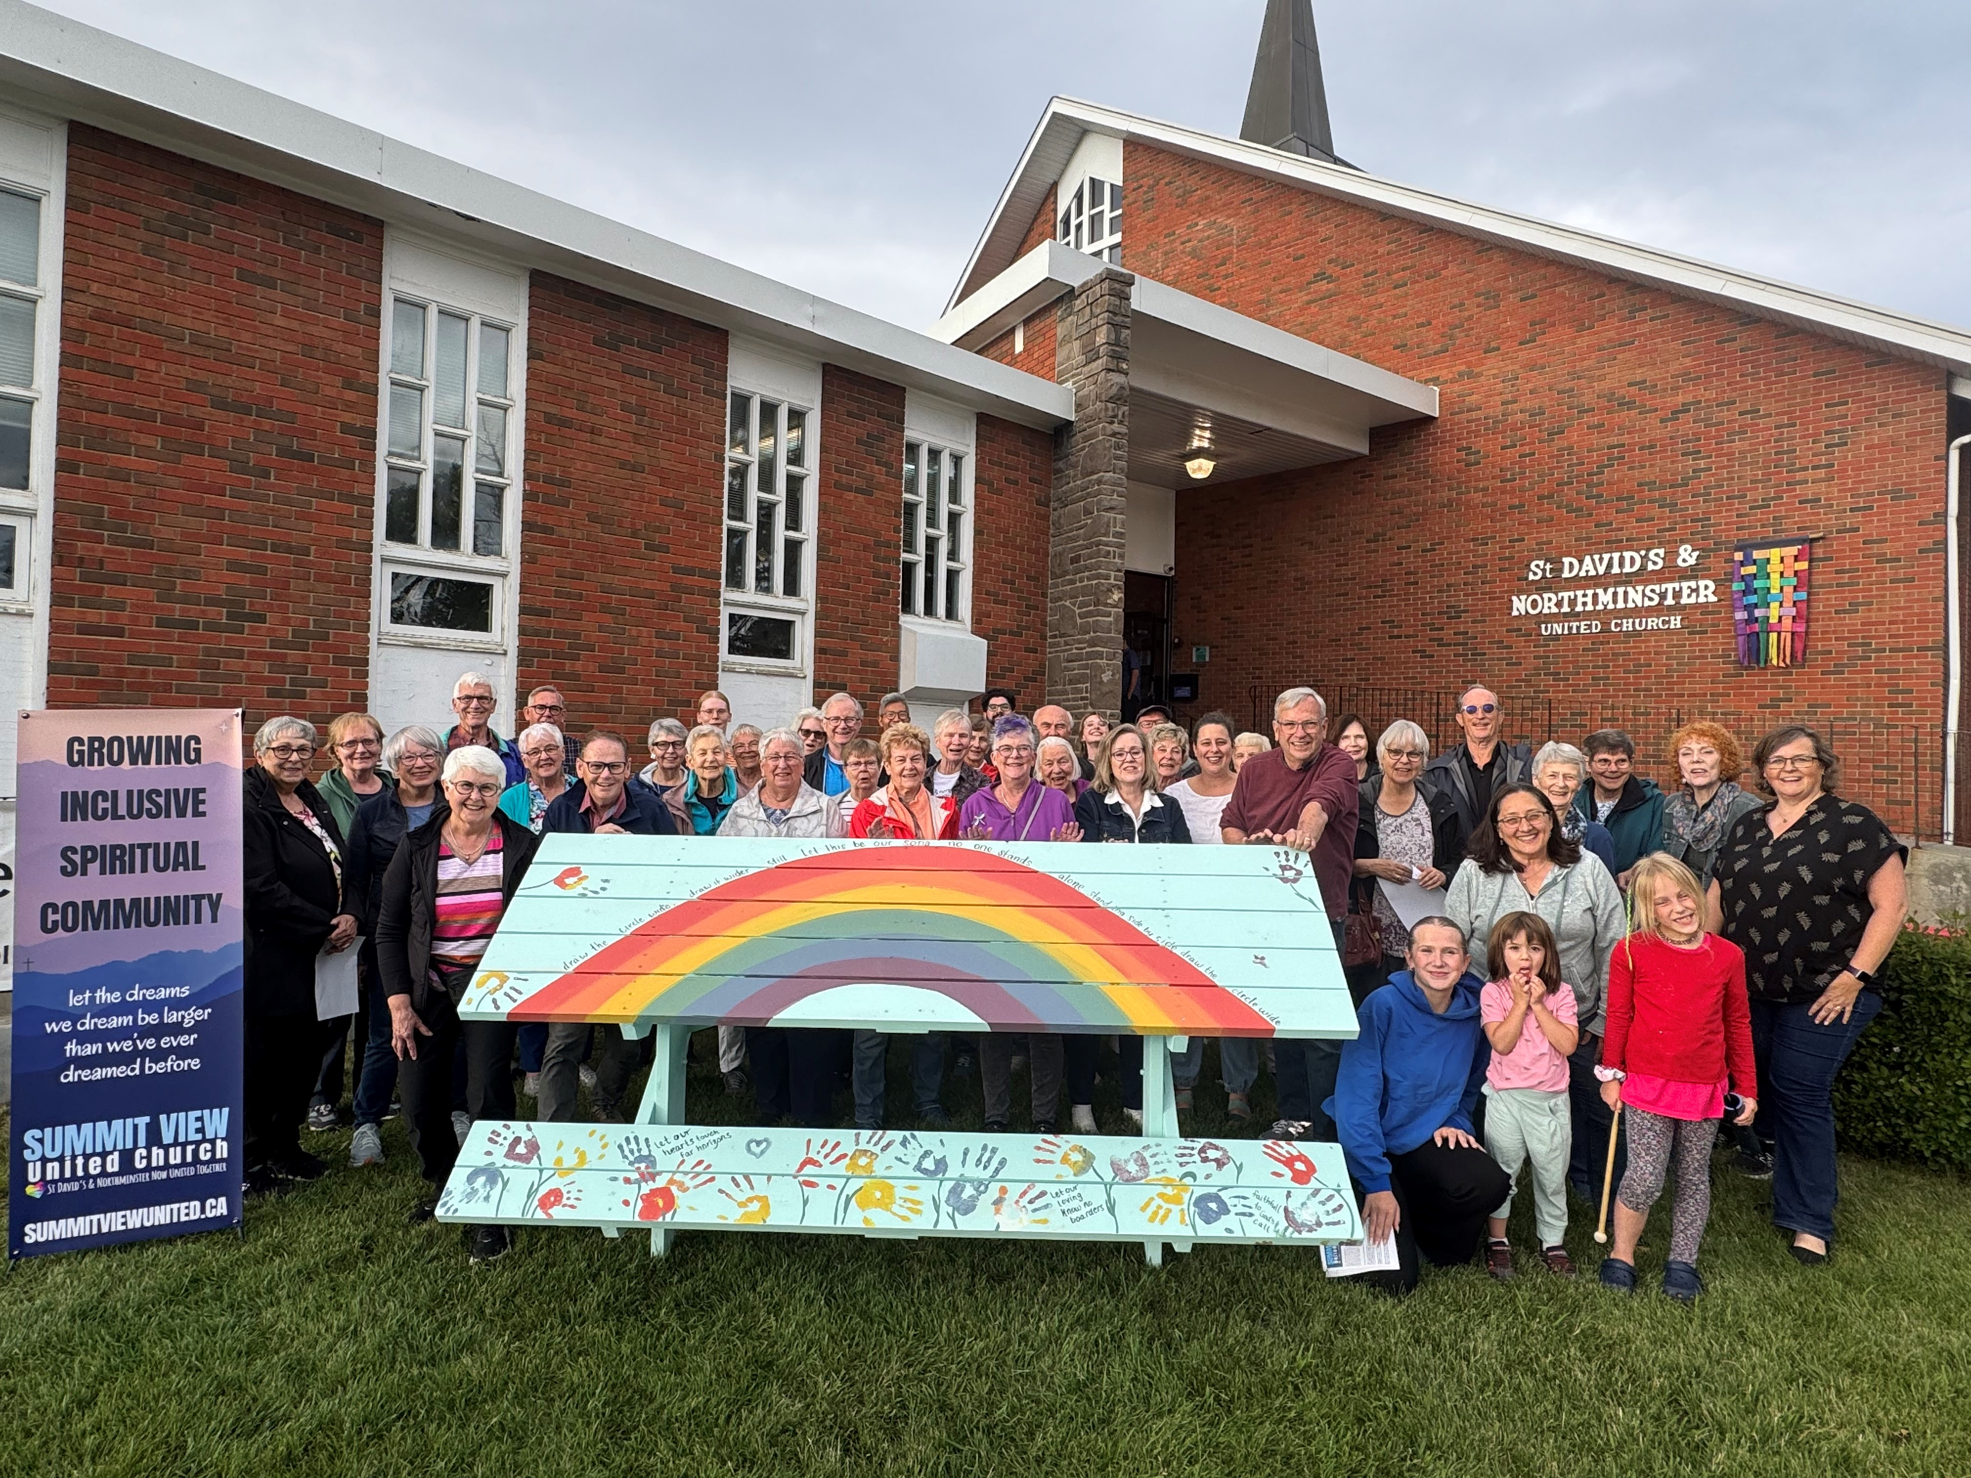
Strengthen Invitation (Growth) Humility and Confidence in Sharing Faith
100 Tables at Summit View United Church (formerly St. David’s and Northminster), Calgary, Alberta
Credit: Summit View United Church

Slide 9
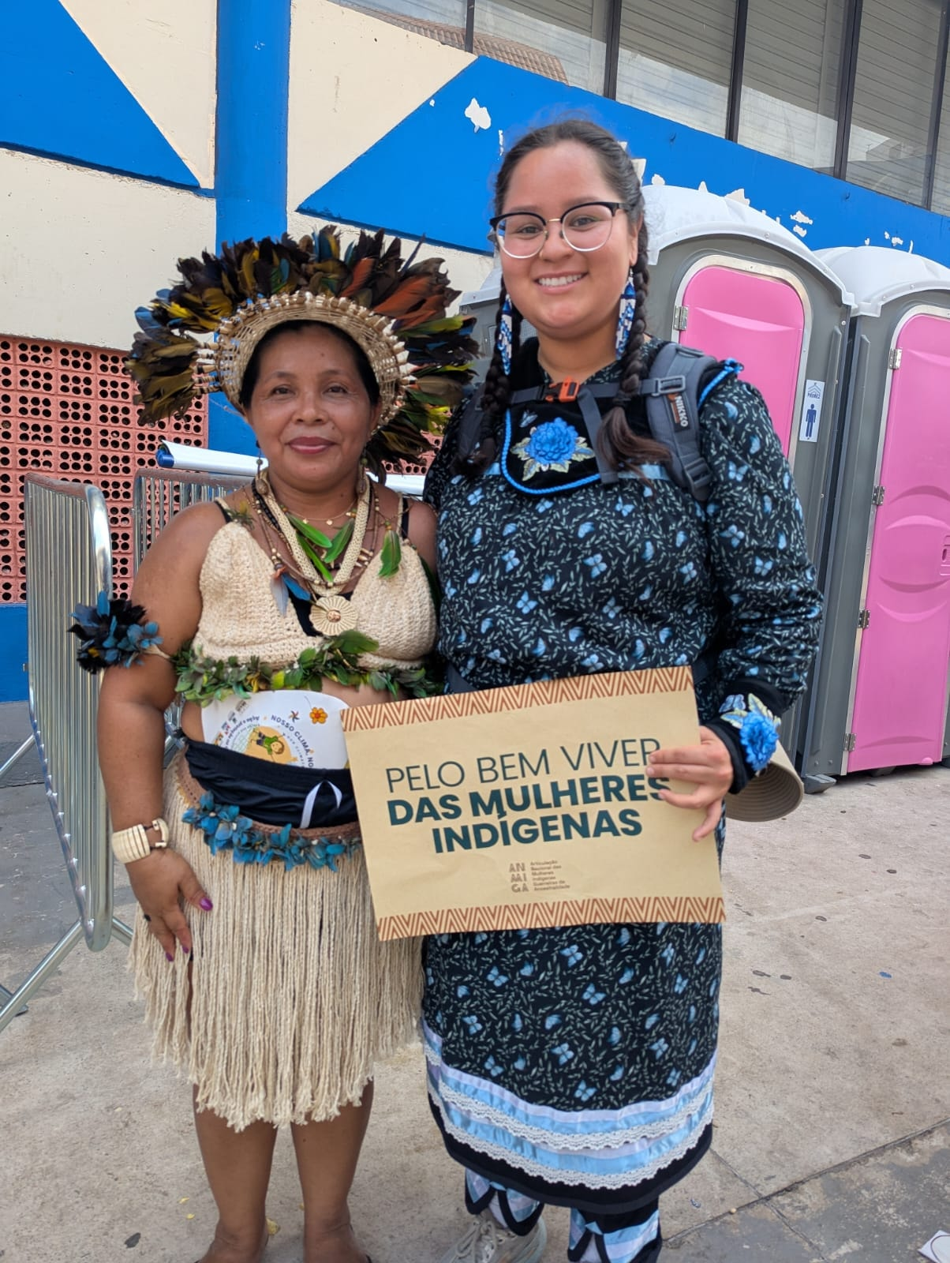
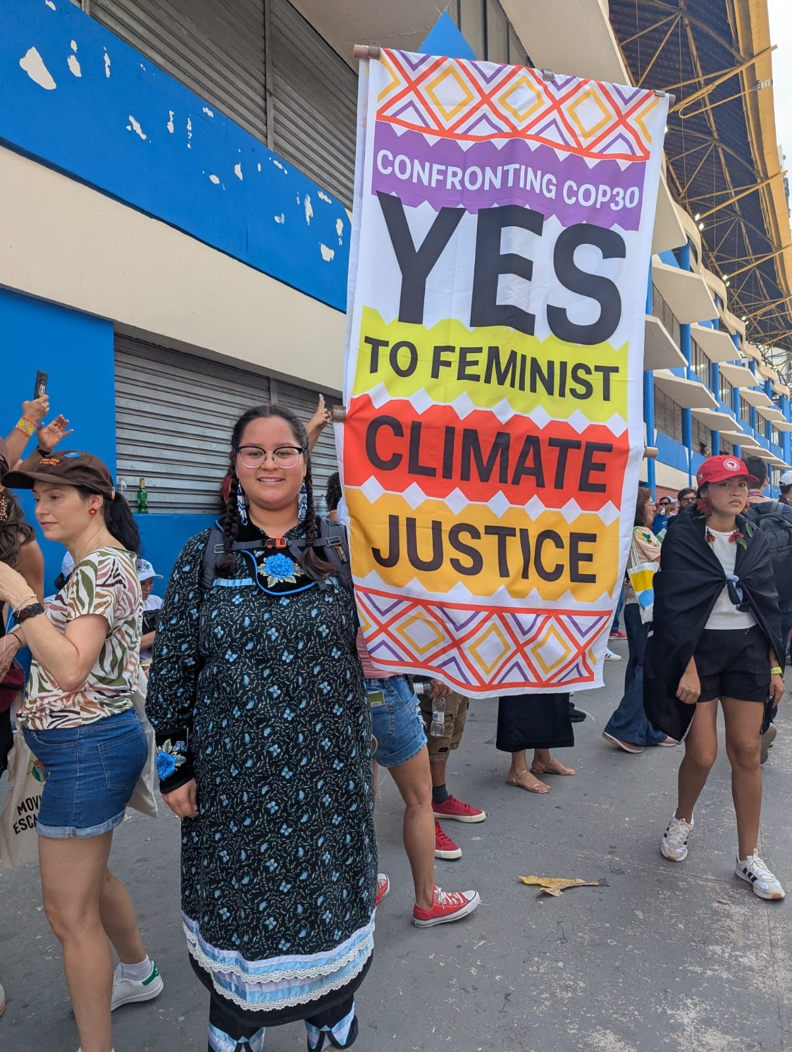
Journeying Indigenous Pathways Forging Right Relations
Samantha Miller at a demonstration at COP30 in Belém, Brazil
Credit: Samantha Miller

Slide 10

Youth Action Across the Strategic Plan
Youth participants at General Council 45, held in Calgary, Alberta in August 2025

Slide 11
Learn more about the Strategic Plan by searching “Our Call and Vision” on united-church.ca and selecting the link for each strategic objective.
See the full 2025 Strategic Plan Report by following this QR code or visit united-church.ca/call-vision

