Slide 1
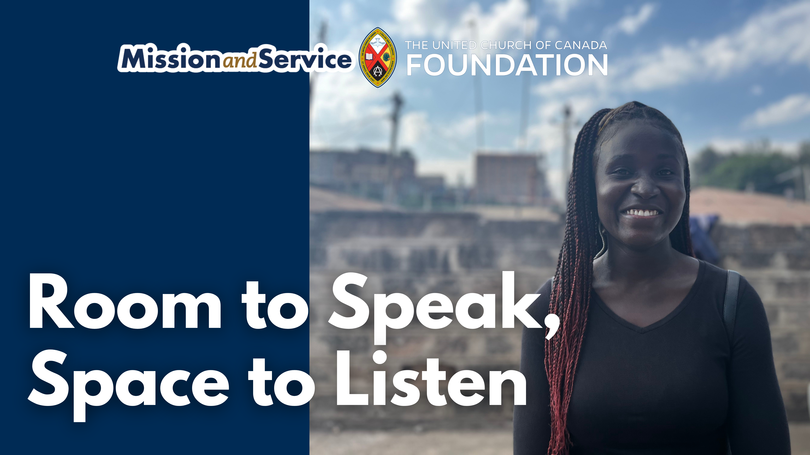

Slide 2
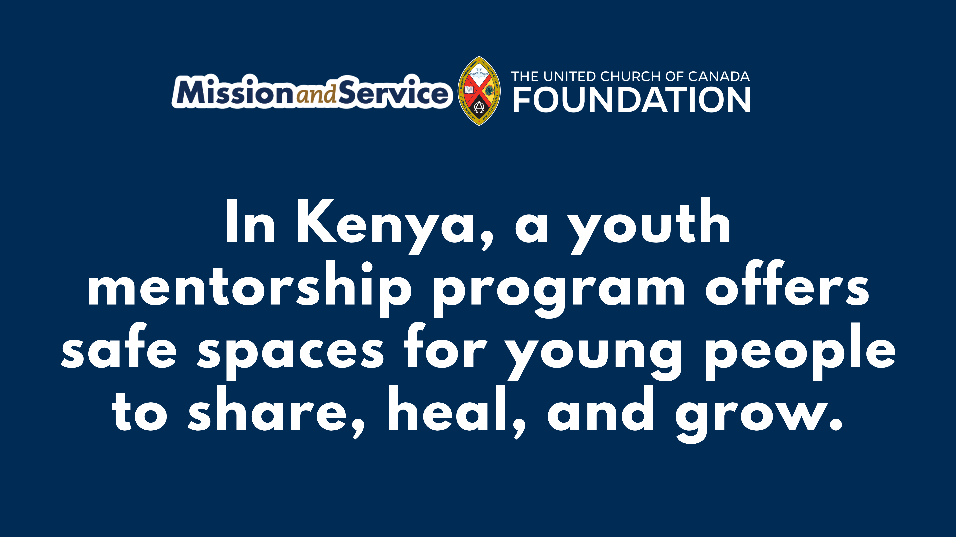
Notes:
On Wednesday afternoons, a group of young people come together to do something simple and powerful. They talk. These gatherings are part of a mentorship and mental health program through the National Council of Churches of Kenya (NCCK). For many of the youth who take part, it's one of the few places where they feel safe enough to share what they're thinking and experiencing.
Christine now leads these conversations as a mentor, but her journey to this moment began in a similar circle, as someone seeking support herself.
In Kenya, young people are expected to grow up fast. By age 15, they may be seen as old enough to handle life on their own. But the reality is hard – youth may not get the encouragement or support they need. Some may leave school early, often because of teen pregnancy, the need to work, or lack of access to education in general. And showing emotion – crying, opening up – can be seen as weakness.
Christine knows this reality firsthand. When struggles go unspoken, young people can feel completely alone. Youth suicide is a real and painful reality. She once carried burdens in silence, feeling the weight of expectations without a safe space to share what she was experiencing.
Then she found the NCCK mentorship program.
In those Wednesday gatherings, Christine discovered something she had been missing: a place where she could speak freely, where her thoughts and feelings mattered. "Mental health means feeling safe enough to express your thoughts and feelings," she now explains with the clarity of someone who has lived it. "Talking it out is the best way out."
The support she received didn't just help her survive – it transformed her. "It's been one of my dreams to be there for someone," she shares. That dream became her reality.
Today, Christine mentors 40 young people through the UCC youth mentorship program. She brings to each session the understanding of someone who has sat in their seats, who knows what it means to need someone to listen. As a mother, she practices intentional parenting – encouraging confidence, conversation, and honesty with her own daughter. She's become the person she once needed.
Her advice to the young people she mentors comes from experience: "Embrace the support if you have someone."
Christine envisions building a community of young people who can support one another, breaking the cycles of silence that too often lead to isolation and despair. Through her journey from mentee to mentor, she's proving that healing isn't just personal – it multiplies.
Through Mission and Service partner the National Council of Churches of Kenya, Christine and her community are creating spaces for young people to be heard and reminding them that they matter.
When we support Mission and Service, we are helping make spaces like this possible – places where listening leads to hope, and where young people don't have to face everything alone.
Let’s be the community that shows up. By giving to Mission and Service, we stand with young people in Kenya and around the world, helping ensure that safe circles continue, mentors are trained, and hope keeps multiplying.

