Slide 1
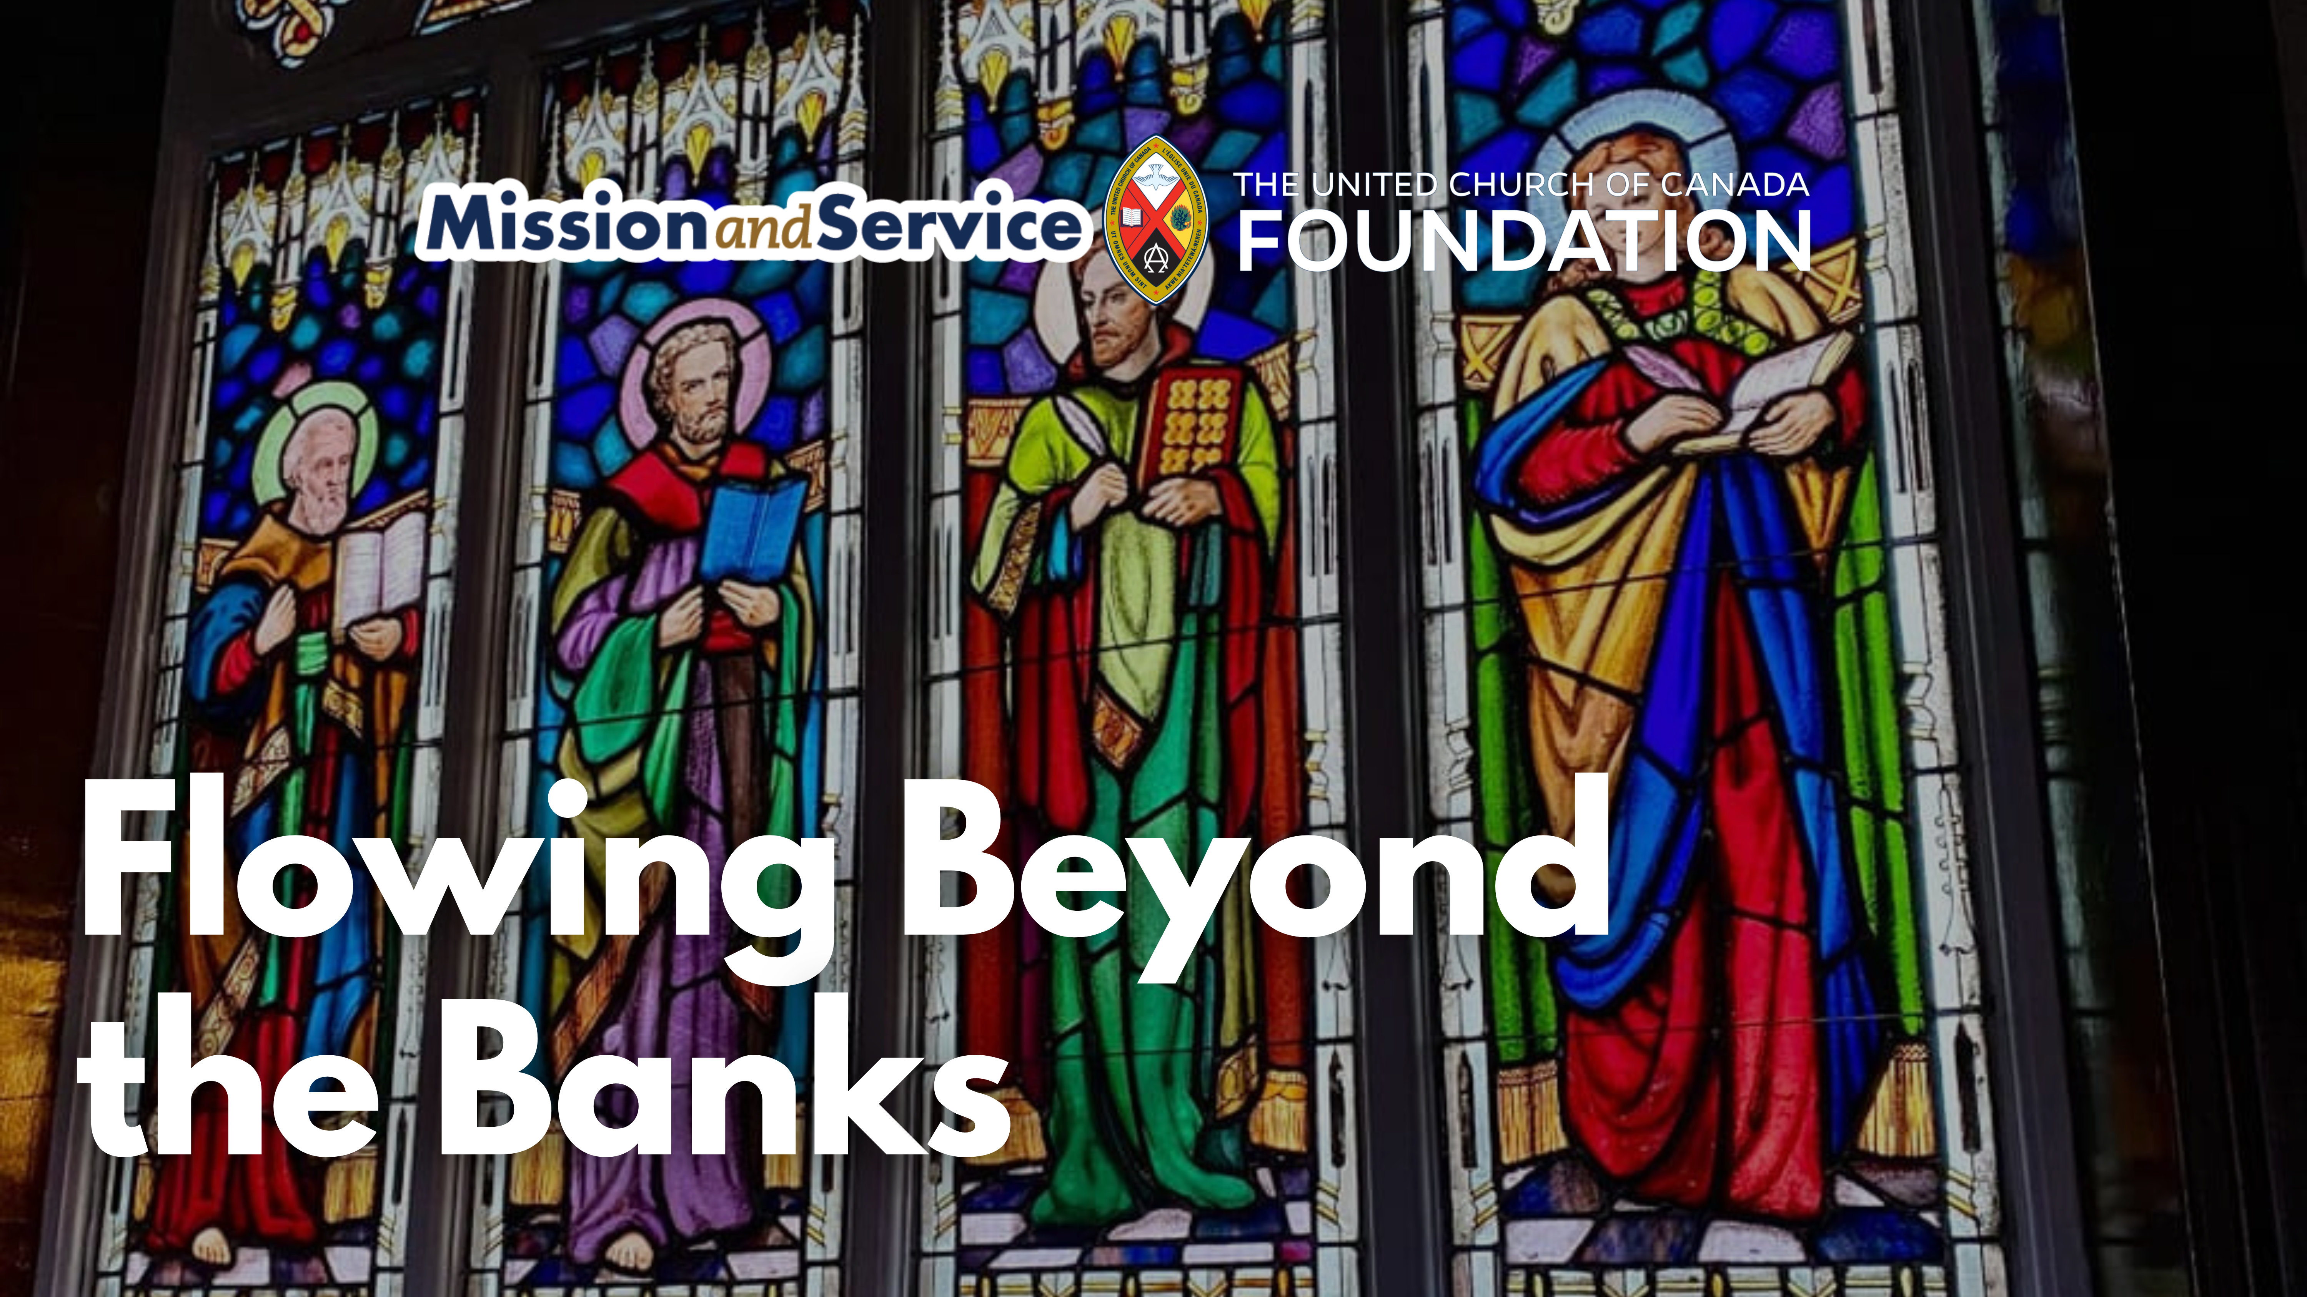

Slide 2
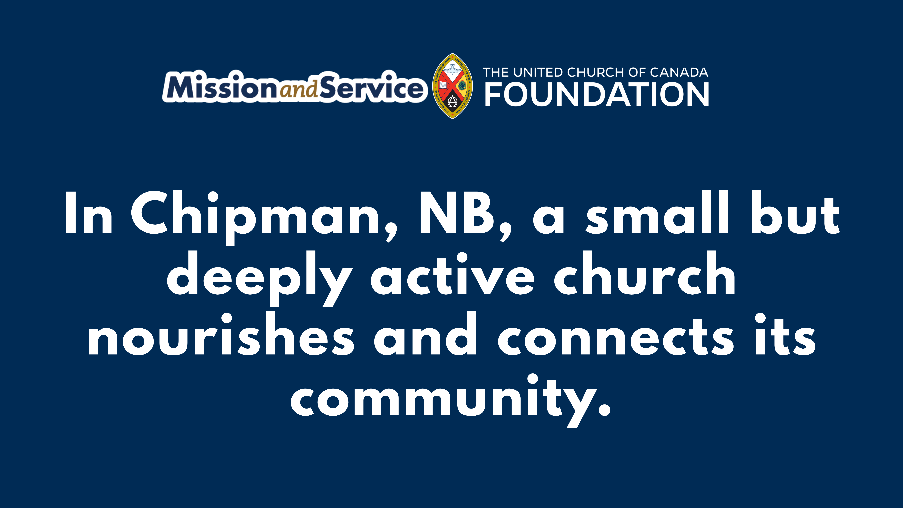
Notes:
In Chipman, New Brunswick, along the Salmon River, community isn’t just an idea – it’s how life flows. For over 126 years, Chipman United Church has been woven into the heart of the town.
The congregation is small – mostly seniors with a handful of youth, four of whom now help lead worship – and the choir is modest. But the impact is anything but small. Each month, about sixty meals are prepared and delivered through the LIFT program, feeding children, seniors, and neighbours who can’t leave home. The church hall hosts community groups and sports programs, and members pour hot chocolate at the Christmas parade. Service here isn’t occasional; it’s a habit.
When some members could no longer attend in person, the church brought worship online. What was expected to reach twenty people drew thousands. Prayer requests now arrive by email, and a painting of the sanctuary is being turned into cards to remind those who feel alone that they belong.
This is rural ministry: rooted, connected, and alive. Mission and Service helps sustain communities like Chipman, keeping churches at the centre of town life.
We can make a difference together. When we give to Mission and Service, we help ensure that churches like Chipman continue to feed, care for, and connect their communities. Donate today and be part of keeping this heart of the town alive.

