Slide 1
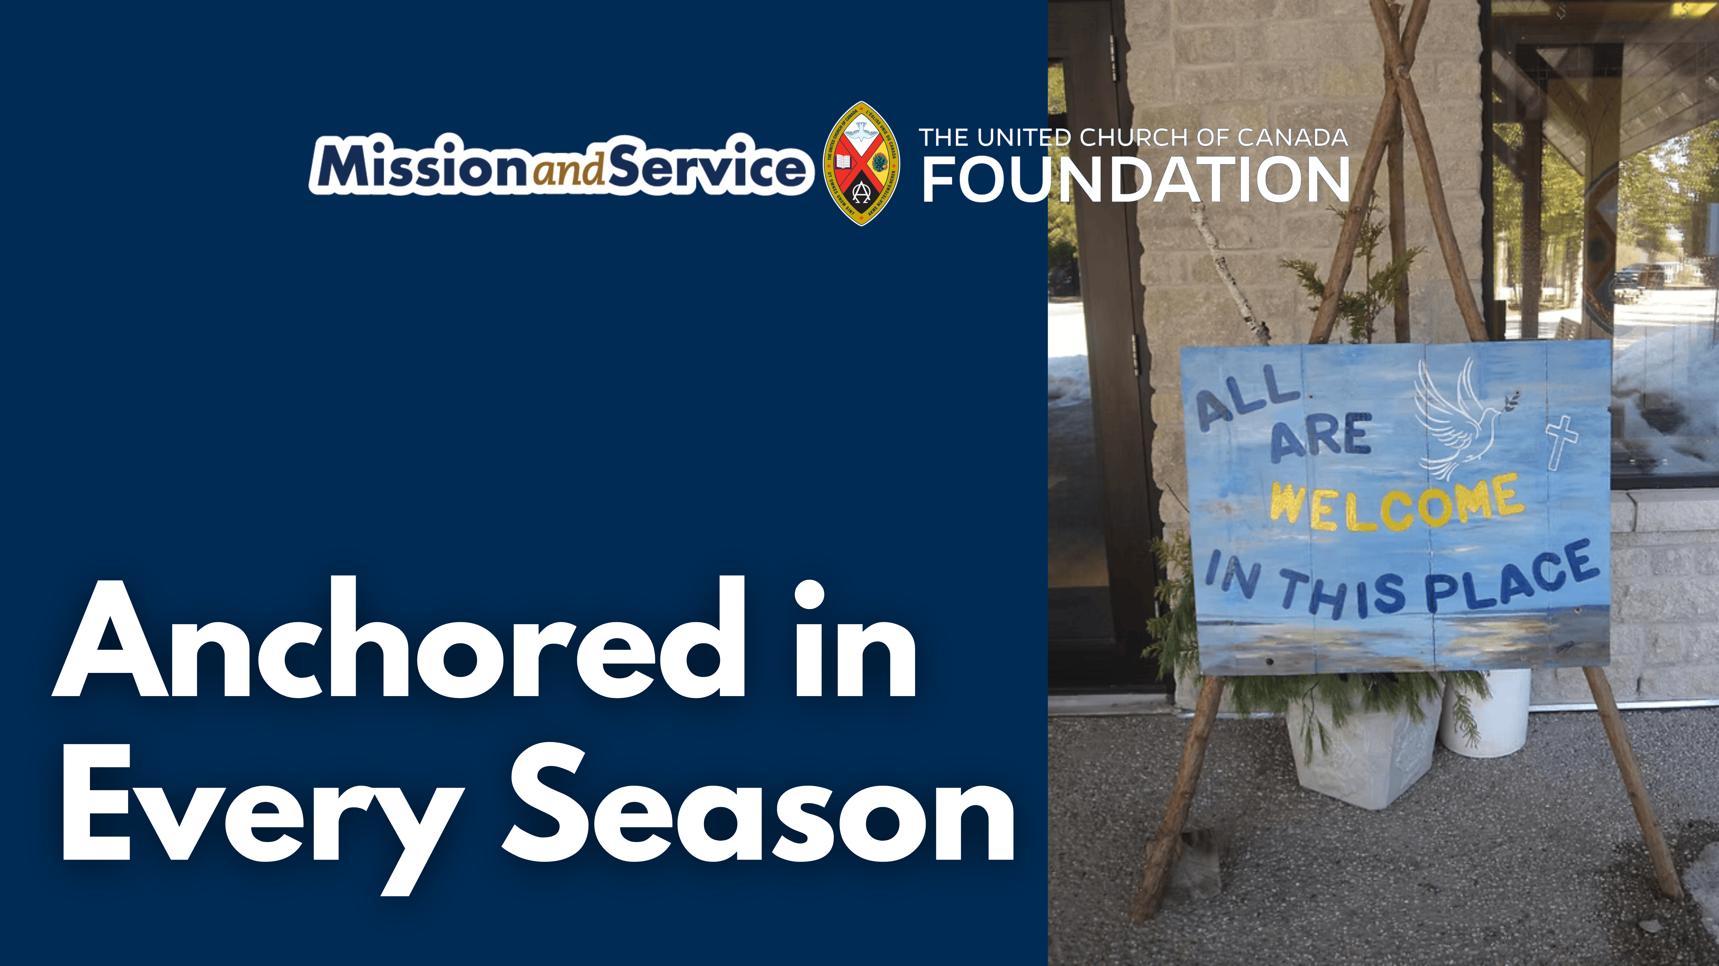

Slide 2
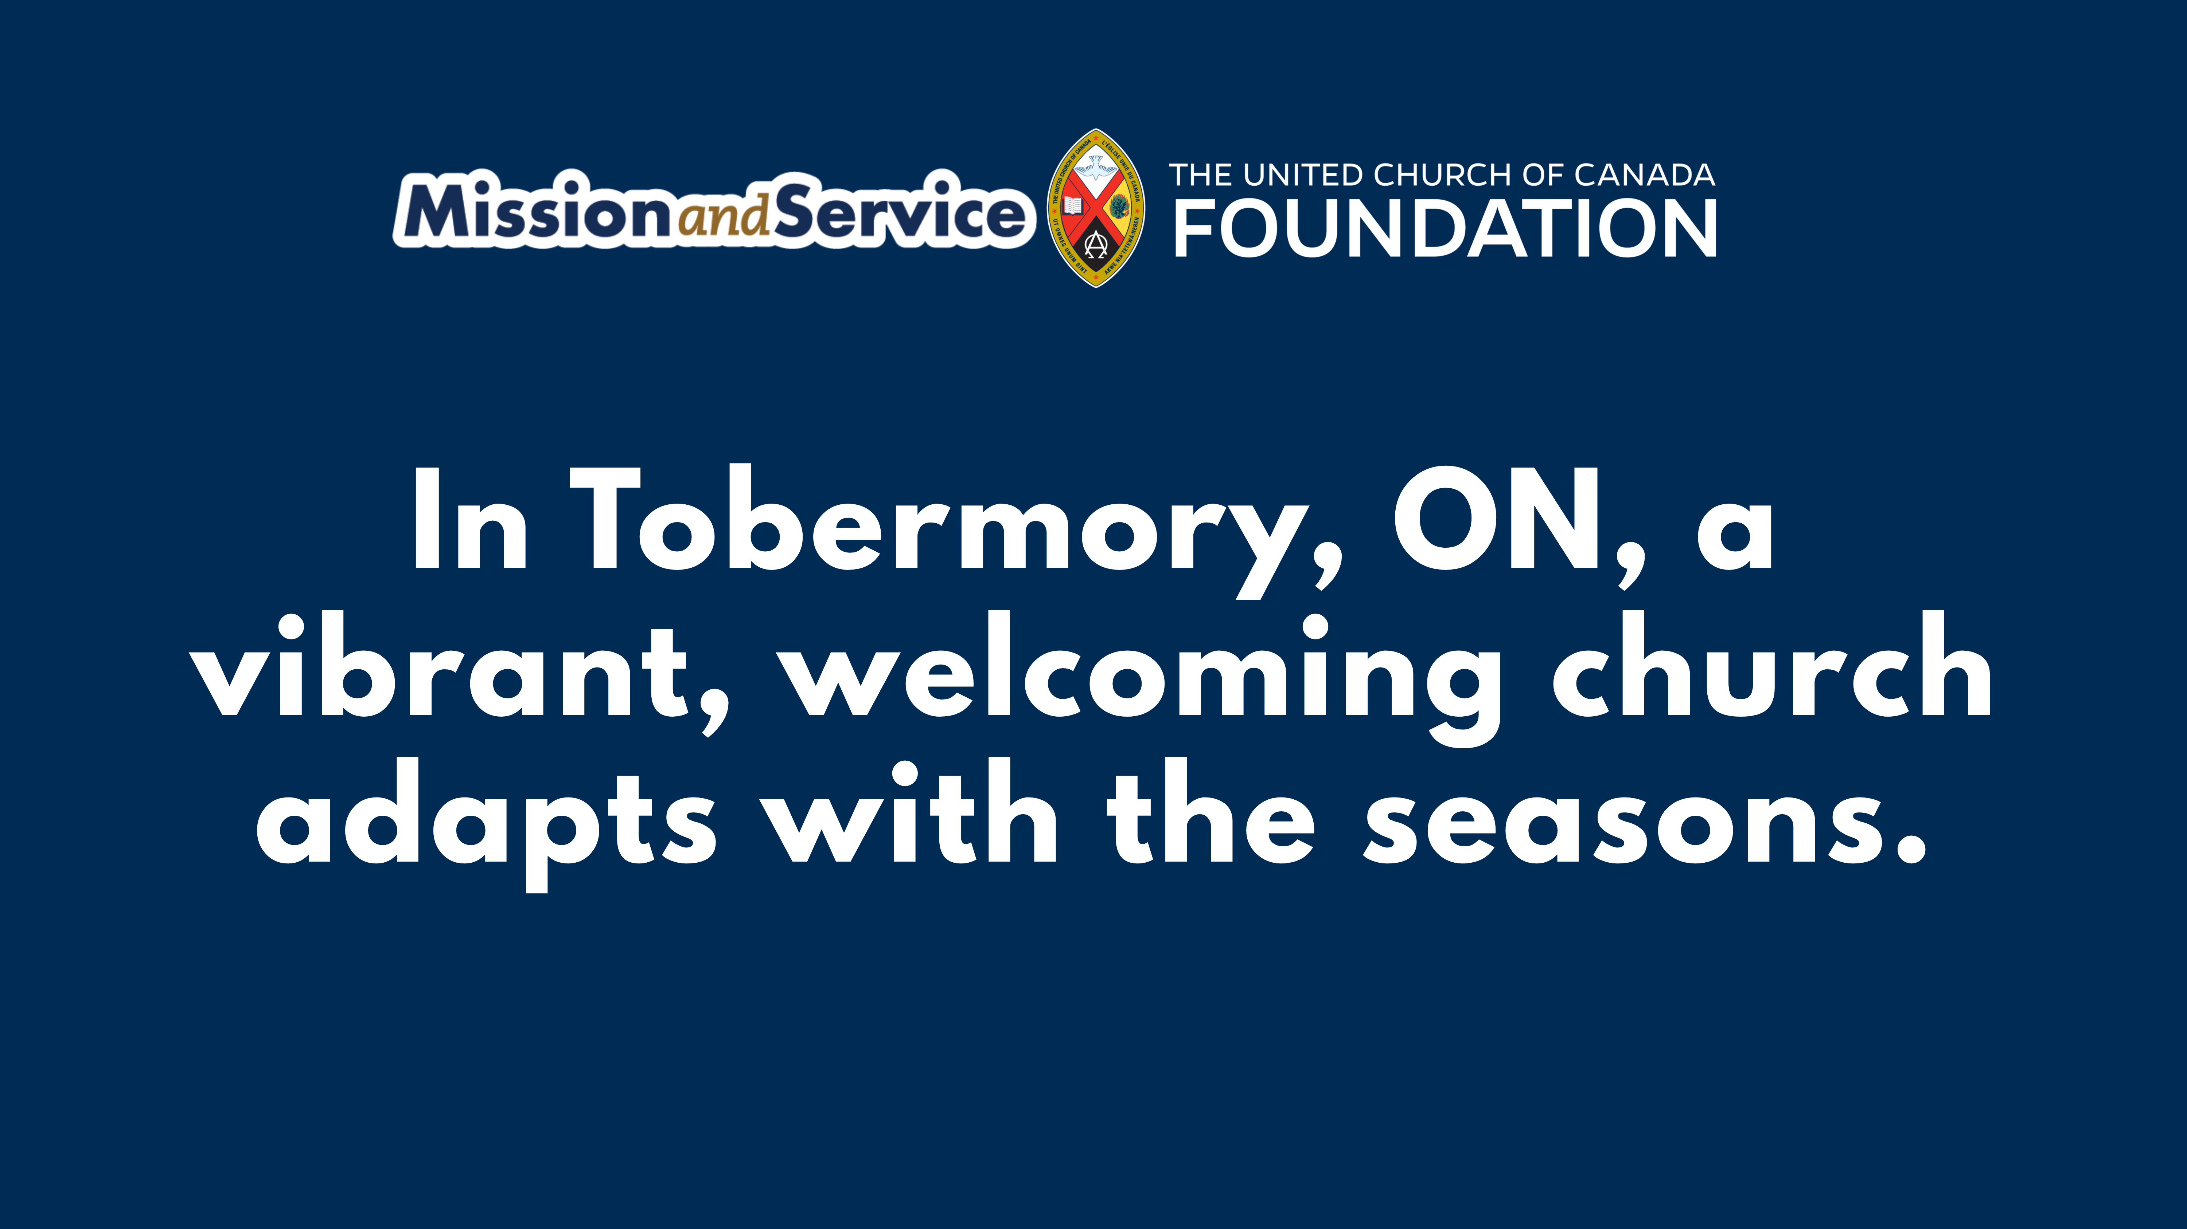
Notes:
In Tobermory, Ontario, the town pulses with the seasons. Summer brings busy roads, kayaks on the harbour, and lively streets. Winter brings quiet and long stretches of stillness. Through it all, Tobermory United Church remains a steady, welcoming presence at the northern edge of the Bruce Peninsula.
The building is more than a church. It hosts drumming circles, Tai Chi, bridge games, and poetry gatherings. Worship is shared with St. Thomas the Apostle Mission. Outside, the annual thrift shop turns donations into care, offering affordable items to the community and giving freely to those in need. Hospitality here is intentional, welcoming 2SLGBTQ+ people with courage and care. Even the building reflects this spirit, with cedar-lined walls and clear windows framing the surrounding forest.
Through Mission and Service, Tobermory United Church is connected to a wider movement of faith, creativity, and resilience.
We can keep this welcome strong. When we give to Mission and Service, we help ensure that churches like Tobermory stay open, connected, and full of care for everyone. Give today and be part of sustaining this vital community.

