Slide 1


Slide 2
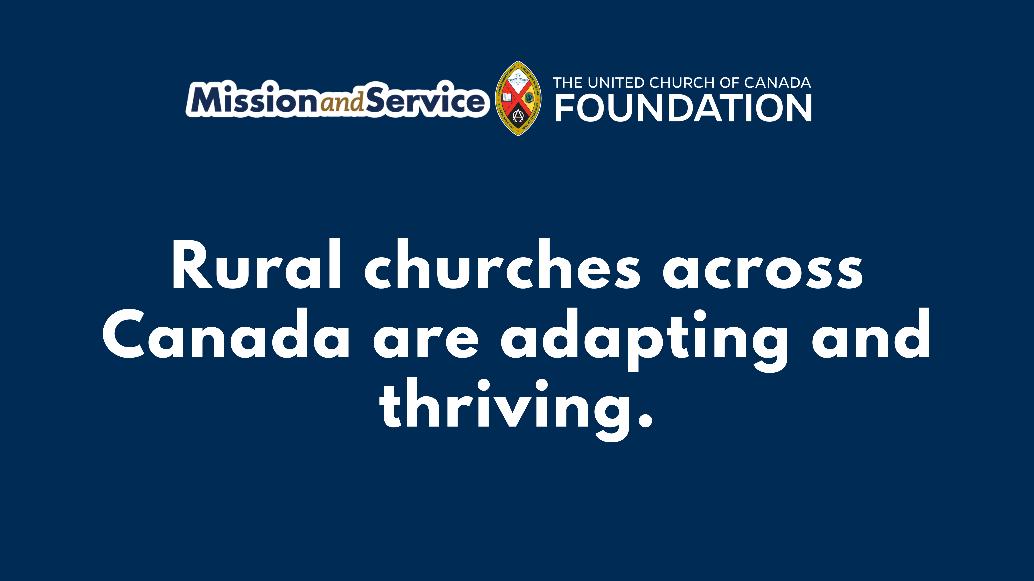
Notes:
The stone was rolled away in a small, overlooked place. Not in the centre of power, or a crowded city. Across Canada, in small towns and rural communities, churches continue to be places of discovery and renewed life.
In Fort Nelson, British Columbia, Hillcrest United Church has stood on the northern landscape for more than 60 years. In a place shaped by distance and long winters, the church gathers neighbours in prayer, in song, and in everyday acts of care. Traditions are honoured, new life is welcomed, and everyone is invited in.
In Chipman, New Brunswick, volunteers at Chipman United Church prepare meals for neighbours who need them. Young people help lead worship. When some members could no longer attend in person, the church carried worship online – and discovered thousands of people joining to be part of that circle of prayer.
At Tobermory United Church, the building hums with life throughout the week. Community groups gather and space is shared with neighbouring congregations. Down the road, their thrift shop offers affordable goods – and when someone needs help, those items are tenderly given.
This is rural ministry. Creative, determined, and deeply rooted in community. These churches are not fading away. They are adapting, experimenting, and opening their doors in new ways so faith and community can continue to flourish.
At Easter, we proclaim that new life can break through even when the future feels uncertain.
Through Mission and Service, we help make that possible. Together, we strengthen communities that continue to serve, welcome, and care in places across this country.
This Easter, please give generously to Mission and Service. We are helping to ensure that hope continues to rise – in rural communities across Canada, and around the world.

