Slide 1
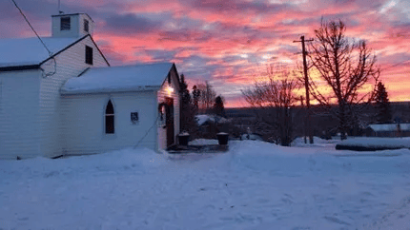

Steady Presence on the Northern Landscape
Notes:
Building on a Year of Care

Slide 2
People show up for one another. Faith flows outward — into kitchens, into conversations, into everyday life.
Notes:
In Fort Nelson, BC, where the landscape is vast and the seasons are bold, Hillcrest United Church has been a vibrant presence for more than 60 years.
Rural ministry carries its own rhythm – shaped by distance, resilience, and close-knit relationships. At Hillcrest, that spirit is tangible. Worship blends cherished hymns with newer songs. Faith is lived not only in the sanctuary, but in everyday acts of care and connection.
As a rural church, Hillcrest plays an essential role in community life – offering pastoral presence, encouragement, and a welcoming space where everyone belongs. Accessible and intentionally inclusive, it reflects the strength and generosity that define rural communities across Canada.
Hillcrest offers points of connection beyond Sunday services, inviting the community to Christmas and Spring teas, garage sales, and events peppered throughout the year.
Through Mission and Service, Hillcrest is part of a wider movement of hope. From northern British Columbia, their generosity supports ministries across the country and around the world – and they, too, are strengthened by this shared experience.
Hillcrest reminds us that rural congregations are vital expressions of faith – grounded, resilient, and forward-looking.
When we give to Mission and Service, we are standing with rural communities like Hillcrest – sustaining ministry, nurturing connection, and helping vibrant congregations continue to flourish in every part of Canada.

