Slide 1
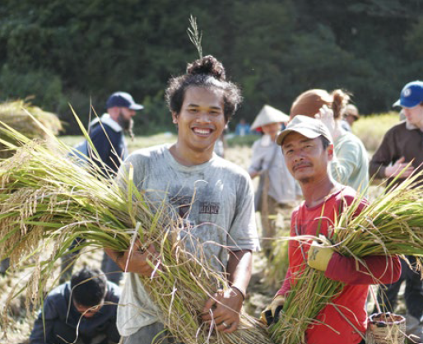

Local Knowledge,
Global Transformation
Notes:
Good Food, Good Futures

Slide 2
Through hands-on learning and shared life, the Asian Rural Institute equips rural leaders to nourish both land and neighbour.
Notes:
At the Asian Rural Institute in Japan, leadership begins with a simple truth: you are already an expert in your own life.
In 2024, 20 participants from 13 countries arrived as pastors, farmers, teachers, and organizers, carrying questions about food security, climate change, and community resilience.
They planted crops. Reduced plastic use in the fields. Practiced nonviolent communication. Travelled across Japan to meet farmers and activists. Reflected deeply on what their communities need most.
And they left equipped – not just with ideas, but with practical skills they will multiply at home.
Their impact will ripple outward: stronger local food systems, healthier land, more confident leadership.
Through Mission and Service, we’re helping make that training possible. We’re helping to sustain the farm, the classrooms, and the shared learning that transforms participants into catalysts for change.
When we give, we’re investing in leaders who will nourish communities long after their year in Japan ends.
Let’s continue cultivating that future.

