Slide 1
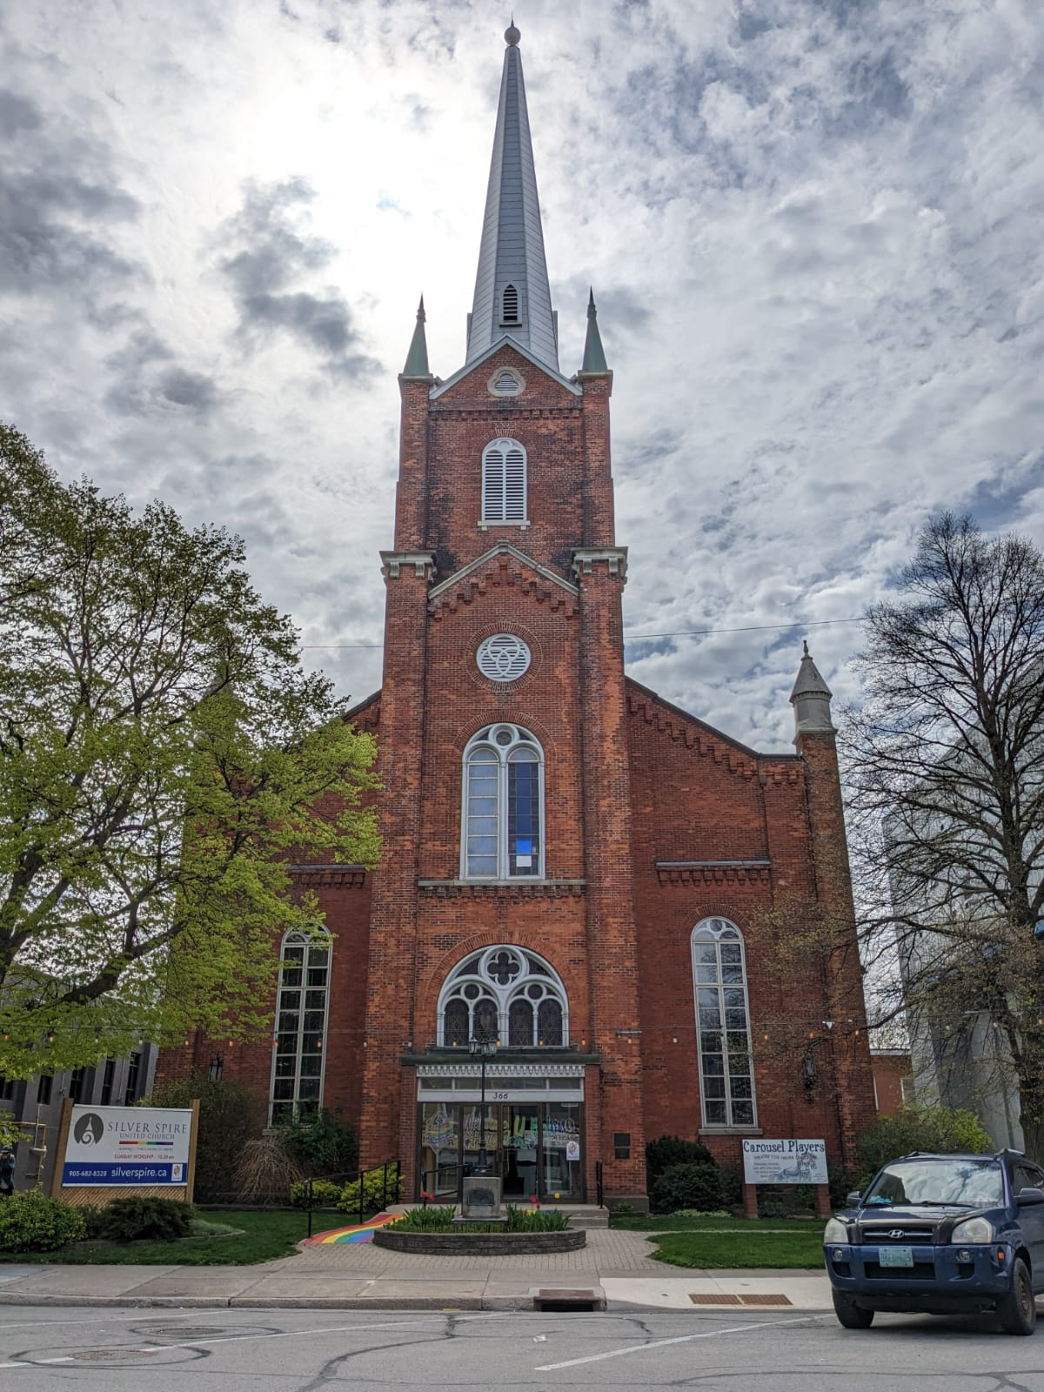

A Steady Flow of Care
Notes:
Good Food, Good Futures

Slide 2
While someone showers, their clothes tumble clean beside them — a simple act of dignity made possible by community care.
Notes:
For most of us, a shower is routine.
For someone without stable housing, it can be transformative.
In St. Catharines, Ontario, Silver Spire United Church offers more than access to water. Their shower program offers dignity, relief, and a fresh start to the day – sometimes all in the same hour.
While guests take a private shower, their laundry is washed and dried in the next room. Clean clothes are ready when they step out. Toiletries like soap, shampoo, deodorant are generously donated by the community and is available to all guests. Devices can be charged in the room, and guests are welcome to keep their belongings in the room with them to keep them secure.
It may sound simple, but being able to wash your body and your clothing at the same time changes a day. In the extreme heat of summertime, a cool shower can prevent illness and save lives. In the winter, warm water restores circulation and comfort. Beyond physical relief, something deeper happens: people are reminded they matter.
But programs like this require steady support. Costs for utilities, supplies, coordination, volunteers, and care can mount quickly.
Through Mission and Service, we’re helping Silver Spire United Church keep the water running and the program staffed. We’re helping ensure that dignity is not an afterthought, but a priority.
A shower should not be a luxury, and clean clothes should not be out of reach.
When we give, dignity flows.

