Slide 1
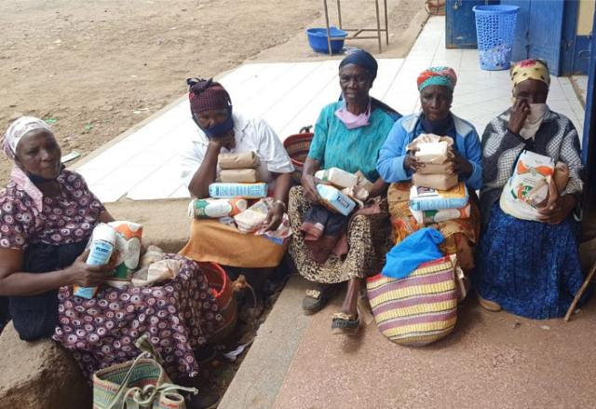

Grandmothers Leading with Love
Notes:
Building on a Year of Care

Slide 2
Grandmothers and church leaders are choosing compassion, creating communities rooted in care.
Notes:
In Kenya’s Rift Valley, HIV and AIDS have reshaped entire families. More than 200,000 people in the region live with HIV. Many children are being raised not by their parents, but by grandmothers.
Women in their 60s and 70s are burying their own children and then stepping forward to raise grandchildren. They cook, farm, comfort, and pray – often while facing stigma in their own communities.
In some churches, HIV has been preached as punishment. A sign of sin. That stigma isolates families who are already grieving.
Through partnership with leaders at St. Paul’s University in Limuru, Kenya, Mission and Service has helped create something simple but transformative: a space for conversation. Grandmothers and pastors gathered in the same room.
One grandmother stood and told her story. She spoke of losing both her children and described the pain of being judged while loving her children fiercely. She spoke of her grandchildren, and her unshakable belief that God’s love does not abandon anyone.
Pastors listened. They asked questions, challenged their own assumptions, and made commitments. They pledged to preach compassion, visit homes, and offer pastoral care instead of condemnation.
That is how change begins.
Through Mission and Service, we’re helping to create spaces like these, where learning replaces stigma, and where churches become places of healing again.
When we give, we help grandmothers carry hope and love instead of shame.
Help love have the final word: make your own commitment today and make a gift for Mission and Service.

