Slide 1
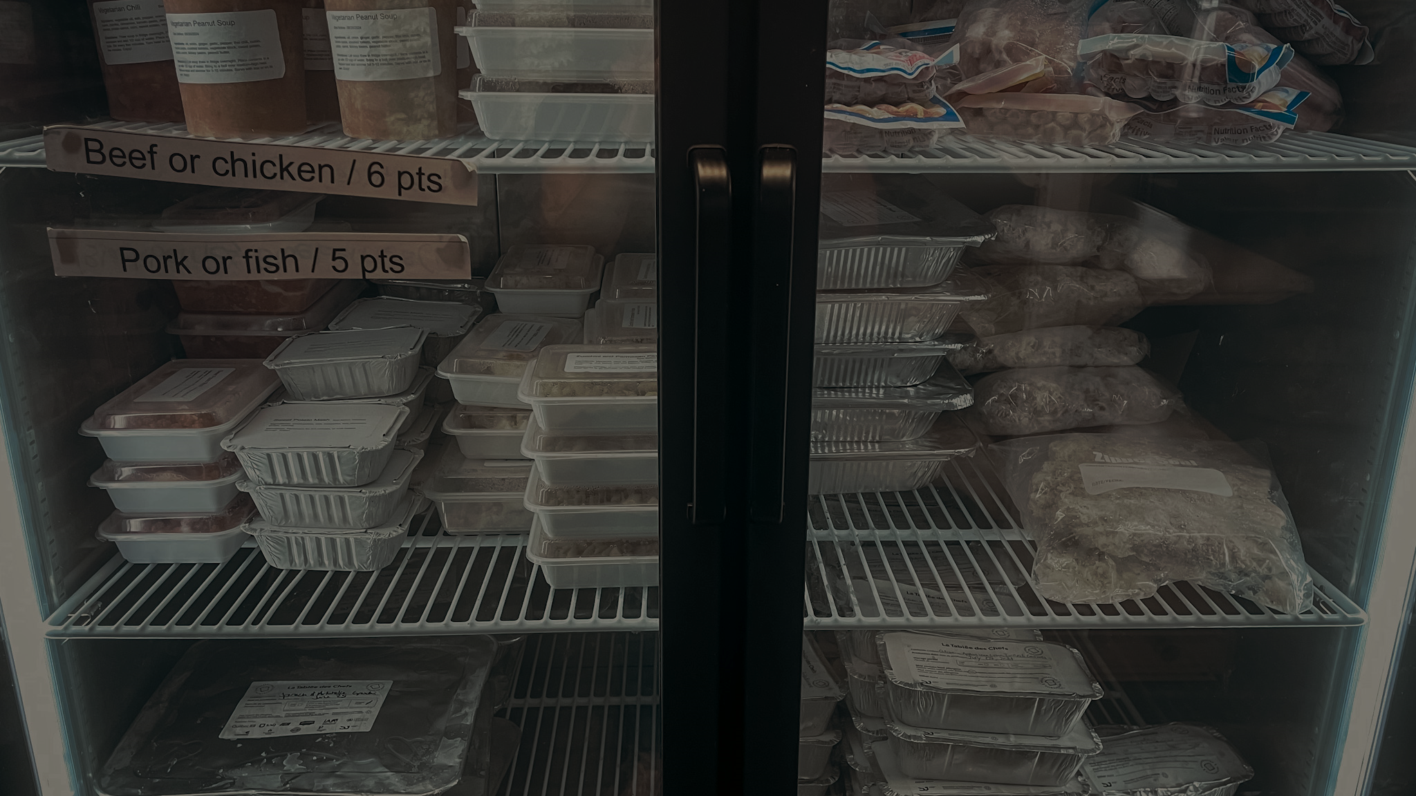

Where Neighbours Meet
Notes:
Where Neighbours Meet

Slide 2
Your support fuels the spirit of community, dignity, and choice at Brunswick Street Mission.
Notes:
In Halifax, NS, Brunswick Street Mission is a steady presence for people who need support, connection, and dignity. Every day, neighbours come through its doors to find a place where they are seen and valued.
Every weekday morning, the Mission serves a hot breakfast. For many, it’s the most reliable meal they will have that day. Staff serve eggs, protein, toast, fruit, juice, and coffee, and they do so with care and connection. Some enjoy breakfast in the dining area, while others take their meal to go. Either way, the meal offers nourishment, but also a sense of stability and welcome.
The Mission’s café offers a warm, safe space to land. People gather around puzzles, books, and quiet rest areas, sharing moments of calm that are often hard to find elsewhere.
The food bank continues the spirit of dignity and choice. Community members shop with a grocery cart, selecting items that fit their cultural traditions, dietary needs, and personal preferences. Gluten-free, vegetarian, and other specialized options are available whenever possible.
Staff walk alongside people navigating difficult systems—from housing and health care to replacing lost documents—always recognizing that the people they serve are the experts of their own lives. They listen, they support, and they create pathways where obstacles once felt insurmountable.
Support from Mission and Service helps Brunswick Street Mission keep doors open, meals hot, and spaces safe. Together, we walk alongside the Mission and its community, ensuring that it remains a place where people can rest, connect, and find small but meaningful ways to thrive.

