Slide 1
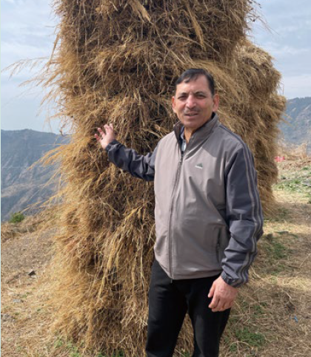

Mountains of Service
Notes:
Mountains of Service

Slide 2
Your support helps leaders gain the skills and confidence to transform their communities.
Notes:
If you ever travel to the northern mountains of India and meet a man named Surrender Singh, the first thing he’ll do is invite you on a walk. Not a short stroll, but a real mountain trek. And the beauty of the Himalayas is only part of what he wants to show you.
With him as your guide, the trail becomes a story. Every bend holds a memory. Every village has a face he knows.
Many still call him “Singh san” from his time training at the Asian Rural Institute, a Mission and Service partner in Japan. For more than four decades, he has climbed these ridges. As you walk beside him, people call out greetings. He calls them by name. Someone brings tea. He digs in his pack and pulls out bananas or biscuits to share. And suddenly you’re not just passing through—you’re part of the conversation.
He’ll point to a house and tell you how he once slept on the floor there while helping build a water pipeline with the Mussoorie Village Development Committee, the group he now leads. Another turn in the path, and he’s showing you the school that has given local children a chance to learn close to home.
And then there are the women’s groups. Surrender Singh lights up talking about them. He trained them in organic farming. Now they grow and sell their produce, earning steady incomes and strengthening their families and communities.
By the time you reach the end of the trail, you realize that you haven’t just taken a hike. You’ve walked through the story of a life spent in gratitude and service to others.
Mission and Service partners like the Asian Rural Institute are where leaders like Surrender Singh gain the skills and confidence to transform their communities. When you support Mission and Service, you help grow this kind of leadership and community—the kind that takes root, spreads, and changes lives, one mountain path at a time.

