Slide 1
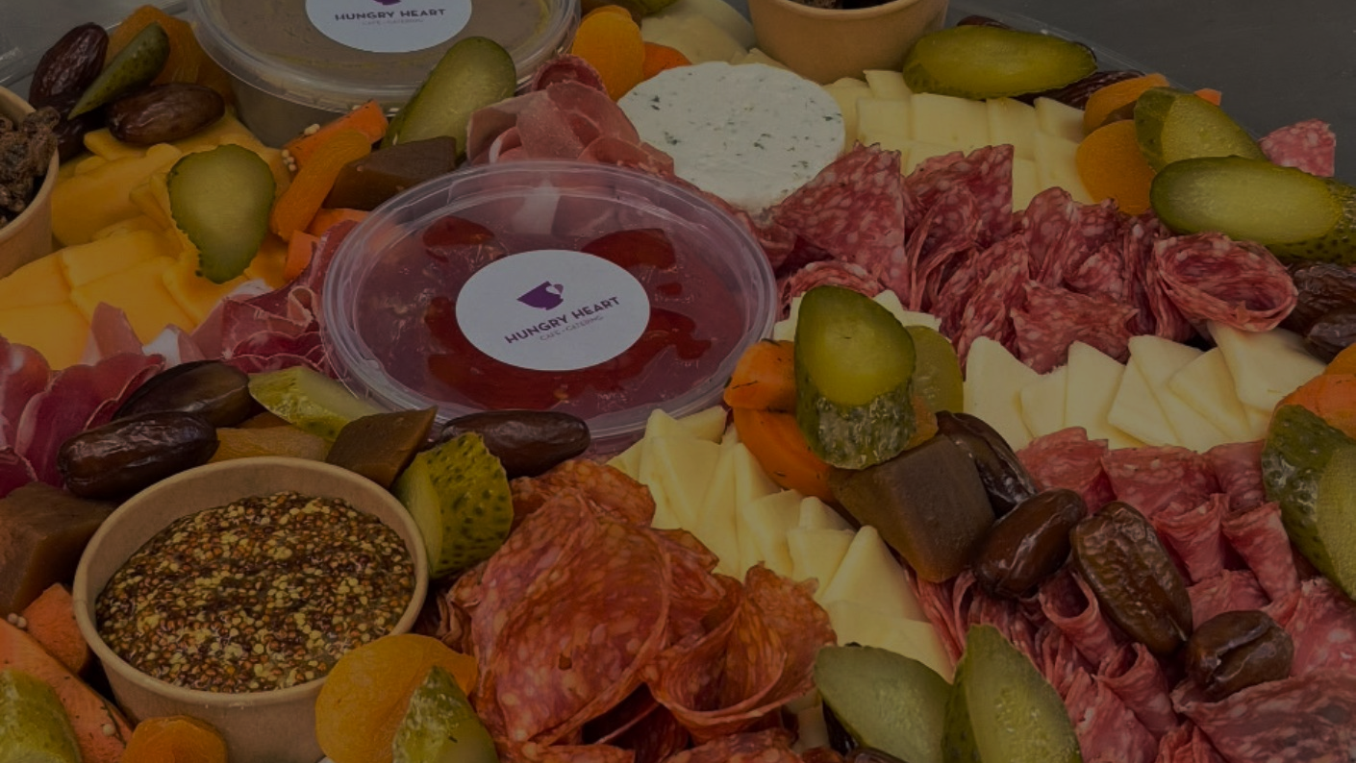

Good Food, Good Futures
Notes:
Good Food, Good Futures

Slide 2
Hungry Heart Café & Catering is a place where good food and good hearts come together.
Notes:
In St. John’s, NL, Hungry Heart Café & Catering is a place where good food and good hearts come together. For 18 years, this social enterprise of Mission and Service partner Stella’s Circle has been serving the community while opening doors for people who face barriers to employment.
At Hungry Heart, every dish tells a story of learning and possibility. The café provides hands-on culinary training and real work experience for people who are rebuilding their lives. Many participants live with the impacts of mental health challenges, trauma, poverty, homelessness, or low literacy. Some are trying to re-enter the workforce after long absences.
What they find at Hungry Heart is a safe space to learn at their own pace. Staff offer mentorship, life-skills support, and steady encouragement. The goal isn’t just to teach restaurant skills. It’s to help people gain confidence, develop independence, and imagine a future where they can thrive.
Food security is another part of the café’s mission. Through the Meals Squared program, customers can add a small donation to their bill. That donation goes directly toward providing nutritious meals to Stella’s Circle participants and other neighbours who are experiencing hunger. It’s a simple way to care for the community, one meal at a time.
And behind it all is Stella’s Circle, a Mission and Service partner known for responding quickly to changing needs, and for creating programs that meet people where they are. Whether it’s updating training opportunities, collaborating with community groups, or addressing rising food insecurity, the people at Stella’s Circle continue to innovate so community members can receive the kind of support that makes a real and sustainable difference.
Through Mission and Service, your support helps strengthen Stella’s Circle and the Hungry Heart Café, ensuring this community remains a place of opportunity, dignity, and good food shared with care. It’s one way to come together to help people build skills, find stability, and move toward the futures they imagine for themselves, reflecting Christ’s call to walk with one another in compassion and hope.

