Slide 1
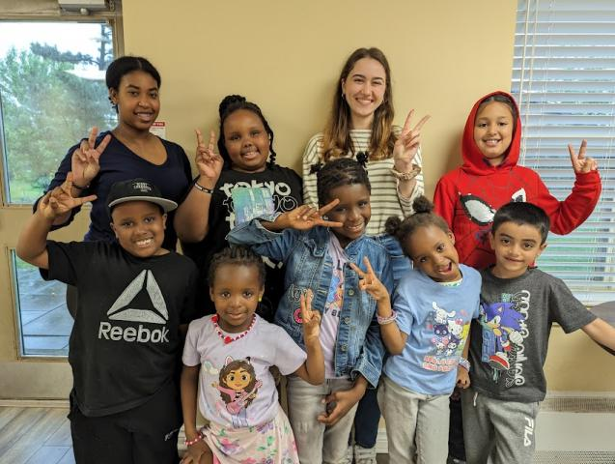

Where Play Builds Community
Notes:
Where Neighbours Meet

Slide 2
The Tomken Grove Afterschool Program creates a recreational space outside of school where neighbourhood kids can spend time together in an electronics-free environment.
Notes:
“I’m going to sleep here!” Amarah, age 6, threatens from under the table. Along with her sisters, she hides from her family at the Tomken Grove Afterschool Program’s pickup time. This is a common occurrence because every Tuesday at 6:30 p.m., the children feel that two hours together is not enough.
Through the passion of Westminster United Church in Mississauga, ON, the Tomken Grove Afterschool Program aims to encourage community among local children. The program creates a recreational space outside of school where neighbourhood kids can spend time together in an electronics-free environment.
Some form of physical activity is always scheduled: dance battles, obstacle courses, hula-hooping, spending time outdoors, and more. Snacks such as fresh fruits and yogurt keep the kids healthy and energized, and everyone is involved in cleanup responsibilities for snack and outdoor time, which encourages independence and innovation.
Your gifts through Mission and Service help programs like this as they encourage community and connection. Thank you.

