Slide 1
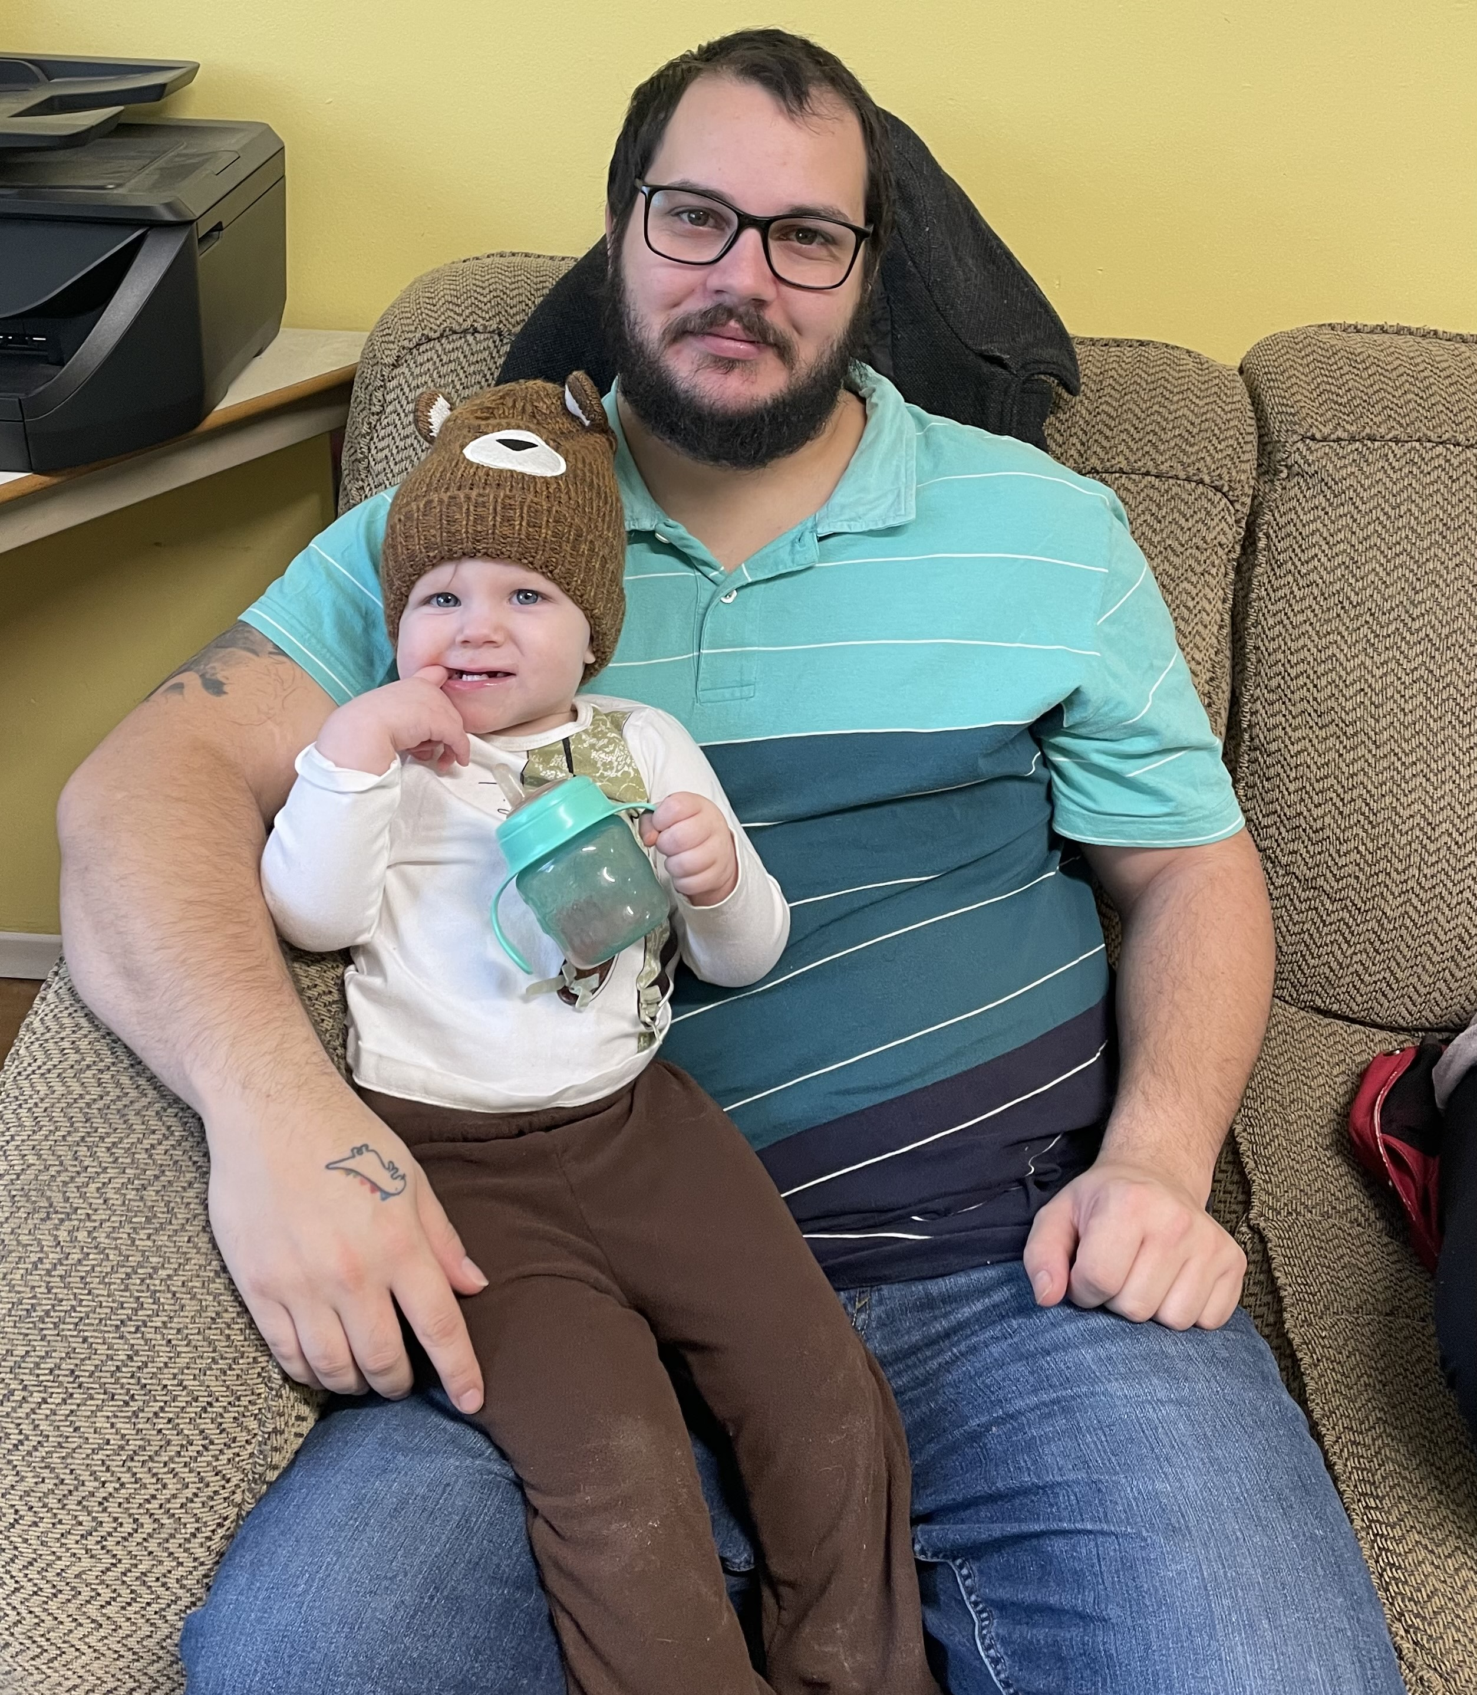

Support That Grows with Families
Notes:
Mountains of Service

Slide 2
London Community Chaplaincy provides a welcoming and safe social setting for adults to connect and grow as parents.
Notes:
Becoming a parent or guardian is a life-changing, complex experience that doesn’t have a one-size-fits-all answer. As kids, we looked to adults for guidance as we navigated the world with fresh eyes. Now, as adults, we recognize that we’re still figuring things out as we go, and there’s always an opportunity to grow our skills and minds.
In London, Ontario, Mission and Service partners with the London Community Chaplaincy as they respond to parents and guardians who want to build a network of support, share the parenting journey, and develop new skills as they navigate raising children in a low-income setting. Together, these parents are working hard to build a positive future for their children and families.
Each week, London Community Chaplaincy provides a welcoming and safe social setting for adults to connect and grow as parents. Not only do they learn how to guide a child through critical stages of development, but also how to navigate being a parent or guardian while managing financial stress, food insecurity, housing complications, and more. Gathering with other adults in a similar situation allows participants to share their struggles and triumphs, further building a sense of community.
Your gifts to Mission and Service support partnerships like the London Community Chaplaincy as they help empower parents along the parenting journey. Thank you.

