Slide 1
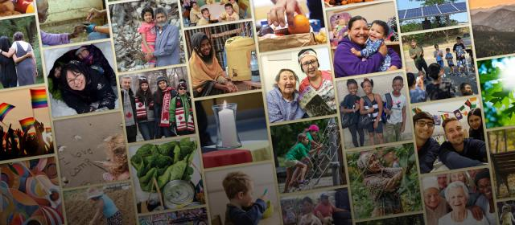

Gifts with Joy, Gifts with Hope, Gifts with Vision

Slide 2
Make your Christmas meaningful with Gifts with Vision!
Notes:
December always seems to arrive in a blink, doesn’t it? Some are already checking off shopping lists, and others are thinking about starting. Wherever you fall, Gifts with Vision can make your Christmas giving simple and meaningful.
With Gifts with Vision, there’s no wrapping, no shipping deadlines, and no frantic mall searches. Instead, you can choose a gift that truly matters. Every gift supports communities across Canada and around the world—addressing poverty and hunger, strengthening education, supporting healing and reconciliation, and more. There’s something thoughtful for everyone on your list.
Each Gift with Vision connects directly to a Mission and Service project that relies on the generosity of people like you. Your gift becomes part of real change and real hope for people who need it.
As you settle into the season, whether you’re a planner or a last-minute shopper, consider a gift that gives back. Gifts with Vision is just a click away.

