Slide 1
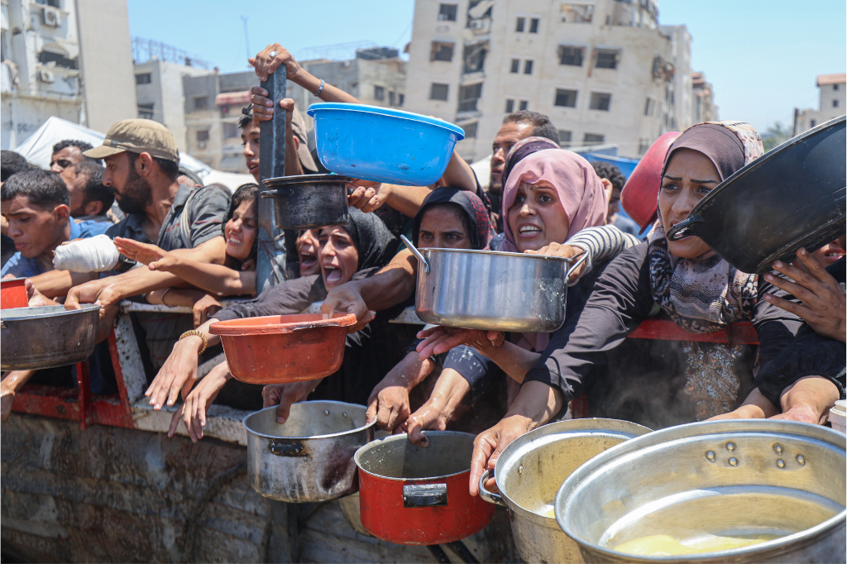

Faithful Witness in a Time of Despair

Slide 2
Your gifts to Mission and Service help support organizations like DCIP, who stand beside children in Gaza with compassion and conviction.
Notes:
“[T]he army surrounded us,” recalled 16-year-old Ramez. “We had nowhere to go. Either we move toward death, or we stay and risk dying. Either way, it’s death.”
For most children, childhood is a time to dream, go to school, play with friends, and imagine the future. But for children in Gaza, those simple dreams have been replaced by fear and survival.
Mission and Service partner Defense for Children International–Palestine (DCIP) shares that the situation in Gaza remains catastrophic. Families face famine, and the lack of access to clean water and medicine. Many have seen their homes bombed and are forced to live in tents or makeshift shelters. Parents spend hours in line each day for a small ration of bread or water, while children go hungry. Hospitals have run out of supplies, and schools have been reduced to rubble.
In interviews conducted by DCIP, children described their lives in stark, heartbreaking words. “We have no rights,” said one child. Fourteen-year-old Jana shared what life is like now: “We live in a tent. Every few days we have to move again. We spend hours waiting for water or food. Even to use the bathroom, we wait in line for hours. There’s no rest. We can’t go on like this.”
These children have endured unimaginable hardship. Many have been displaced multiple times, separated from friends, and have lost their entire family. Hospitals have run out of medicine. Schools are destroyed. Safe water is rare. Hunger is constant.
And yet, through it all, DCIP continues its mission, documenting violations of children’s rights, amplifying the voices of those who have been silenced, and calling the international community to act. Their courage ensures that the world cannot look away.
Your gifts to Mission and Service help support organizations like DCIP, who stand beside children in Gaza with compassion and conviction. When you give, you help make sure their stories are heard, and that the call for justice and protection does not fade into silence.
This Giving Tuesday, we invite you to join in prayer and action for the children of Gaza. May every child one day live free from fear, with food on the table, a place to learn, and the chance to simply be a child again.
Because every child has the right to food, shelter, safety, and education.
In collaboration with Maastricht University, Defense for Children International–Palestine interviewed four children living in Gaza about the status of their rights. Read these firsthand accounts.

