Slide 1
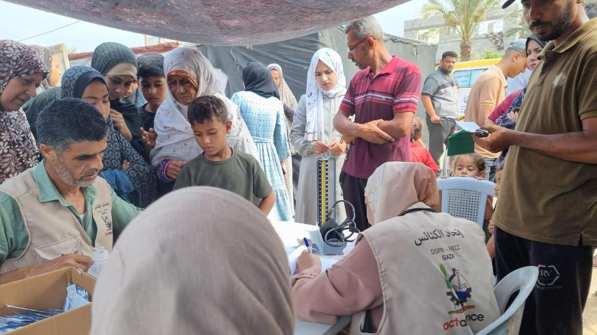

Together in Prayer and Solidarity

Slide 2
Mission and Service partners continue to serve in Gaza with remarkable faith and perseverance.
Notes:
Through Mission and Service, The United Church of Canada accompanies global partners who bring compassion and courage to some of the world’s most difficult places. Today, we hold in prayer our partners in Gaza, where the situation remains catastrophic.
Partners in the ACT Palestine Forum share that families are facing famine, and shortages of clean water, medicine, and shelter. The cost of even the most basic items has risen far beyond reach. Many are forced to make painful choices simply to survive. Children are especially vulnerable as malnutrition and lack of medical care take a growing toll.
Even amid these overwhelming challenges, Mission and Service partners continue to serve with remarkable faith and perseverance. Through ACT Alliance, they distribute food parcels, clean water, and medical supplies. They offer hygiene kits and psychosocial support to children and families living through trauma. And they raise their voices for a just and lasting peace, humanitarian access, and the protection of human dignity.
Each month, the ACT Palestine Forum organizes a global prayer vigil for Palestine and Gaza. “It gives us strength,” one representative says, “to know that people around the world are praying with us, for justice, peace, and human dignity.”
Your gifts for Mission and Service make this work possible. They help contribute to efforts to provide food, health care, and hope to reach those in greatest need, and that our partners know they are not alone.
Please continue to pray for all who are affected by this violence, and for peace rooted in justice to take root and grow.

