Slide 1
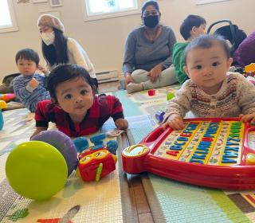

From Sleepless Nights to Shared Strength

Slide 2
The New Parents Support group aims to walk with parents as they navigate the complexities of raising a newborn.
Notes:
Becoming a new parent can be overwhelming, with the constant demands of caring for a newborn, sleepless nights, and the pressure to make the right choices for your child. The exhaustion of balancing daily responsibilities while navigating the unknowns of parenthood often leaves new parents feeling unsure and isolated. It’s a time filled with great joy, but also uncertainty, as parents adjust to their new roles and work to create a safe and nurturing environment for their little one.
At Fairview Resource Centre in Halifax, Nova Scotia, the New Parents Support group aims to walk with parents as they navigate the complexities of raising a newborn. Once a week, parents gather to meet with a public health nurse who provides education and answers questions. From expectant parents to those with babies up to 18 months, the program provides resources for those who might not otherwise have access to in-person support or resources.
Parents connect not only with health professionals, but form deep bonds with each other, and some are still in contact many years later. Many of us have heard that “it takes a village to raise a child,” and Fairview Resource Centre is truly taking action to give a positive space for children in the community to flourish. Thank you for walking alongside our Mission and Service partners as they help children and communities grow.
Your support of Mission and Service is vital to the continuation of incredible programs like these.

