Slide 1
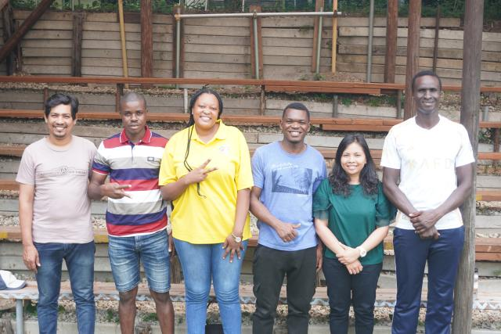

Faith, Farming, and Friendship

Slide 2
ARI trains rural leaders from the Global South in servant leadership, sustainable agriculture, and community building.
Notes:
For the first time in human history, more people live in cities than in rural areas, and that shift has brought new challenges, especially in caring for the Earth. In Japan, your Mission and Service gifts support a partner that’s responding with vision and hope: the Asian Rural Institute (ARI).
Founded in 1973 by Rev. Dr. Toshihiro Takami, ARI trains rural leaders from the Global South in servant leadership, sustainable agriculture, and community building. Each year, participants from around the world come together for nine months of hands-on learning, studying, farming, cooking, and cleaning side by side. The farm provides almost all of the food they eat, and the surplus supports their neighbours.
This year, your support through Mission and Service helped purchase a used minibus for ARI and provided scholarships for six participants: Arun from Sri Lanka, Robert from Liberia, Lily from Zambia, Lukogo from Congo, Sarmo from Indonesia, and Bob from Kenya.
They’re learning organic farming methods like composting, natural pest control, and ways to keep soil healthy. As Arun says, “God creates everything in order. If things are in order, then everything will be okay. Everything is connected.”
But the lessons go beyond agriculture. Students also learn about servant leadership, leading by serving others. “Peace is number one,” explains Bob. “Then love.”
For Lily from Zambia, it’s been especially powerful to see so many women in leadership roles. She shares, “It inspired me to show others what is possible.”
Life at ARI isn’t easy. Days begin early, with prayer and physical work. Cultural differences, personalities, and misunderstandings do sometimes lead to conflict. Yet these tensions also provide rich opportunities to learn reconciliation, communication, and collective responsibility. Robert said, “It is wonderful to be in diversity. There are a lot of things I like and don’t like. It is a challenge to learn to overcome them. It shifted my perception on how to live, to respect culture and not to offend. It is teaching me how to live.” Arun summed up, “It is sacred to live in this environment.”
Through your gifts for Mission and Service, participants at ARI experience transformation in their faith, their farming, and their leadership. And when they return home, they bring that transformation with them, helping their communities grow in hope, peace, and sustainability. Thank you.
Thank you for helping seeds of change take root around the world. To learn more about ARI and the participants you support, you can read the full story online.

