Slide 1
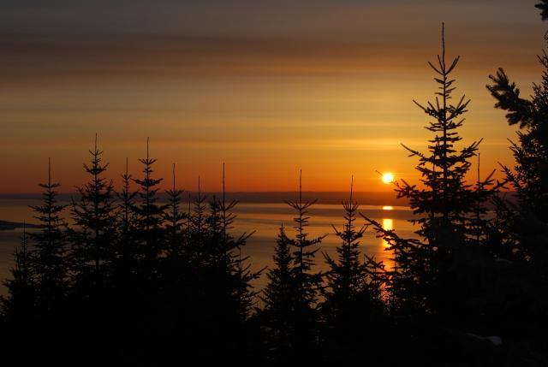

Preparing a Place of Healing

Slide 2
Your generosity is creating a space where ministers, who are so often the ones offering care, can finally receive it themselves.
Notes:
United Church ministers serving in northern communities will soon gather at Sandy-Saulteaux Spiritual Centre in Manitoba for a time of healing and renewal.
The Northern Indigenous Ministers retreat comes at a critical moment. These ministers carry extraordinary burdens: walking alongside communities devastated by loss, often among young people; leading funeral after funeral; and tending to the deep wounds of grief. This year’s wildfires brought further hardship, forcing the retreat to be postponed until October. The need for rest and renewal has only grown.
Because of your incredible generosity through Mission and Service, the retreat will soon take place. Plans are in place for sharing circles where ministers can express what they’ve been carrying, gather for meals that nourish body and spirit, and engage in cultural practices like ribbon skirt making and beading that bring connection and joy. Massages and other healing activities will help restore strength and release long-held tension. Most importantly, ministers will be surrounded by peers, who understand the unique weight they bear and who can hold that burden alongside them.
The outpouring of support from across the church has been remarkable. Your generosity is creating a space where ministers, who are so often the ones offering care, can finally receive it themselves.
Our ministers will soon step away from the constant demands of ministry and into a circle of care, healing, and renewal. And when they return to their communities, they will carry back not only renewed strength but also the reminder that they are not alone.
Your compassion through Mission and Service makes this gathering possible. Thank you.

