Slide 1
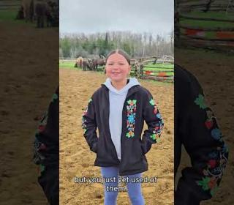

Healing with Horses: Transforming through Trust

Slide 2
These horses, and the people who work alongside them, are changing lives.
Notes:
In Wiikwemkoong Unceded Territory, the Healing with Horses program brings people together to share, listen, and connect with each other, the land, and the gentle strength of the horses guiding the healing journey.
Among them are four Ojibwe Spirit Horses, a rare and sacred breed. At one point in history, they were stolen from the community, but in an act of resilience and reconciliation, they have been returned to the land and the people who have always known and cherished them. Their presence is a living reminder of survival, restoration, and hope.
Supported by your Mission and Service gifts, the program blends equine therapy with Anishinaabe ways of knowing, the Medicine Wheel, and traditional teachings to support emotional, spiritual, and cultural healing. Children learn emotional regulation, adults reconnect with their inner strength, and participants find the courage to speak and be heard.
Watch the video to see how these horses, and the people who work alongside them, are changing lives.
Thank you for supporting the Healing Fund through Mission and Service. Your generosity makes this life-changing work possible.

