Slide 1
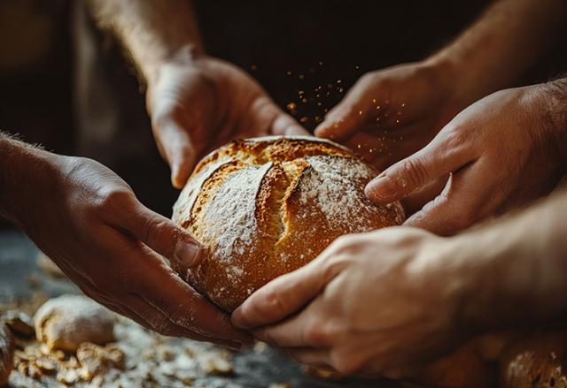

Setting More Tables Together

Slide 2
At Thanksgiving, many of us gather around tables filled with food, and share familiar traditions and prayers of gratitude.
Notes:
At Thanksgiving, many of us gather around tables filled with food, and share familiar traditions and prayers of gratitude. In the Bible, food is more than just sustenance: it’s manna in the wilderness, a feast shared among thousands, and a table where all are welcome. Again and again, food is a sign of God’s care and abundance.
But we know that not everyone has the blessing of a full table or loved ones to gather with. Hunger remains a painful reality for far too many. These are not just numbers or statistics: these are our neighbours, making impossible choices between heat and dinner.
Through Mission and Service partners, your generosity is part of God’s response. Together, we are helping farmers in India care for their livestock, families in Zimbabwe grow food in drought conditions, and communities in Northern Canada access nutritious food despite high costs. Across Canada, ecumenical campus ministries and community centres serve weekly dinners where everyone is welcome. These meals don’t just ease hunger, they help reduce stress, support learning, and bring people together where everyone has a place at the table.
This Thanksgiving, may gratitude fill our hearts. May that gratitude ripple outward, becoming generosity that helps set more tables, share more bread, and create more moments of joy. Because when we share what we have, God’s promise of abundance comes to life, not just as a symbol, but as a feast of hope and possibility for all.
Thank you for the difference you make through Mission and Service.

