Slide 1
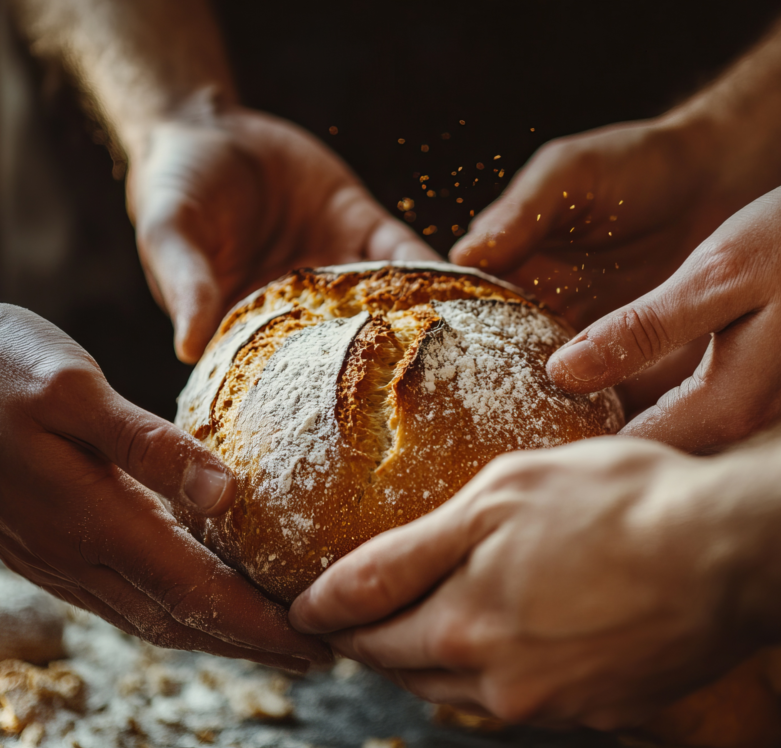
From Manna in the desert,
to breaking bread at the
Last Supper, bread is in
the Bible.
A lot.
Photo: ID 366826122 © Elena Hryhorova | Dreamstime.com

Slide 2
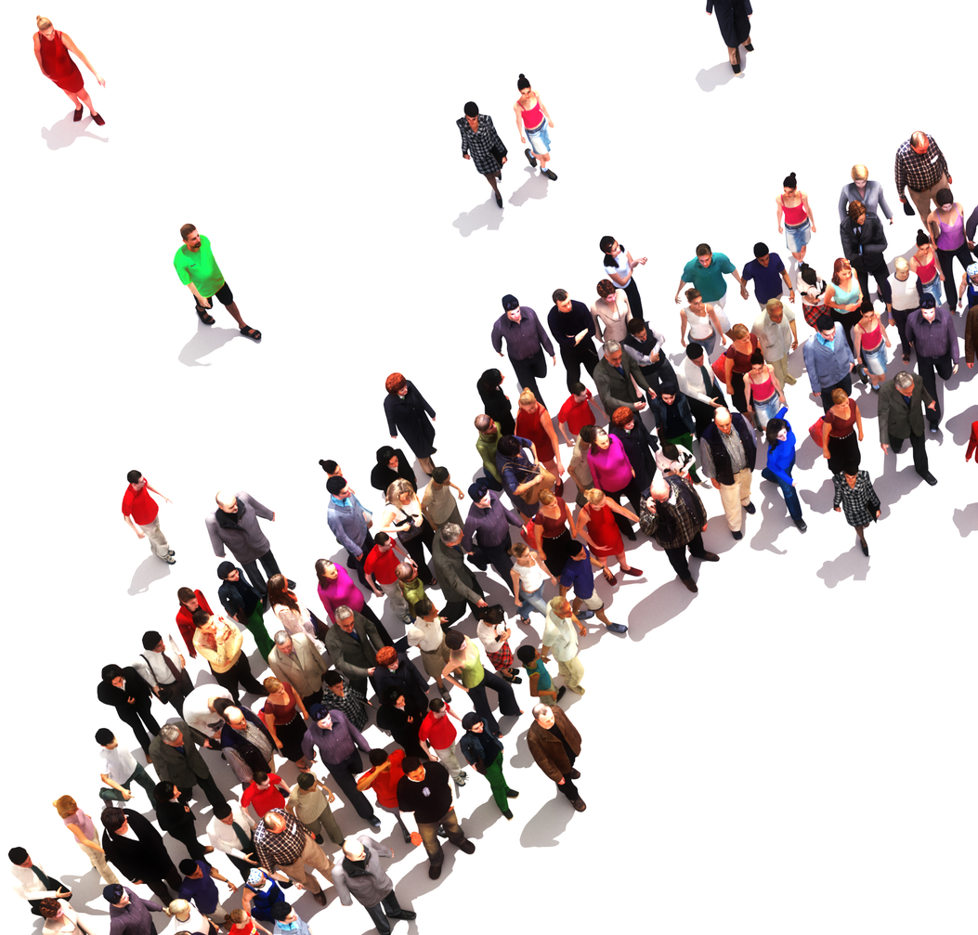
God knows that food is
a basic human right.
But 8.7 million Canadians
are living with food insecurity,
not knowing how they will afford their next meal.
Source: https://proof.utoronto.ca/food-insecurity/
Photo: ID 44811030 © Digitalstormcinema | Dreamstime.com

Slide 3
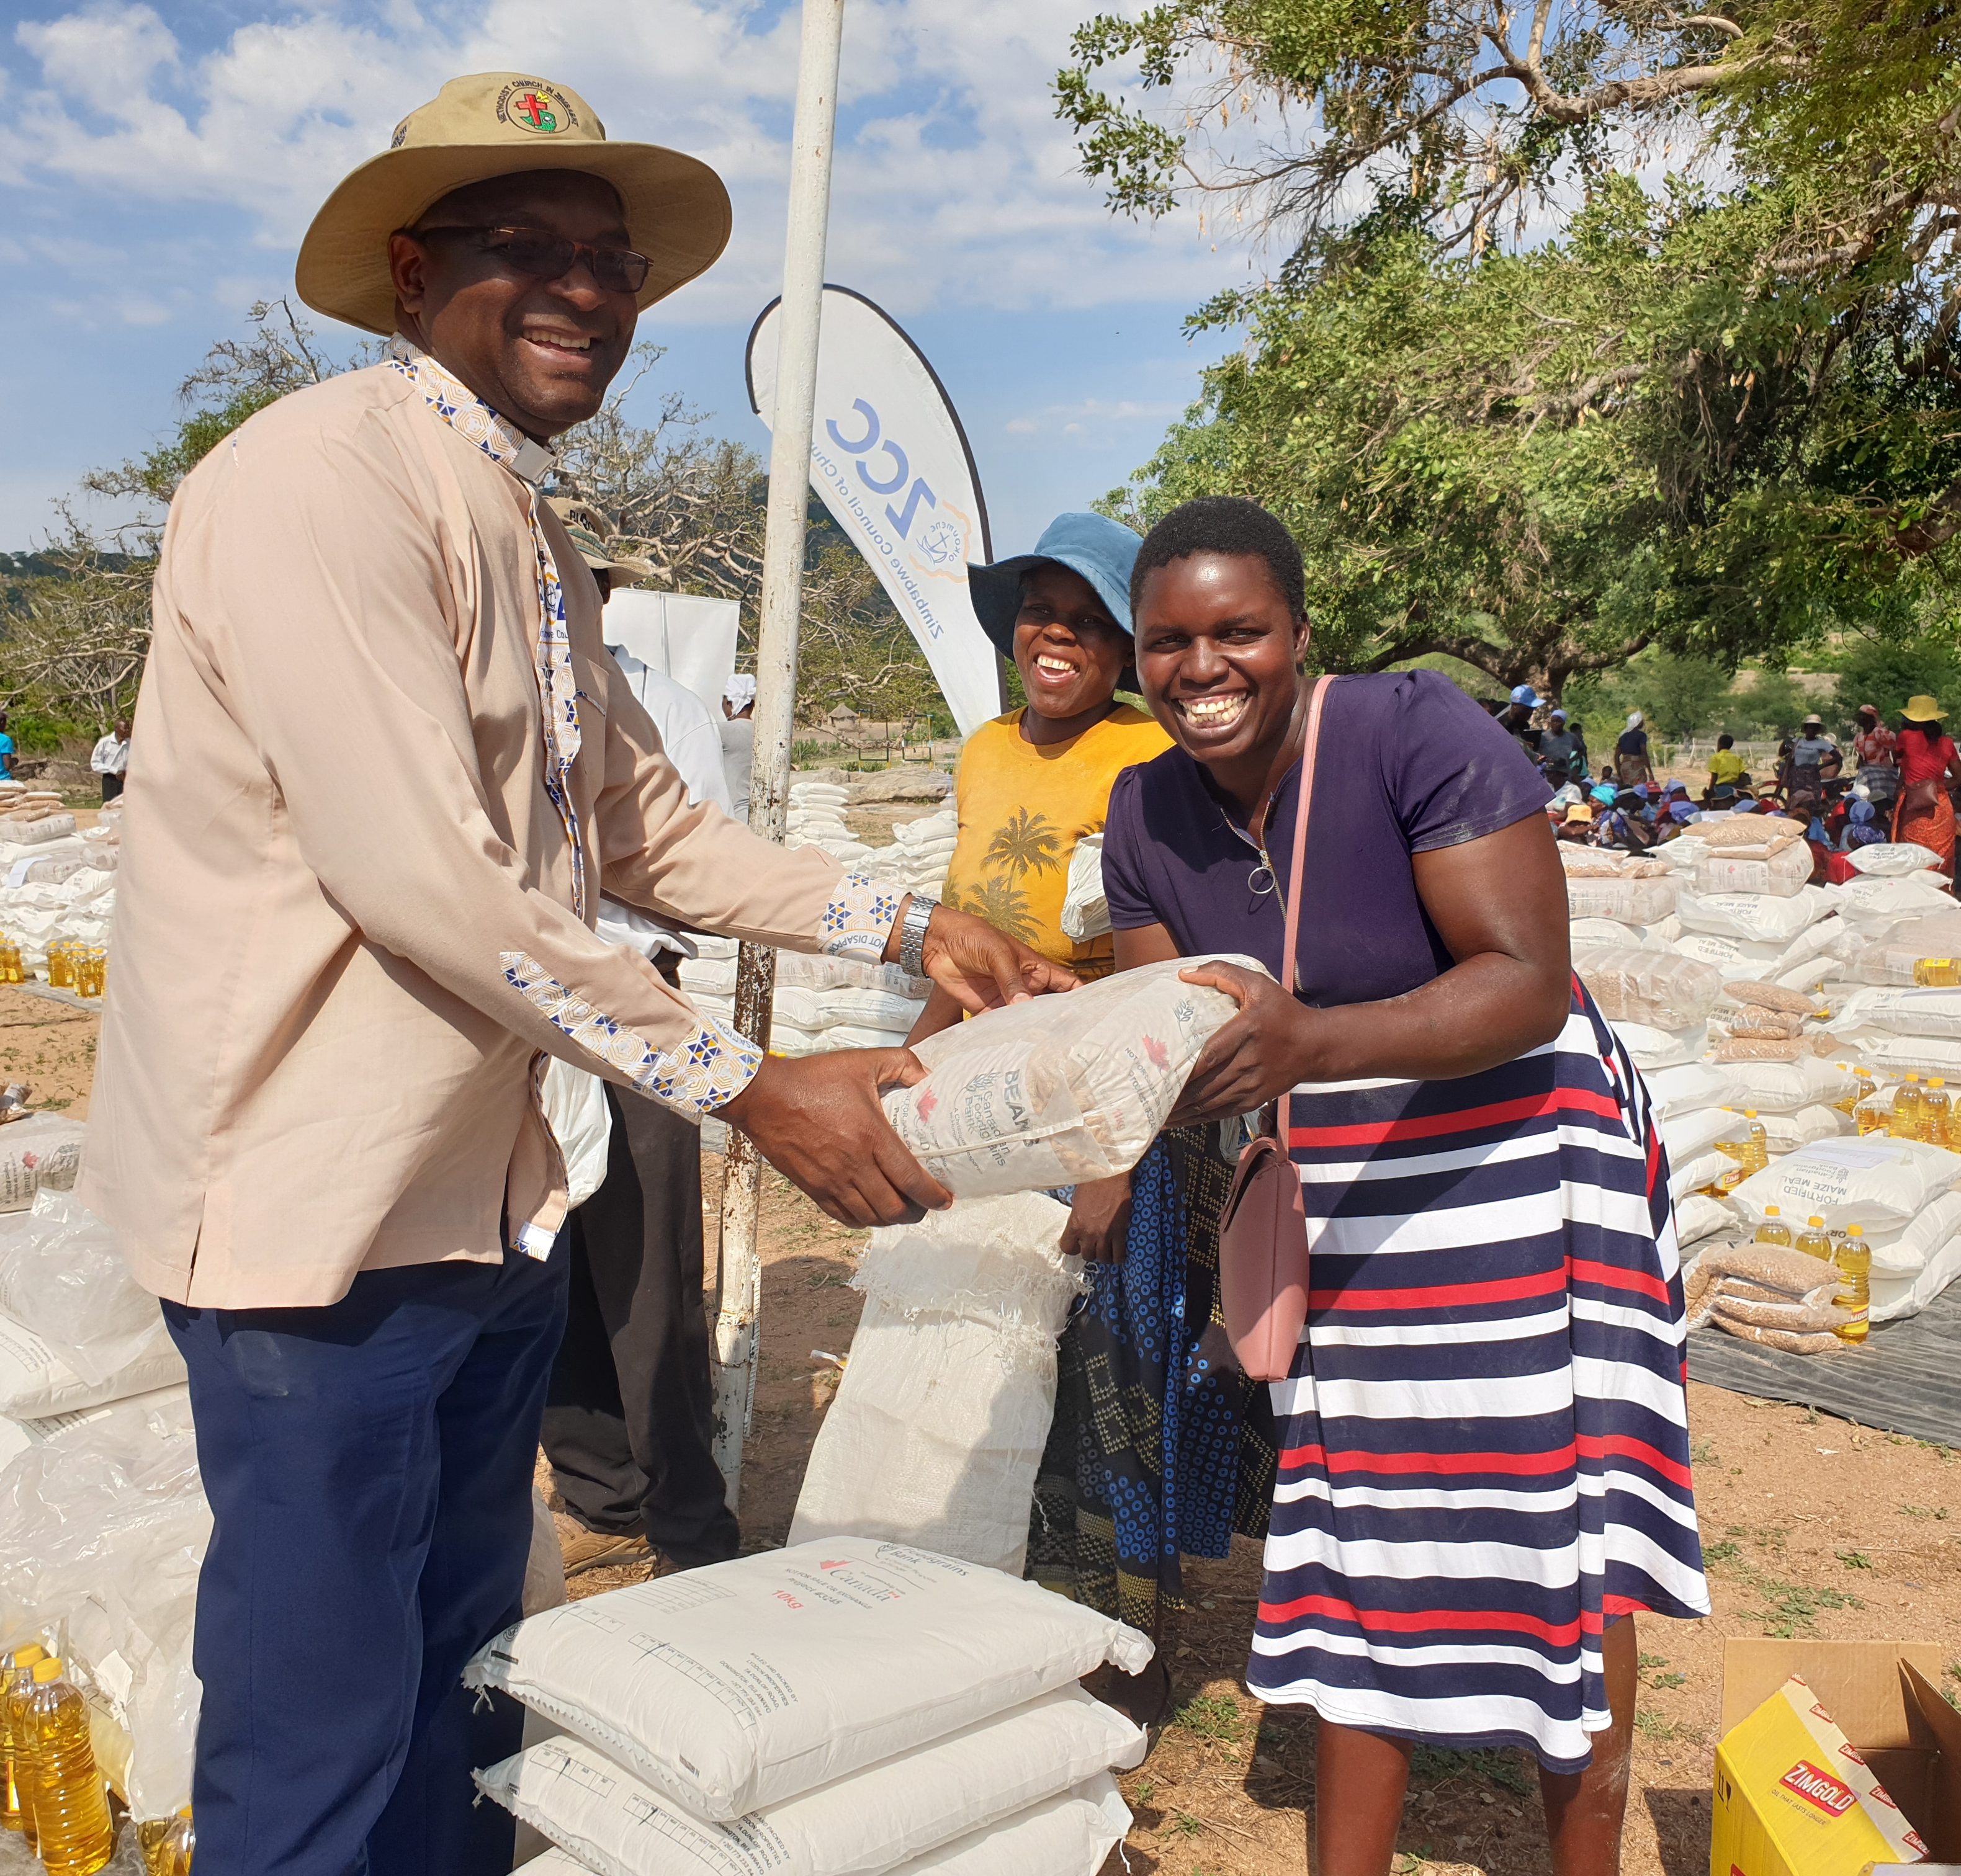
This Thanksgiving,
you can make a difference.
Your gifts to Mission and Service will help fight hunger
here in Canada, and around the world, from Alberta
to Zimbabwe.
Photo: Zimbabwe Council of Churches

Slide 4
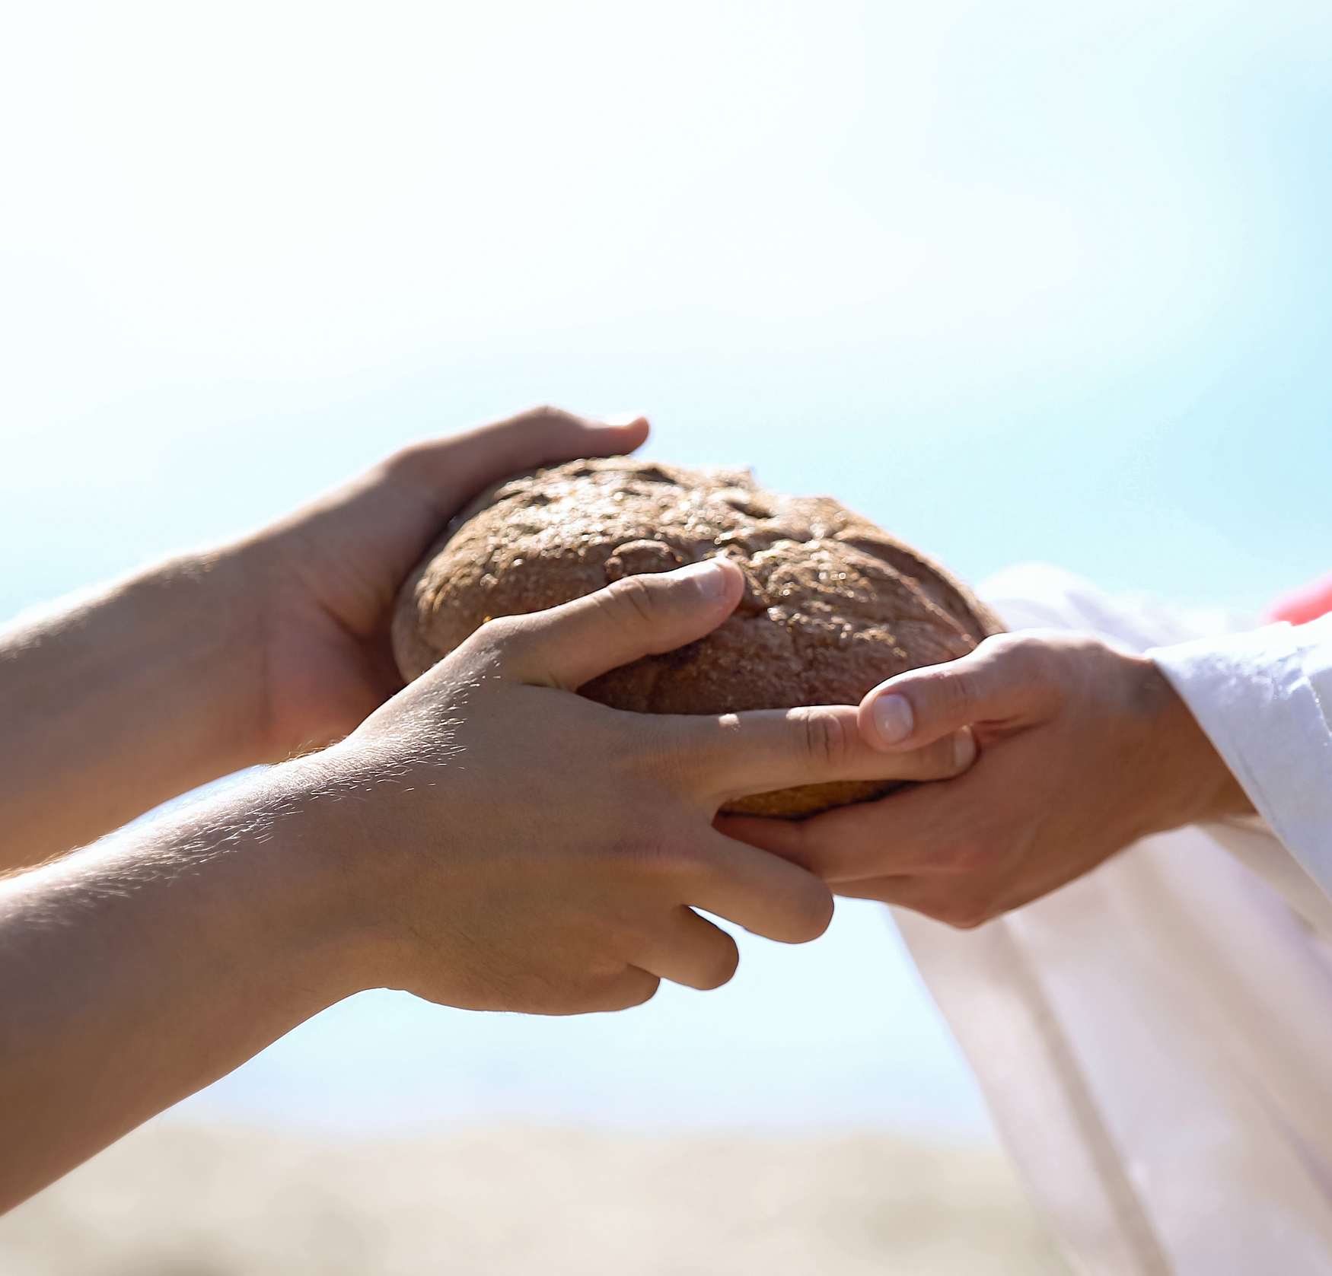
Make a donation today,
and make sure the
hungry can eat.
Photo: ID 158966304 © Motortion | Dreamstime.com

