Slide 1
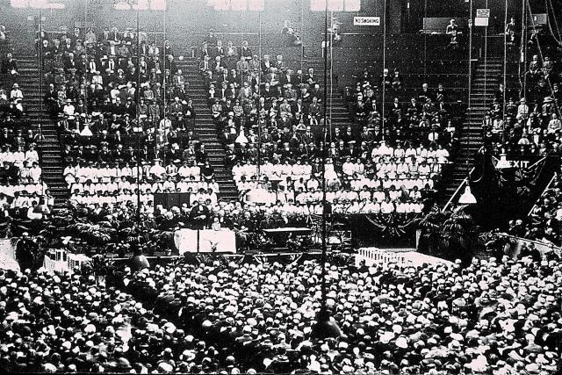

Our Past, Present, and Future

Slide 2
For 100 years, people of The United Church of Canada have faithfully come together to follow Jesus and help others.
Notes:
For 100 years, people of The United Church of Canada have faithfully come together to follow Jesus and help others. Through Mission and Service, we have supported people in need across Canada and around the world—bringing food to the hungry, shelter to the vulnerable, justice to the oppressed, and hope to communities.
This is ongoing work. And as we look ahead, we know the needs we face will not disappear—they will deepen. Poverty, injustice, and the climate crisis will continue to challenge us, but so will our call to respond with love, compassion, and courage.
That’s why we are invited to take part in something extraordinary: the Centennial Legacy Campaign. This is the most ambitious initiative our church has ever taken on. Its goal is to inspire legacy gifts that will strengthen local communities of faith, Mission and Service, and The United Church of Canada Foundation.
These gifts will honour our past, sustain our present, and ensure that our church will keep meeting the world’s needs for the next hundred years—offering security, faith, and community for generations to come, and sharing God’s love boldly, generously, and without hesitation.
When we give to Mission and Service, we are not only helping today; we are also planting seeds of hope for tomorrow. Together, we can ensure that this ministry continues to grow, adapt, and serve in a world where it is increasingly needed.
Thank you for your generosity, your faithfulness, and the hope you bring to the future of our church and the world.

