Slide 1
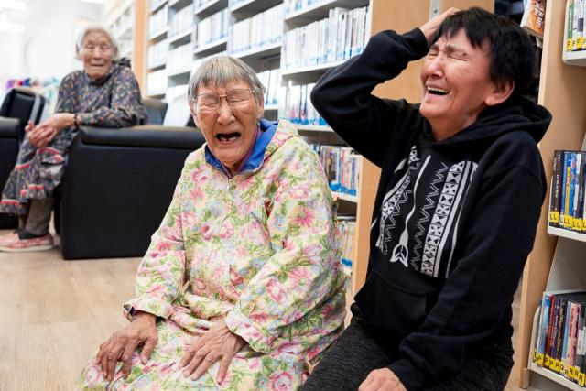

Keeping Language and Culture Alive

Slide 2
Programs that help preserve language and culture are supported by your compassionate gifts through Mission and Service.
Notes:
The Inuinnaqtun language is the cultural foundation of the Inuinnait people, who live in the central Canadian Arctic. The word Inuinnaqtun literally means “to be like an Inuinnaq (a person).” Today, fewer than 600 people can speak Inuinnaqtun fluently, with many having lost the language when they were taken from their communities and sent to residential schools.
Mission and Service partner Pitquhirnikkut Ilihautiniq/Kitikmeot Heritage Society in Cambridge Bay, Nunavut, is dedicated to keeping Inuinnaqtun alive. They offer one-on-one language immersion sessions with mentors to inspire reconnection.
Since the initial gathering of the Inikhaliuqatigiit team in 2021, many significant successes have occurred. Over the past year, the team has worked hard together, both in person and online, to create helpful resources for revitalizing the Inuinnaqtun language. They have spent many hours making sure these resources will make a positive impact.
One big success is the development of the Inuinnaqtun Dictionary app, which is newly available for free on Android and Apple. The team has also created a beginner Inuinnaqtun curriculum called Inuinnaujunga and is working on lessons for more advanced levels. They are also teaming up with linguist Richard Compton from the Université de Quebec à Montreal to create a Community Grammar of Inuinnaqtun.
Your compassionate gifts through Mission and Service are supporting programs that help preserve language and culture.

