Slide 1
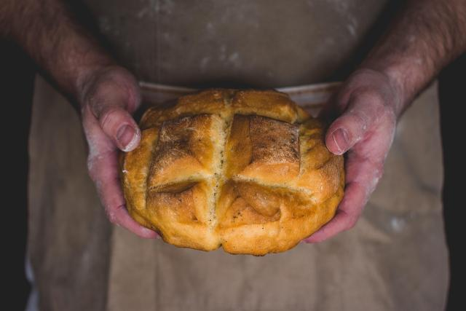

Bread for the
Journey

Slide 2
As we give thanks for the food we share in our own homes, may we also remember those for whom a full plate is never certain.
Notes:
Bread shows up often in the Bible in important ways—manna in the wilderness, Jesus feeding the crowds, and the bread broken at the Last Supper. Again and again, bread is a sign of God’s care and provision.
That care continues today, through the hands of people willing to share what they have. And yet, hunger is still a daily reality for far too many people. Here in Canada, millions struggle to put food on the table. Around the world, nearly a third of the global population faces food insecurity. These aren’t just numbers—these are our neighbours, here and far away, who are making impossible choices between paying rent or buying groceries, between keeping the lights on or feeding their families.
Through Mission and Service, we are part of the response. Together, we’re helping farmers in India care for their livestock so they can keep their animals and their livelihoods healthy. We’re helping families in Zimbabwe use climate-smart farming techniques so they can grow food even in drought conditions. We’re supporting Indigenous Elders in Alberta with grocery cards, and helping offset the high cost of groceries in Northern Canada through the Food for the North program.
As we give thanks for the food we share in our own homes, may we also remember those for whom a full plate is never certain. And may our gratitude move us to action—so that bread is not just a symbol of God’s promise, but a daily reality for all.
Thank you for the difference you make through Mission and Service.

