Slide 1
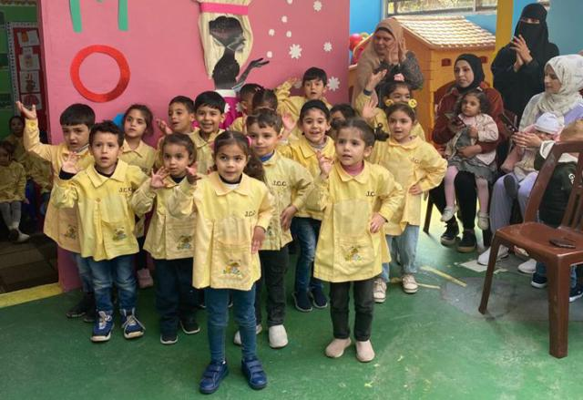
Education Shaped by Compassion

Slide 2
Education is more than just access to classrooms or books.
Notes:
In some parts of the world, children are preparing to return to school. They are sharpening pencils, packing backpacks, and stepping into another year of possibility. But in communities across the globe, education can look very different.
Our global partners understand that education is more than just access to classrooms or books. It’s a foundation for hope, dignity, and lasting change. Because they are rooted in their communities, Mission and Service partners can respond directly to local needs, creating educational opportunities that are culturally relevant, spiritually meaningful, and deeply empowering.
Picture a kindergarten class in a refugee camp where children are not only learning letters and numbers but reclaiming a sense of safety and possibility. Imagine a young adult encountering their faith in a new way, guided by mentors and peers who offer space for honest exploration and spiritual growth. Think of parents gathered in workshops tailored to their realities, where they share stories, strengthen leadership skills, and envision a future grounded in compassion and justice. Envision elders and youth learning together, reviving ancestral languages and knowledge long threatened by colonization and displacement.
These aren’t just moments of learning; they are acts of restoration, resilience, and renewal. And they are possible because of you.

