Slide 1
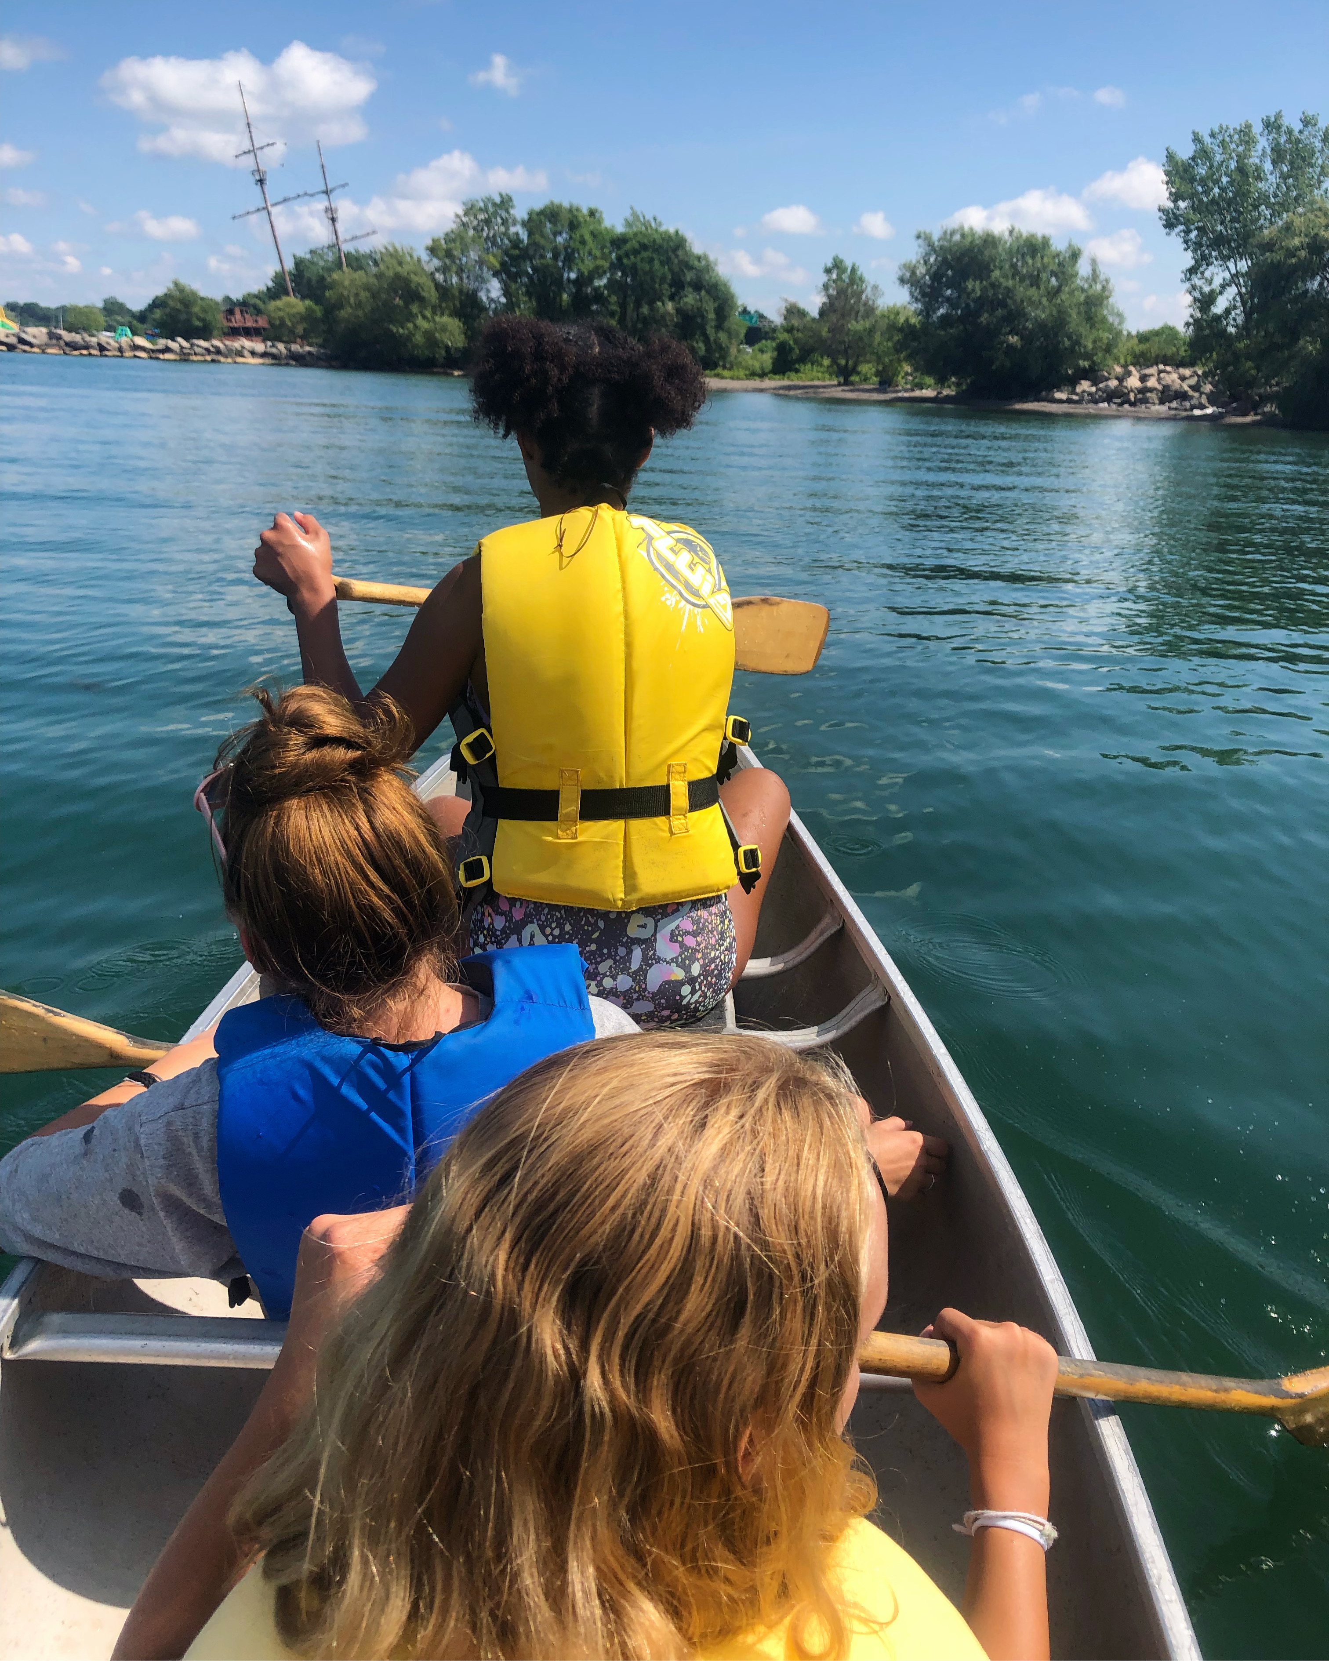
Wonder and Worship in the Wilderness

Slide 2
United Church camps are helping young people grow in spirit, courage, and care.
Notes:
United Church camps create space for children and youth to grow in faith, friendship, and love for the earth. Among whispering trees and winding trails, young hearts open to wonder, discovery, and connection.
At Cave Springs Camp in Beamsville, Ontario, that’s exactly what happens. Nestled along the beautiful Niagara Escarpment, campers leave behind the noise of everyday life to discover something deeper: a sense of belonging in nature and with each other.
Surrounded by birdsong, rustling leaves, and forest paths, the campgrounds come alive with joyful discovery. A camper excitedly shouts, “I found a salamander!” bringing others running in awe. Even something as simple as a uniquely shaped rock becomes a shared moment of intrigue and delight.
These moments matter. Whether singing around a campfire, engaging in outdoor activities, gathering for meals, or sharing quiet reflection during evening worship, children at Cave Springs form lasting bonds. They gain confidence, feel seen, and discover what it means to be part of a caring community, held by both people and creation.
This kind of connection can change lives. It encourages gratitude, deepens compassion, and nurtures a love for the Earth that lasts long after camp ends.
Thanks to your support of Mission and Service, these life-giving experiences continue, not only at Cave Springs, but at all United Church camps. You are helping young people grow in spirit, courage, and care. Thank you.

