Slide 1
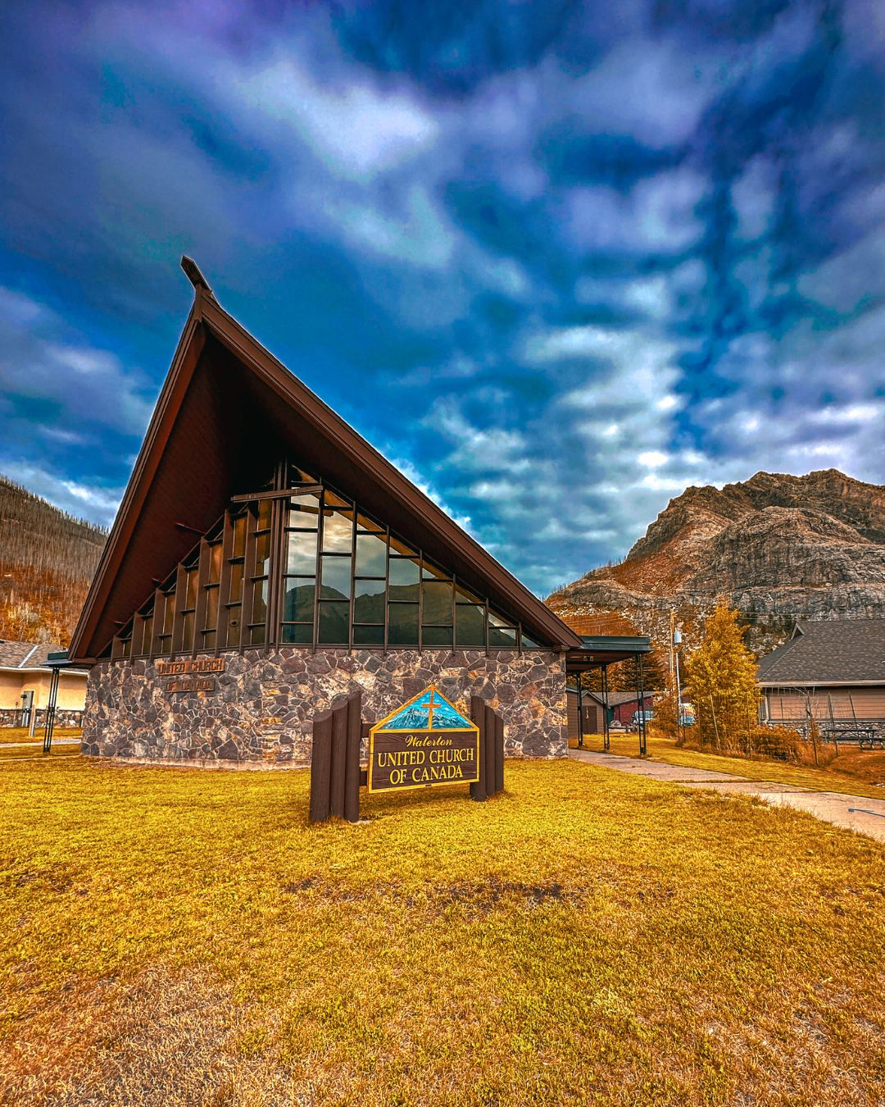
Framed by Creation

Slide 2
In places like Waterton, where land and spirit meet, your gifts help make sacred encounters possible.
Notes:
Waterton United Church rests in the heart of Waterton Lakes National Park in Alberta, where wind brushes the tall grass and mountains rise like blessings above the lake. Surrounded by breathtaking natural beauty, the church is a place of welcome, wonder, and worship. A sanctuary within a sanctuary.
The United Church has had a presence in the park since 1955. The current building, dedicated in 1961, was thoughtfully designed to honour its setting. Architect George Watson positioned the sanctuary’s great cathedral window to frame Mount Vimy, inviting creation into every service.
“People who aren’t involved in the church but just stop to visit look out, captivated by the view of the mountain over the lake,” says Carol Watt, Secretary. “It’s a special thing that happens. It touches something deep within.”
Your gifts through Mission and Service help keep the church open year-round for youth group sleep-overs, weddings, meetings, occasional workshops, and retreats. In the summer, guest ministers and musicians arrive weekly to lead worship from late June through September, filling the sanctuary with inspired voices and music that echoes across the valley. The church hosts youth retreats, weddings, and spiritual gatherings, and with a small room and kitchenette tucked behind the sanctuary, it also welcomes leaders seeking quiet and renewal.
“Providing space for reflection and retreat is an important aspect of the ministry we offer,” Watt shares.
A newsletter captures the heart of it: “Waterton United offers a unique ministry to the wealth of summer visitors who flock happily into the national park and then find this gem of a United Church of Canada.”
Thank you for supporting ministries that honour and care for community and creation. In places like Waterton, where land and spirit meet, your gifts help make sacred encounters possible.

