Slide 1
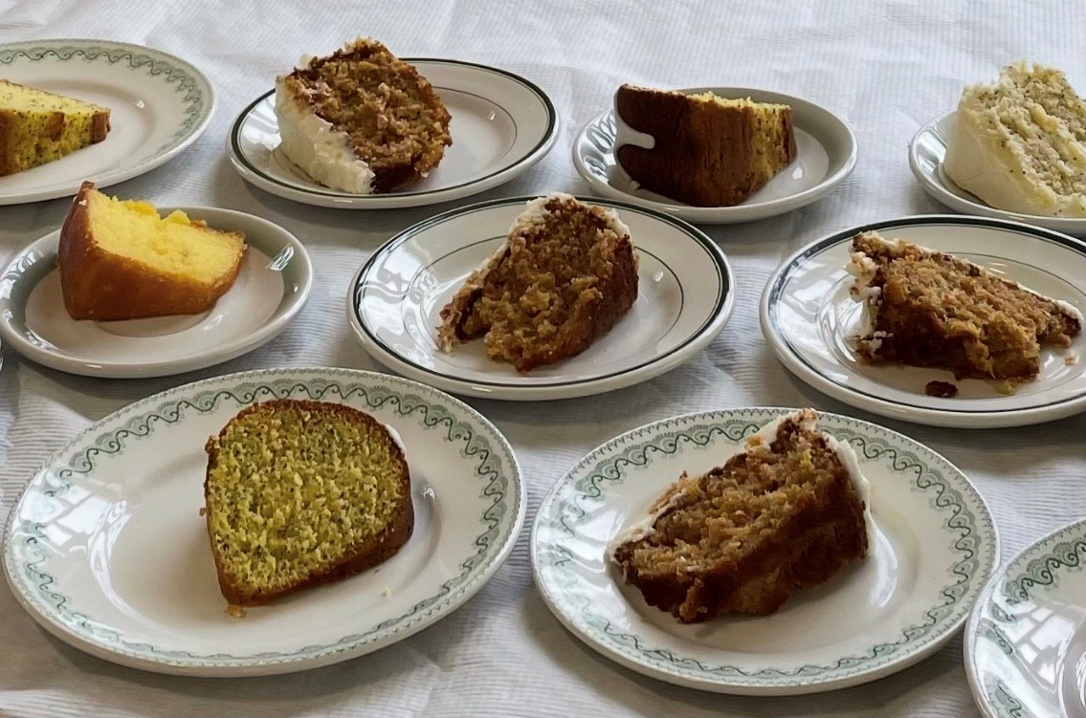
Ladles of Love

Slide 2
The annual Soup Luncheon at Spring Park United Church is a living expression of faith in action.
Notes:
At Spring Park United Church in Charlottetown, PEI, the annual Soup Luncheon in support of Mission and Service has grown into something truly special—a celebration of community, compassion, and connection.
More than just a meal, it’s a moment where people gather to enjoy hearty soup, delicious desserts, rich conversation, and the joy of being together. The Sunday service sets the tone with powerful Mission and Service stories and guest speakers who remind us why this work matters so deeply. Each message connects to the wider church, and to people whose lives are being changed thanks to your generous support.
The luncheon also connects generations. Youth and adults alike enjoy laughter and connection, filling the space with energy and purpose. Mission and Service volunteer Joyce MacLeod adds a thoughtful touch by placing Mission and Service bookmarks and pens on each table, quiet reminders of the impact our shared generosity can have.
With over 20 dedicated volunteers offering their time and efforts, the Soup Luncheon is more than a tradition. It’s a living expression of faith in action, showing how support of Mission and Service continues to nurture hope, build relationships, and change lives.
The response from the community? Overwhelmingly positive. Year after year, this event continues to strengthen the bonds at Spring Park United, offering a living example of how Mission and Service helps us grow in faith, friendship, and love. Thank you for being part of Mission and Service, making a difference locally, in Canada, and around the world.
If your community of faith shines a light on Mission and Service, we’d love to hear from you!

