Slide 1
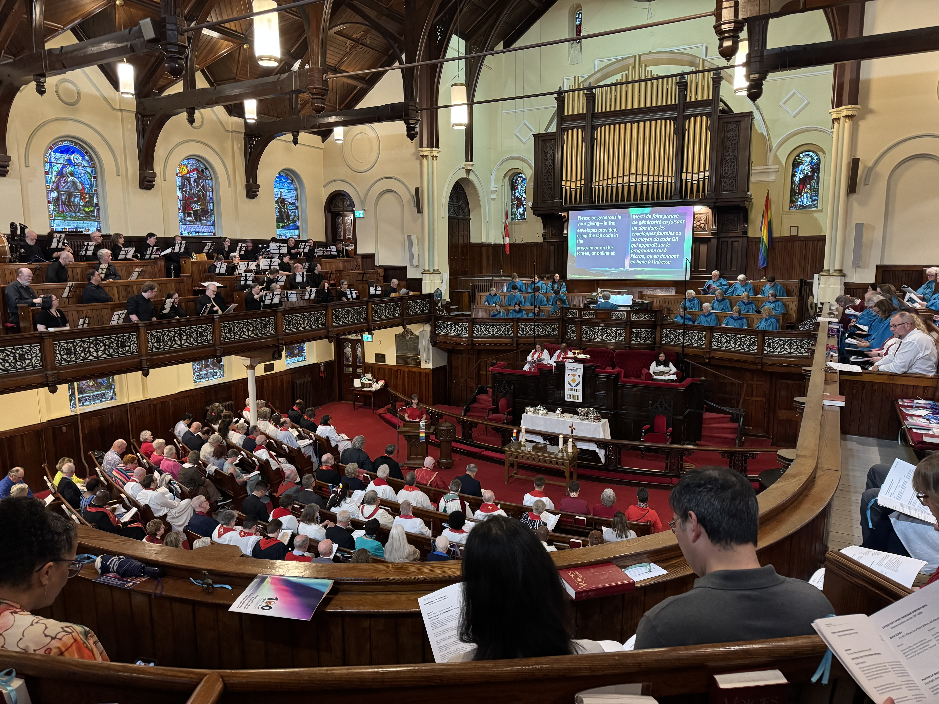
100 Years of Spirit and Song

Slide 2
On Sunday, June 8th, Gower Street United Church in St. John’s, Newfoundland and Labrador, was alive with joyful celebration.
Notes:
On Sunday, June 8th, Gower Street United Church in St. John’s, Newfoundland and Labrador, was alive with joyful celebration. The sanctuary buzzed with warm greetings, laughter, and the unmistakable hum of love and connection as people gathered to mark The United Church of Canada’s 100th anniversary. Many more joined the festivities via livestream, sharing in the spirit of the day from near and far.
It was a celebration of history, community, and hope. Guests admired the church’s beautiful historic architecture, an ideal setting for such a milestone. The choir, along with the Gower Community Band Bell Choir, filled the space with soul-stirring music that brought both tears and smiles. Liturgical dancers brought Pentecost flames to life, their movements echoing the Spirit’s energy and presence.
Moderator The Right Rev. Dr. Carmen Lansdowne and General Secretary Rev. Michael Blair presided at the service, and The Rev. Prof. Dr. Jerry Pillay, General Secretary of the World Council of Churches, offered a stirring message calling the church to remain rooted in deep spirituality, bold discipleship, and daring justice.
Thanks to your gifts to Mission and Service, vibrant ministries continue to thrive, offering not only worship and music, but hospitality, outreach, and a strong voice for love and justice in their communities.
Your support helps carry this legacy forward. Thank you for being part of the story. Here’s to the next hundred years, together.

