Slide 1
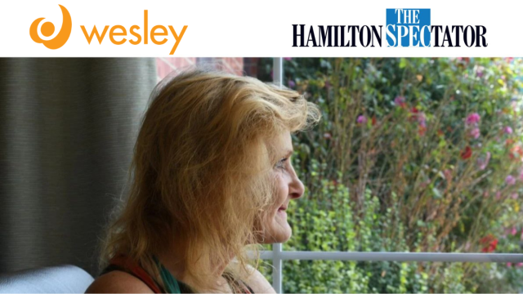
Healing with Compassion: Sue’s Story at Wesley
The United Church of Canada

Slide 2
Partnered with Mission and Service, the Wesley special care unit offers transformative support to those building a better future for themselves and their families.
Notes:
Sue, 61, has faced a lifetime of challenges, starting in her youth when her mother was involved with organized crime and jailed for fraud. Later, as a young mom, a car accident left Sue with chronic back pain. And last fall, a fire destroyed her Hamilton apartment, forcing her onto the streets. Despite these struggles, Sue has found stability at Mission and Service partner Wesley. In Wesley’s special care unit, Sue is working to overcome the drug addiction that she has lived with since she was 11. While the process has been difficult, she is slowly reducing her drug use with the help of prescribed medications and support from Wesley’s staff.
The care unit operates under a harm reduction model, allowing clients like Sue to manage their addictions in a supported environment. Wesley’s program is part of a broader effort in Hamilton to address homelessness and substance use. Recently, the program expanded its capacity, and now provides about 30 beds for individuals struggling with multiple substances. Clients are not expected to quit drugs immediately but are supported in stabilizing their lives, receiving medical care, and reconnecting with family. Wesley’s team includes doctors, nurses, and addiction specialists who help clients find their own path to recovery.
For Sue, this support has been transformative. Her room at Wesley provides a much-needed sanctuary, offering a reprieve from the constant stress of homelessness and addiction. She continues to focus on her recovery, working in the garden and taking steps toward quitting fentanyl altogether. Sue dreams of eventually finding her own home and reuniting with her beloved cat, Kitty Cat, who was rescued from the fire and is being cared for by a friend.
Your gifts through Mission and Service help support people like Sue on her ongoing journey to build a better future for herself and her children. Thank you for your continued support.
Sue’s story was recently featured in The Hamilton Spectator. Read more about Sue’s story.

