Slide 1
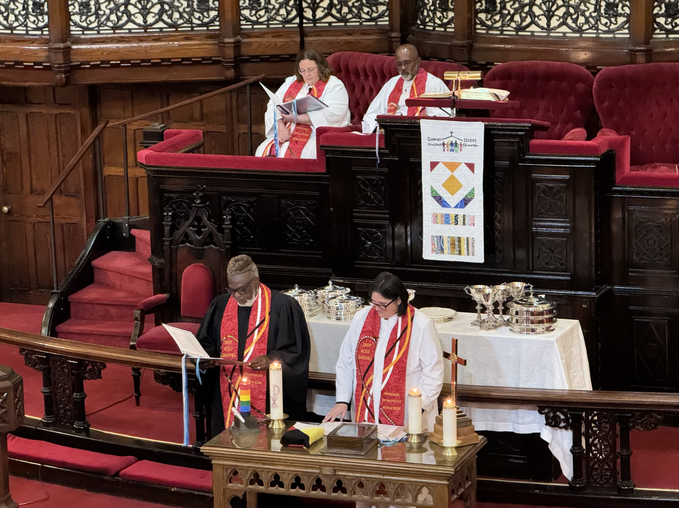
Words That Carry the Spirit

Slide 2
In a historic moment, a newly translated Mohawk Bible was formally dedicated at the Centennial Celebration in St. John's, NL.
Notes:
On June 8, during The United Church’s Centennial Celebration at Gower Street United in St. John’s, NL, a historic moment unfolded. A newly translated Mohawk Bible was formally dedicated, a powerful act of spiritual continuity and cultural renewal. The Bible stands as a successor to the Union Bible that was prayed over when The United Church of Canada was formed in 1925. Now, nearly a century later, this new translation was lifted in ceremony and celebration, symbolizing a deepening journey of reconciliation.
Language is more than words, it is worldview. It carries the wisdom of ancestors, the heartbeat of community, and the sacred connections between people, land, and Creator. When a language is lost, something immeasurable disappears with it. That’s why projects like the Mohawk Bible translation matter so profoundly.
Created through decades of devotion, linguistic skill, and cultural insight by Harvey Satewas Gabriel, with the support of generations of women in the Gabriel family and the communities of Kanesatake and Kahnawake, this translation is both a labour of love and an act of resistance. Collaborators worked with care and humility, in close relationship with the Mohawk Nation, to ensure the translation honoured the depth and specificity of the language.
Your gifts to Mission and Service help make work like this possible, supporting the preservation of Indigenous languages and cultures, and walking alongside communities in respectful partnership.
Ohiatonhseratokénti: The Holy Bible in Mohawk is available through the UCRD bookstore, ensuring that this living word will continue to inspire and teach for generations to come.
Thank you for your gifts to Mission and Service that are helping keep language and spirit alive.

