Slide 1
2024 Strategic Plan Report

Slide 2
The General Council Office’s Strategic Plan is helping the church realize our Vision, working closely with regional councils across the country.
If the embedded video does not play, use this link to download and play from your local device.

Slide 3
This is the second year for our annual Strategic Plan Report, which aligns with the budget. We are continuously refining our efforts to meet our strategic objectives.
Embolden Justice
Collaborating to Mend Church and World
Deepen Climate Integrity
Living Climate Commitments
Invigorate Leadership
Adapting and Innovating for Bold Discipleship
Strengthen Invitation (Growth)
Humility and Confidence in Sharing Faith
Nurture the Common Good
Equity and Sustainability in Resources
Journeying Indigenous Pathways
Forging Right Relations

Slide 4
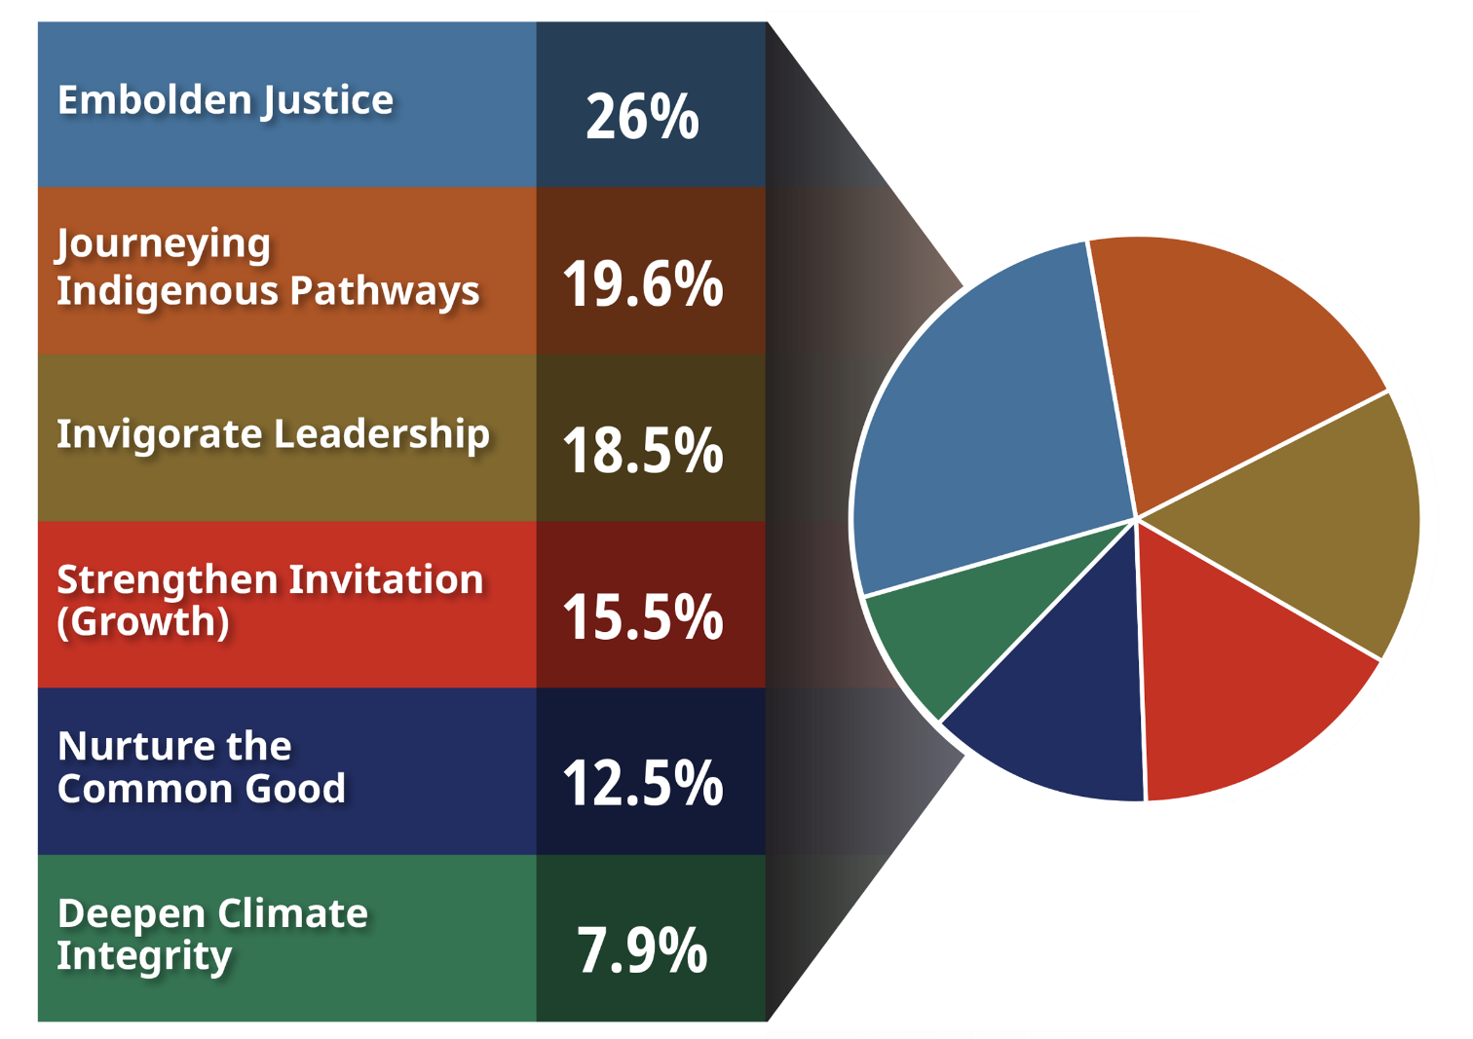
Financials Operating Budget PLUS Fund Centre Activities
In 2024, the General Council of the United Church dedicated resources (salaries, grants, programs, etc.) from the operating budget to the six areas of the Strategic Plan.
In addition, particular areas were supplemented by specialized reserve funds, or fund centres.

Slide 5
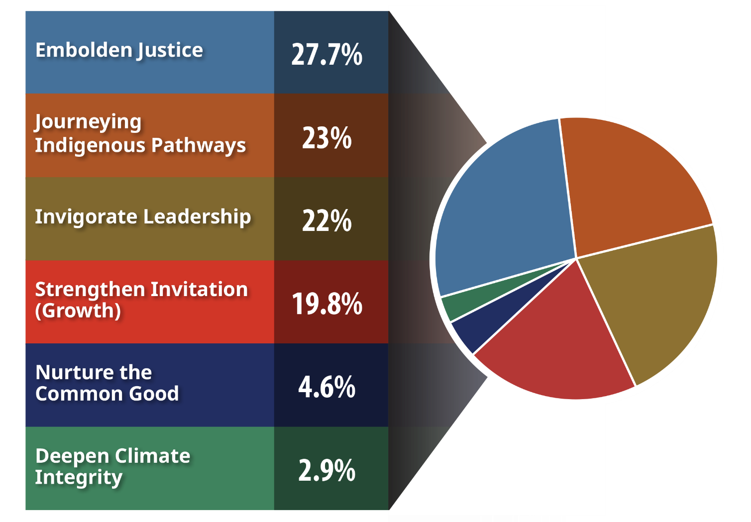
Financials Operating Budget only
In 2024, the General Council of the United Church dedicated resources (salaries, grants, programs, etc.) from the operating budget to the six areas of the Strategic Plan.

Slide 6
By the Numbers in 2024

Slide 7
Embolden Justice Collaborating to Mend Church and World
The Reverend Michael Blair speaks at the Human Sexuality and Gender Diversity consultation, Maputo, Mozambique.
Credit: Jane Thirikwa/The United Church of Canada

Slide 8
Invigorate Leadership Adapting and Innovating for Bold Discipleship
The (Re)Generate cohort at the first group retreat, January 2024.
Credit: Five Oaks Education and Retreat Centre

Slide 9
Nurture the Common Good Equity and Sustainability in Resources
The Reverend Victor Kim, Presbyterian Church; The Reverend Michael Blair, United Church, and The Venerable Alan Perry, Anglican Church, on site in March 2024.
Credit: Patrick-James Boyd/The United Church of Canada

Slide 10
Deepen Climate Integrity Living Climate Commitments
Transcona Memorial United Church’s solar panel rooftop
Credit: Transcona Memorial United Church

Slide 11
Strengthen Invitation (Growth) Humility and Confidence in Sharing Faith
Members of the Emmanuel United Methodist Church congregation with the Reverend Dr. Junior Smith of Trinity United Church in Ottawa.
Credit: Issa Winasi

Slide 12
Journeying Indigenous Pathways Forging Right Relations
National Indigenous Spiritual Gathering, 2024.
Credit: Joni Shawana/The United Church of Canada

Slide 13
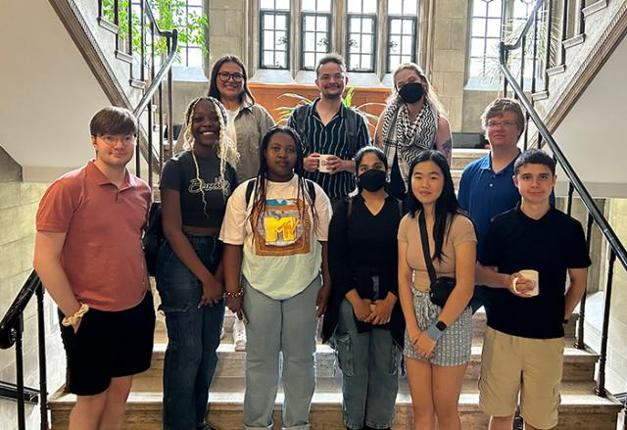
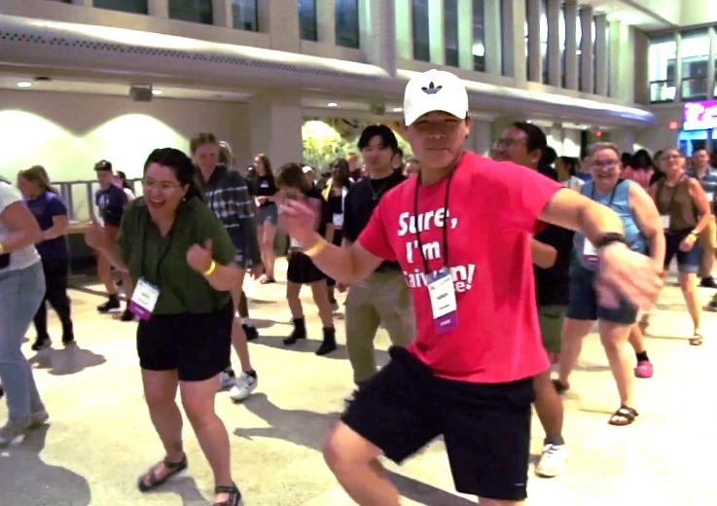
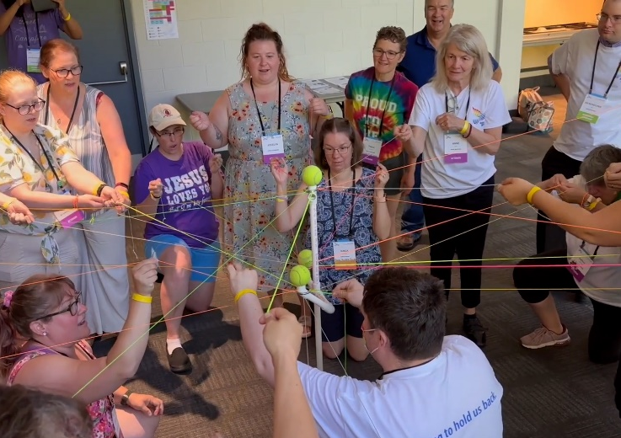
Youth Action Across the Strategic Plan
Clockwise from top left: The 2024 Youth Climate Motivators (Credit: Thea Sheridan-Jonah/ The United Church of Canada); The 2024 Youth Leadership Animators (Credit: Amy Crawford/The United Church of Canada); Youth participants at Audacious Hope 2024 (Credits: Owen Sheppard/ The United Church of Canada; Patrick-James Boyd/The United Church of Canada).

Slide 14
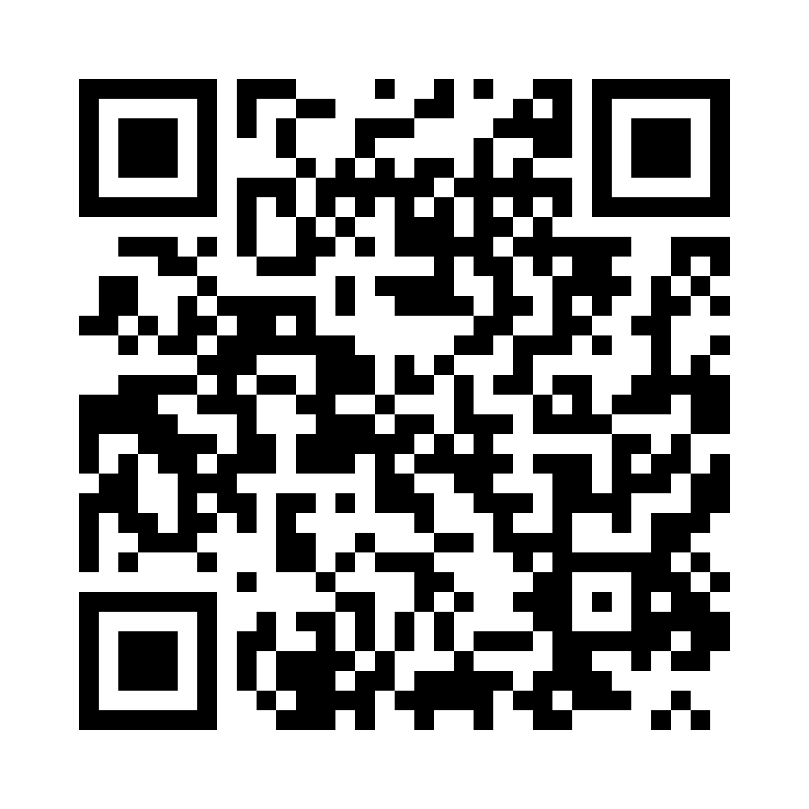
Learn more about the Strategic plan by searching “Our Call and Vision” on united-church.ca and selecting the link for each strategic objective.
See the full 2024 Strategic Plan Report by following this QR code or visit bit.ly/24stratplan

